Slide 1

FY26 Budget Presentation

Slide 2
The Budgetary Landscape
Many factors have led to current budget picture:
The State’s financial challenges
The trickle-down effect of federal funding shifts
Increased costs
Inflation
Personnel costs are up 33% since FY15, mostly due to State COLA/Merit
Decreased enrollment
Fall 2013: 8,643 students vs. Fall 2024: 7,025 students
For perspective, an extra 1,600 students would yield $18 million per year in tuition alone

Slide 3
First and Foremost – Thank You!
University budgeting is complex.
State funding makes it even more challenging, as our allocations can change rapidly.
Our goals:
To be as transparent as possible
To involve shared governance and campus leaders
To work to make sure we were answering questions as they came up
We wanted to involve you, and we know that this meant you might be uncomfortable with us in the uncertainty.

Slide 4
FY26 Financial Facts
The USM was cut $155 million, which represents approximately a 4% reduction to the State allocation to the system.
In January, when the first $111 million in cuts was announced, $4.8 million was removed from our State allocation for FY26.
At the end of session, on April 7, an additional $44 million in cuts was announced, our portion of which we were notified last week will be $1.9 million.
The governor and the legislature have put forward a 1% COLA for all state employees. The cost to the University would be approx. $1 million.
We also see a reduction in our fringe and retirement benefits funding of $2.7 million.

Slide 5
FY26 Financial Facts
Our best estimate is that we need to reduce our projected budget by approximately $10 million, which is 4.6% of our total University budget.
In addition, the USM has shared that they anticipate there could be additional cuts mid-year FY26, and additional cuts on top of that in FY27
Based on the predictions on State budget shortfalls.

Slide 6
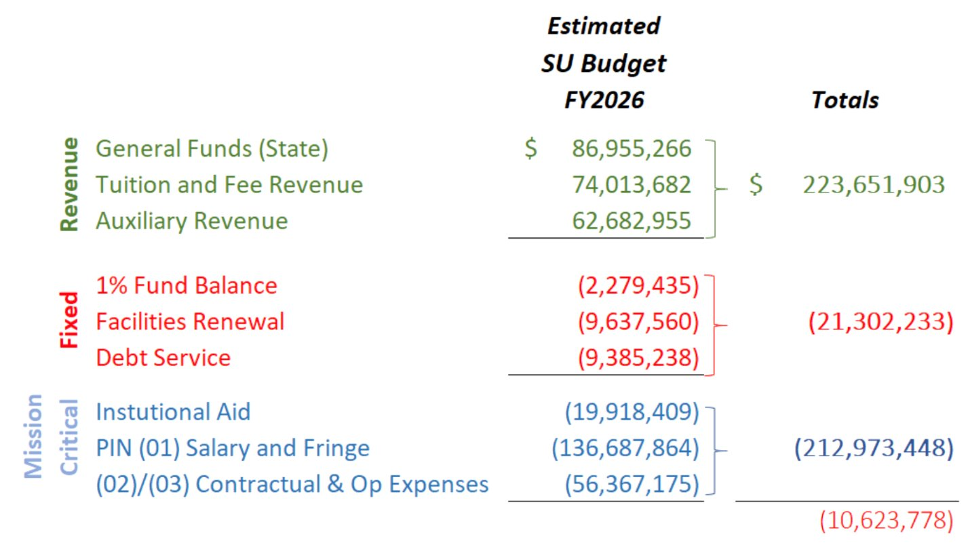
Our Strategy
Given these unknowns, we have analyzed the budget and based on forecasts we feel confident in our strategy to move forward.
We must reduce our Mission Critical Expenses by $10M.

Slide 7
What Does This Mean?
We need proactive planning: Ensuring financial stability requires strategic action now. We must put in place a multi-year budget-reduction strategy, across all divisions of the University.
We will continue to put people first: We have taken all measures to protect our people as much as possible and will continue to do so.
We remain in a strong financial position: Despite these cuts, the University remains financially stable. We have had to do much larger cuts in the past.

Slide 8
FAQs

Slide 9
Are We Alone in These Budget Reductions? How Are Other USM Institutions Being Impacted?
Every institution in the USM has received reductions, and all are engaged in similar reduction exercises.
Some institutions have harder issues to face, primarily facing potential losses of millions in federal grant funding.
We know that other institutions are actively discussing layoffs. SU is not.

Slide 10
Why Does This Feel So Sudden?
SU began planning for a potential budget cut in January, following initial announcements about reductions to the USM budget.
However, an additional cut was announced at the end of Maryland’s legislative session, adding to the challenge.
SU did not learn the full extent of this new cut until 9 p.m. a week ago.
All USM institutions were then given a deadline of April 30 to submit revised budget reduction plans. All USM institutions have since received a 2-week extension because of the complexity.
This left SU’s finance team just weeks to develop a compliant plan – while also engaging in collaborative planning across divisions, deans, and budget administrators.

Slide 11
How Does SU Plan to Cut $10 Million from the FY26 Budget?
Over the past several months, the University and University representatives have conducted a detailed financial analysis.
The review identified areas for operational efficiencies and provided strategic recommendations.
This approach minimizes disruption and protects key areas such as student services, helping preserve the student experience.

Slide 12
Has Each Division Been Given A Proportional Target Reduction?
Division | FY26 Total Budget | % of Total Budget | Target Reduction | % of Division Budget
Academic Affairs | 121,039,824 | 57.00% | 5,700,000 | 4.71%
Admin & Finance | 50,121,340 | 23.50% | 2,300,000 | 4.59%
Advancement | 2,662,273 | 1.20% | 120,000 | 4.51%
Inclusion, Access and Belonging | 2,465,021 | 1.20% | 120,000 | 4.87%
President | 10,491,275 | 6.00% | 600,000 | 5.72%
Public Affairs | 2,688,610 | 2.00% | 200,000 | 7.44%
Student Affairs | 23,505,106 | 10.00% | 1,000,000 | 4.25%
Total | 212,973,449 | 100.90% | 10,040,000
*Numbers are rounded

Slide 13
How Are the Divisions Handling These Cuts?
All divisions are in progress of review, working to reach their targets.
President Budget (Athletics, General Counsel, Office of the President, UARA)
Travel
Events
Giveaways
Software/Subscriptions
Public Affairs and Strategic Initiatives Budget (Government Relations, Marketing, Creative Services, PR)
Events
Printed Materials
AVP, Marketing and Communications

Slide 14
Other Examples:
We will be delaying a search for a new VP of Student Affairs.
Zebadiah Hall will serve as interim VP of SA for the year.
Auxiliary Services will move to Admin and Finance.
Result: 01 salary savings
A new corporate partner agreement is about to be signed. This will result in a deep discount on food for our student athletes when travelling.
Result: savings to the 03 athletics budget

Slide 15
Could Furloughs Be Used To Generate Savings?
Furloughs offer only short-term, one-time savings. Furloughs also risk harming morale, disrupting academic operations, and triggering complex union negotiations.
Our goal is to protect and prioritize our people as much as possible.
Furloughs also disproportionately impact those on the lower end of the salary scale.

Slide 16
What About Introducing a Voluntary Separation Program or Incentivizing Early Retirement?
These types of programs require Board of Regents approval. It is something that SU is considering. We are currently weighing the benefits versus the risks.
There are significant upfront costs for the incentives, so it is uncertain how much such a program would benefit the University’s FY26 budget.

Slide 17
Did the Upper Administration Get a Higher COLA/Merit or Raises than Other Employees?
They didn’t.
Administrators received the same 5.5% COLA/merit increase that was awarded to every other employee at the University as dictated by the State.
The circulated list contains inaccurate information.
As part of normal University operations, salaries might be adjusted.
Had a portfolio change
Had a salary adjustment performed through our HR processes

Slide 18
It Seems Like We Have A Lot of Administrators – How Do We Compare To Our Fellow USM Institutions?
We are not a top-heavy institution.
 | Salisbury | Bowie State | Towson | UMBC | UMES
Faculty | 605 (59%) | 545 (54%) | 1,676 (60%) | 1,250 (54%) | 335 (52%)
Management | 429 (41%) | 455 (46%) | 1,114 (40%) | 1,079 (46%) | 302 (48%)
 | 1,034 | 1,000 | 2,790 | 2,329 | 637

Slide 19
Why Can’t the University Use Its Reserves to Cover the Gap?
Reserves serve as a one-time financial safety net, not a sustainable solution for ongoing, structural budget shortfalls.
USM policy requires SU to contribute $2.3 million to our fund balance in FY26.
Reserves must be maintained to ensure long-term financial health and meet policy obligations.
SU can only request use of reserves after demonstrating that all reasonable cost-reduction efforts have been made.

Slide 20
Why Can’t the University Use the SU Foundation to Cover the Gap?
Like reserves, using Foundation funds would be a one-time fix, not a sustainable solution for long-term budget challenges.
The vast majority of Foundation funds are restricted, designated by donors for specific purposes (e.g., scholarships, endowed programs).
Very limited discretionary funds are available, and those are already committed to critical initiatives.

Slide 21
Why Are Capital Projects and Renovations Still Happening If the Budget Is Being Cut?
Capital project funds are restricted and cannot be used for salaries, benefits, or operational expenses.
USM requires investment in facilities renewal to keep buildings safe, functional, and cost-effective over time.
Proactive maintenance prevents higher future costs and supports a safe, high-quality environment for students and staff.
Some capital projects are designed to generate revenue that supports SU’s long-term financial health.

Slide 22
What About Raising Tuition to Cover the Shortfall?
SU is committed to affordable, accessible higher education and understands the financial pressure on students.
Significant tuition increases could harm enrollment and retention and are not a sustainable solution for closing the budget gap.
While some institutions are raising tuition well above inflation to offset cuts, SU will implement only a modest increase at the approved rate:
2% for in-state students (~$80/semester)
3% for out-of-state students
This approach maintains affordability while helping to address part of the budget shortfall.

Slide 23
Will Student Organizations or Activities Funded Through the Student Activities Fee Be Impacted?
No.
In fact, just last week, the SGA met to determine how the $900,000 in the Student Activity Fee Budget would be allocated. Students themselves can confirm their funding is intact.

Slide 24
Will Increased Class Size Minimums Hurt Students Because of Cancelled Classes?
Only 11 out of 2191 sections of classes have been cancelled due to low enrollment. That is less than 1%.
This does not mean that every class will meet this minimum. Some courses will have lower course minimums based on classroom size, accreditation requirements, pedagogical needs, or another exceptional circumstance.
Increasing the target for course minimums can also help ensure that there are more seats for students in the courses they need.

Slide 25
Are Academic Programs Being Cut?
No.
We are actively engaging with deans and department chairs to find savings that have the least impact on programs and student learning.

Slide 26
For How Long Should We Expect There To Be a Challenging Budget Situation?
Maryland’s budget outlook is expected to remain challenging over the next few years.
While the FY26 budget is expected to close the current deficit, it leaves a $300 million projected deficit that legislators will need to address in FY27.
The General Assembly added triggers to the FY26 budget that may result in a special legislative session to consider additional budget cuts to the FY26 budget later this year.

Slide 27
Should We Be Concerned for SU’s Future?
No.
Because of Salisbury University’s longstanding fiscal stewardship, we are in a strong position to handle these cuts in ways that some institutions are not.

Slide 28
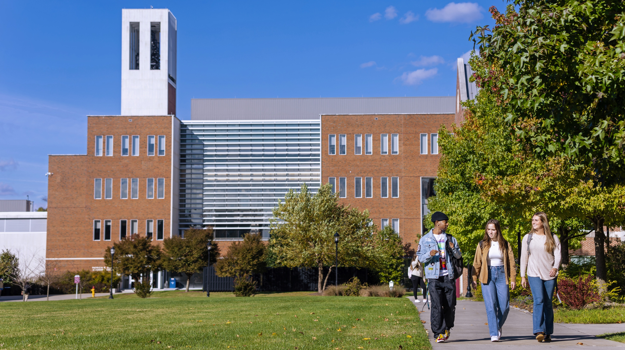
Thank you

