Slide 1
Children’s Developing Strategies
for Dealing with Problems that Require Multiplicative Reasoning
Undergraduate Researchers:
Danielle Nichols-Taylor & Abby Griffin
Faculty Mentor: Dr. Jennifer Bergner

Slide 2
Introduction

Slide 3
Introduction: Research
Students need to have a conceptual understanding of multiplication and division (National Council of Teachers of Mathematics, 2014).
Students should be able to navigate among multiple representations (Common Core State Standards Initiative, 2010).
Students generally display weak conceptual understanding of multiplication and division, relying heavily on algorithmic proficiency instead (Dubé & Robinson, 2018).

Slide 4
Introduction: Our Study
The purpose of this study was to design a problem sequence to develop students’ abilities to select strategies that are appropriate and efficient for solving problems requiring multiplicative reasoning.
Notes:
Mention that our students are going into 5th grade.

Slide 5
Literature Review

Slide 6
Teaching Strategies from the Literature
Create own multiplication word problems (Essex & McCormick, 2017).
Equal-Sized Groups (McDuffie & Sullivan, 2009).
Physical manipulatives (Gurganus & Wallace, 2005).

Slide 7
Methodology

Slide 8
Our Students
Jessie | 9/9 sessions attended
Chase | 9/9 sessions attended
Robbie | 9/9 sessions attended
Sarah | 8/9 sessions attended
Notes:
Just completed 4th grade. We had almost perfect attendance. Don’t read the numbers.

Slide 9
Common Core State Standards
4.OA.2 Multiply or divide to solve word problems involving multiplicative comparison, e.g., by using drawings and equations with a symbol for the unknown number to represent the problem, distinguishing multiplicative comparison from additive comparison (Common Core State Standards Initiative, 2010).
4.NBT.5 Multiply a whole number of up to four digits by a one-digit whole number, and multiply two two-digit numbers, using strategies based on place value and the properties of operations. Illustrate and explain the calculation by using equations, rectangular arrays, and/or area models (Common Core State Standards Initiative, 2010).
5.NBT.6 Find whole-number quotients of whole numbers with up to four-digit dividends and two-digit divisors, using strategies based on place value, the properties of operations, and/or the relationship between multiplication and division. Illustrate and explain the calculation by using equations, rectangular arrays, and/or area models (Common Core State Standards Initiative, 2010).
Notes:
OA - Operations and Algebraic Thinking
NBT - Numbers and Operations in Base 10

Slide 10
Instructional Cycle
Week 1: Pre-Interview | 30-minute interviews with each student.
Weeks 2-8: Weekly Lesson | 1-hour lesson.
Week 9: Post-interviews | 30-minute interviews with each student.

Slide 11
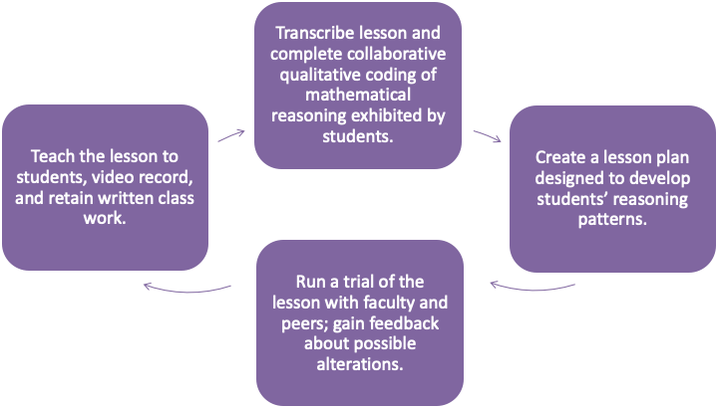
Instructional Cycle

Slide 12

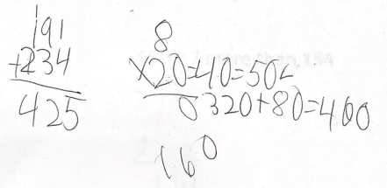
Interview Tasks: Key Task 1
A photographer has 191 photos of animals and 234 photos of plants. He wants to put all of the photos into photo books. Each page of the photo books holds 8 photos. What is the fewest number of pages he could use in the photo books?
Student’s work represented: Chase
Notes:
Chase was able to solve the problem using an alternative algorithm. Chase uses the Additive calculation

Slide 13
Pre-Interview: Task 1
Sarah chose to multiply.
Robbie chose to subtract.
Jessie chose to add.
General Theme: Students had difficulty choosing the correct operation.

Slide 14
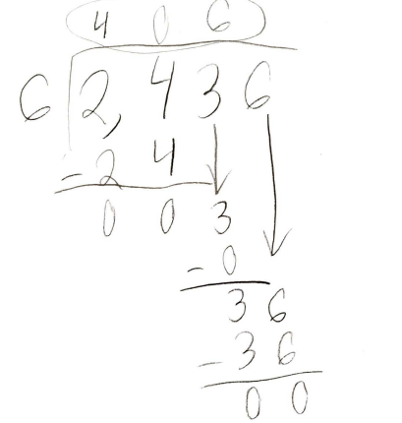
Interview Tasks: Key Task 2
During a class trip to an apple farm, a group of students picked 2,436 apples. They packed them into 6 boxes to take to the local food bank. If each box held the same number of apples, how many apples were in each box?
Student’s work represented: Sarah

Slide 15
Pre-Interview: Task 2
Sarah and Chase were able to complete the problem correctly.
Chase --> “combine groups and add” approach.
Robbie and Jessie were unable to choose the correct operation.
Notes:
In general, our students showed competency with algorithms, but lacked conceptual understanding needed to navigate through the word problem.

Slide 16
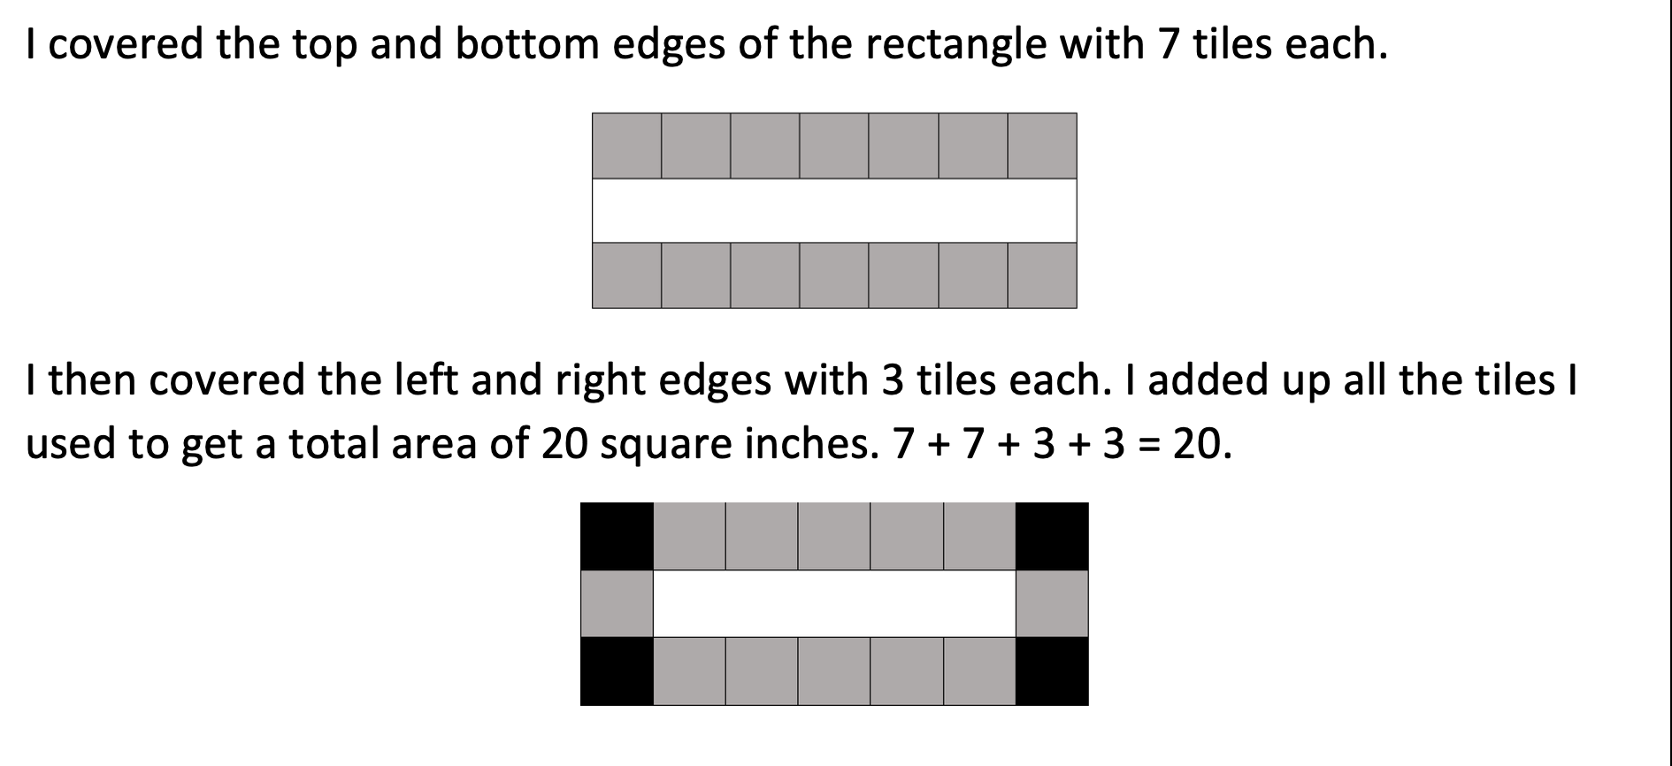
Interview Tasks: Key Task 3
Donald uses square tiles
measuring 1 in. on each side to find the area of a rectangle. His reasoning is shown here:
A. Could you act out and explain what Donald did with his tiles using these tiles (point out the physical tiles again)?
B. What multiplication sentence could you use to find the area?
C. Could you use these tiles to find the area of the following rectangle?

Slide 17
Pre-Interview: Key Task 3
Sarah and Chase
  recreated the diagram
  correctly discussed area in the context of rectangular arrays
Jessie and Robbie
  misinterpreted the diagram
  struggled to explain area using the tiles

Slide 18
Lessons 1-2: Word Problem Interpretation
Lesson 1
Purpose
Word problem comprehension Choice of operation within context
Activity
Individualized word problems Model with manipulatives and/or drawings
Lesson 2
Purpose
Less reliance on key words
Activity
Create division and multiplication word problems Parameters Model and share

Slide 19
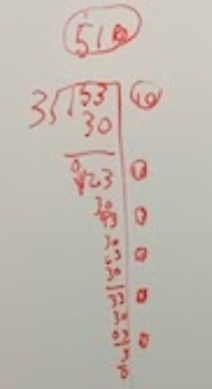
Robbie’s individualized hamster word problem from lesson 1.
Notes:
Robbie shows the use of standard algorithm with partial quotients.

Slide 20
Lessons 3-4: Equal-Sized Groups
Lesson 3
Purpose
Recognizing natural groups Collective nouns
Activity
Own number sentence and animal Create own word problem
Lesson 4
Purpose
Multiple strategies for solving multiplicative word problems
Activity
Interactive presentation Fill in blanks, choose a response, etc.

Slide 21
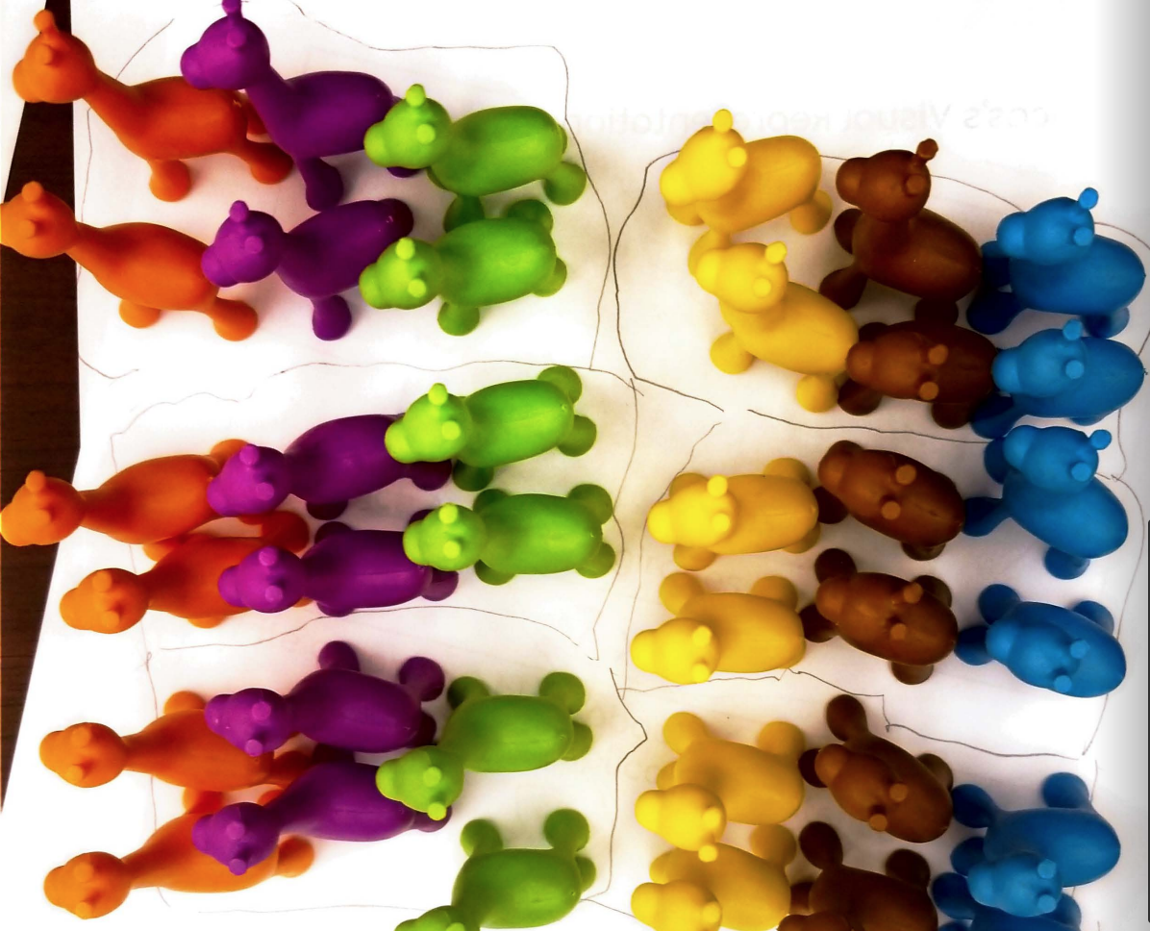
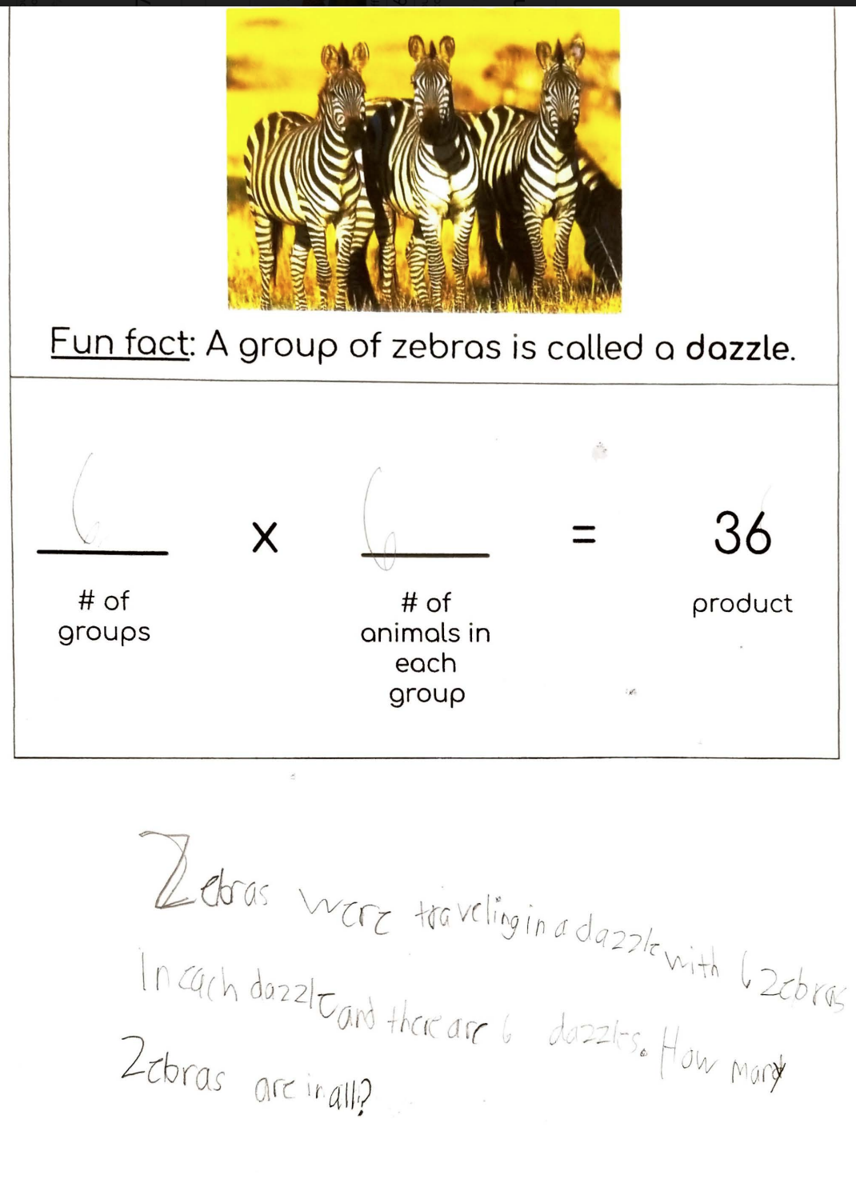
Chase’s work from Lesson 3.

Slide 22
Lessons 5-6: Scaling Up
Lesson 5
Purpose
Strategies for multi-step word problem
Activity
Pizza word problem Worked as a group
Lesson 6
Purpose
Scaling up multi-step word problem
Activity
Same problem, bigger numbers

Slide 23
Word Problems
We want to have a pizza party for the 28 people in our math program. We found that a large pizza cut into 12 pieces would be our cheapest option. If we order 3 pieces for each person, how many pizzas do we need to order?
[Lesson 5]
Dr. Bergner wants to invite more people to the party. She said that each of the 28 people in the program will bring 4 guests. How many people are there now? How many pizzas do we need to order?
[Lesson 6]

Slide 24
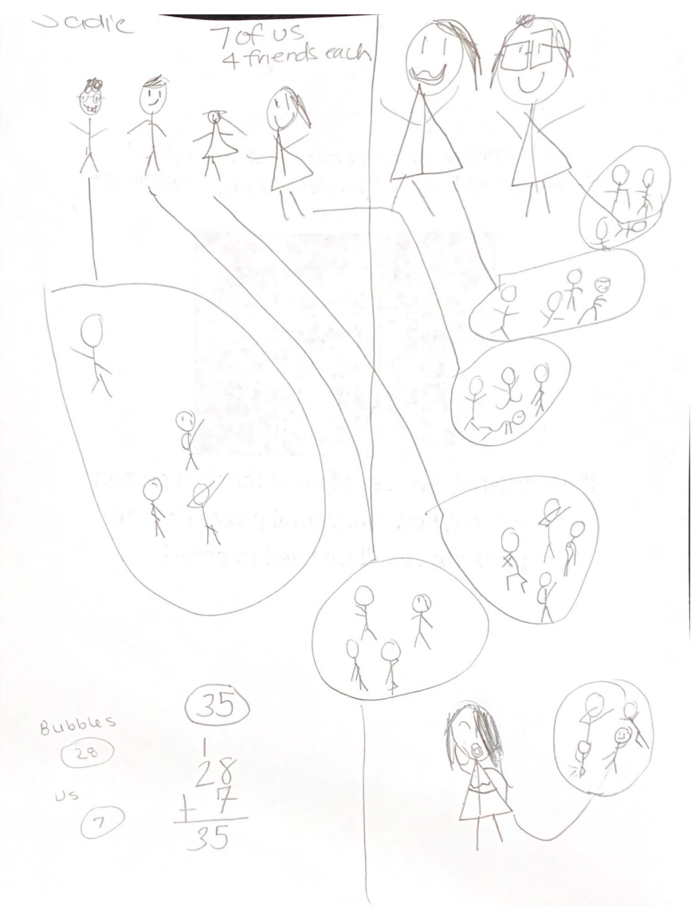
Jessie’s Drawing from Lesson 6
Mini-Scenario: 7 people with 4 guests each

Slide 25
Lesson 7
Lesson 7
Purpose
Put in action all of the strategies and skills from the seven lessons
Activity
Ice cream problem Jessie worked with Miss Abby on the pizza problem
Notes:
Apply the skills and strategies used during previous lessons.

Slide 26
Word Problem
We have 78 scoops of peanut butter ice cream, 112 scoops of strawberry ice cream, and 230 scoops of vanilla ice cream. Half of the 140 people at the picnic brought their dogs. We want to share the ice cream scoops equally amongst all of the people and dogs at the picnic. How many scoops does each receive?
[Lesson 7]

Slide 27
Post-Assessment Results
Key Task 1 | Sarah multiplied the large numbers together, and then divided. She corrected herself at the end. Robbie demonstrated his ability to perform partial quotients.
Key Task 2 | All students wrote statements vertically, rather than horizontally.
Key Task 3 | Students had difficulty modeling an incorrect scenario. Chase and Sarah were able to find area. All students lacked conceptual understanding of area.
Notes:
Most interesting discoveries.
For Key Task 3: Chase and Sarah found the area mathematically, but could not model area using the tiles --> lack of conceptual understanding.

Slide 28
Reflection and Discussion
Student Difficulties:
high level of competence with standard algorithms, but lacked conceptual understanding of the operations
key words in word problems
defaulting to what they claimed was an “easier”, but incorrect, operation
number of groups and group size in multiplicative word problems

Slide 29
We suggest that teachers involve students in modeling problems that rely on multiplicative reasoning and not solely focus on mastery of the standard algorithms.
How?
physical manipulatives and student drawings
Multiple representations and strategies

Slide 30
References
Common Core State Standards Initiative. (2010). Common core state standards for mathematics. Retrieved from
http://www.corestandards.org/math
Dubé, A. K., & Robinson, K. M. (2018). Children’s understanding of multiplication and division: Insights from a pooled analysis of seven studies conducted across seven years. British Journal of Developmental Psychology, 36, 206–219.
Essex, N.K., & McCormick, K.K. (2017). Capturing children’s multiplication and division stories. Teaching Children Mathematics, 24 (1), 40-47.
Gurganus, S. P, & Wallace, A. H. (2005). Teaching for mastery of multiplication. Teaching Children Mathematics, 12(1), 26-33.
McDuffie, A. R., & Sullivan, A. D. (2009). Connecting multiplication contexts and language. Teaching Children Mathematics, 15(8), 502-511.
National Council of Teachers of Mathematics (2014). Principles to actions: Ensuring mathematical success for all. Reston, VA: Author.

