Slide 1
December Snack-and-Chat:
Civic Reflection

Slide 2

Today’s Docket
Introductions
What is PACE
Civic Reflection
How to Get Involved

Slide 3
Michael Webber ‘16 and ‘18
Assistant Director, Institute for Public Affairs and Civic Engagement
Adjunct Faculty, Department of Communication
Who are you?

Slide 4
What is PACE

Slide 5

Institute for Public Affairs and Civic Engagement
Non-partisan unit dedicated to the advancement of community engagement for the entire campus community
Historic mission to expand upon community engagement

Slide 6

PACE for Staff
Voting Resources
  On-campus voting coming soon!
Civic Reflections
Volunteerism
AmeriCorps/ Nonprofit Leadership
  PIN/CII are eligible to participate in both for FREE
Event planning assistance/ co-sponsorships
Grants for research and other activities

Slide 7
Civic Reflection

Slide 8
“The good we secure for ourselves is precarious and uncertain until it is secured for all of us and incorporated into our common life.” –Jane Adams

Slide 9
“The good we secure for ourselves is precarious and uncertain until it is secured for all of us and incorporated into our common life.”
–Jane Adams
Question 1
Think about a “good” you hope to secure. What is it and what does it look like?

Slide 10
“The good we secure for ourselves is precarious and uncertain until it is secured for all of us and incorporated into our common life.”
–Jane Adams
Question 2
Do you agree with Addams that this good will remain “precarious and uncertain” until it is secured for all people? Why or why not?

Slide 11
“The good we secure for ourselves is precarious and uncertain until it is secured for all of us and incorporated into our common life.”
–Jane Adams
Question 3
What is the “good” that matters most for our common life?

Slide 12
Civic Reflections and Staff
Follow-up
What did you like about today’s reflection?
What did you find most interesting?
Do you see ways of using civic reflection in your professional work on-campus?

Slide 13
Volunteerism

Slide 14
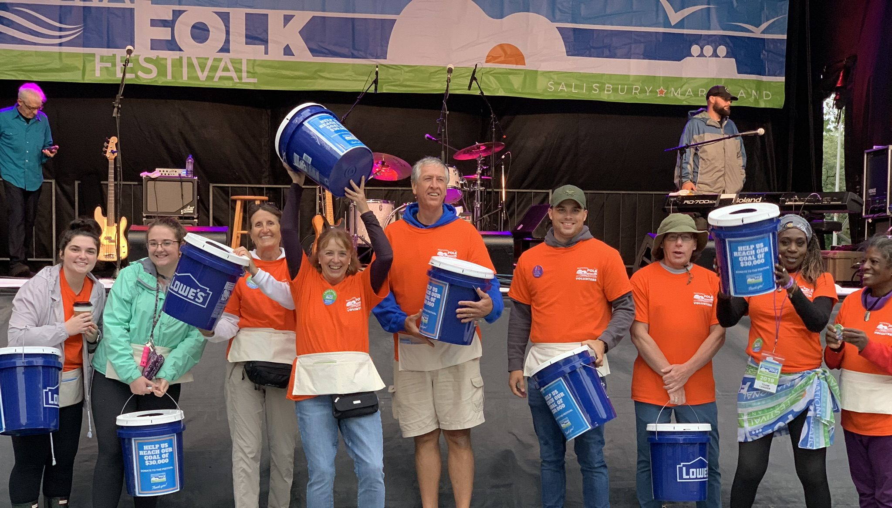

Slide 15
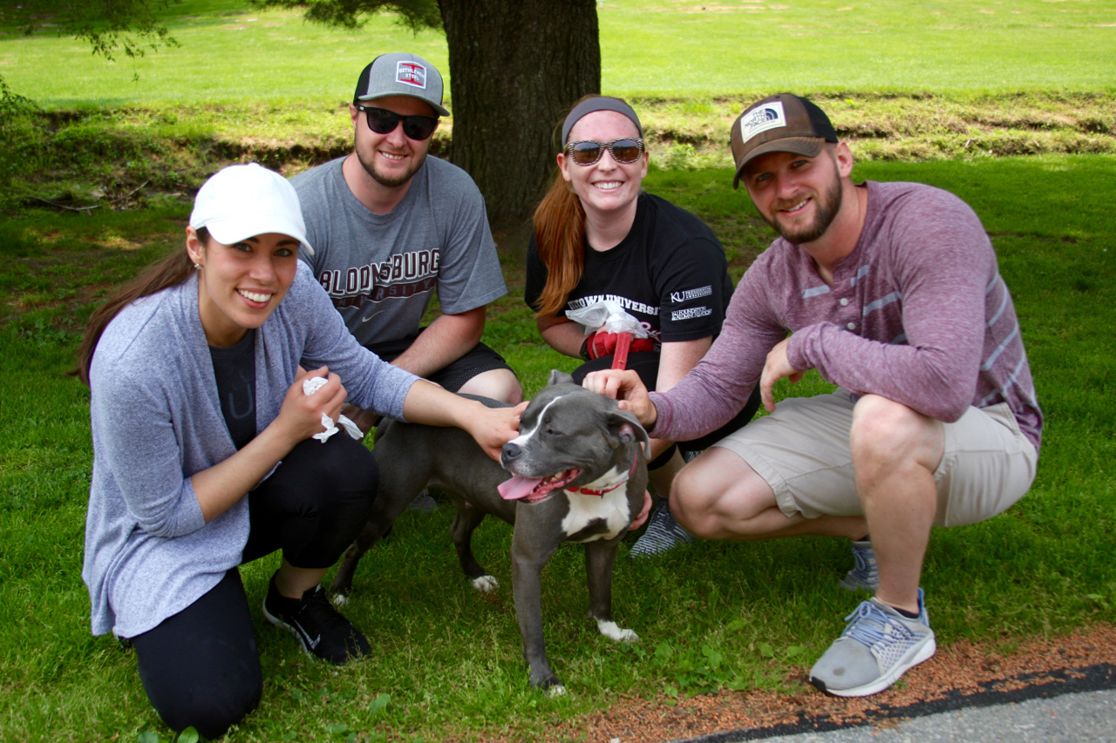

Slide 16
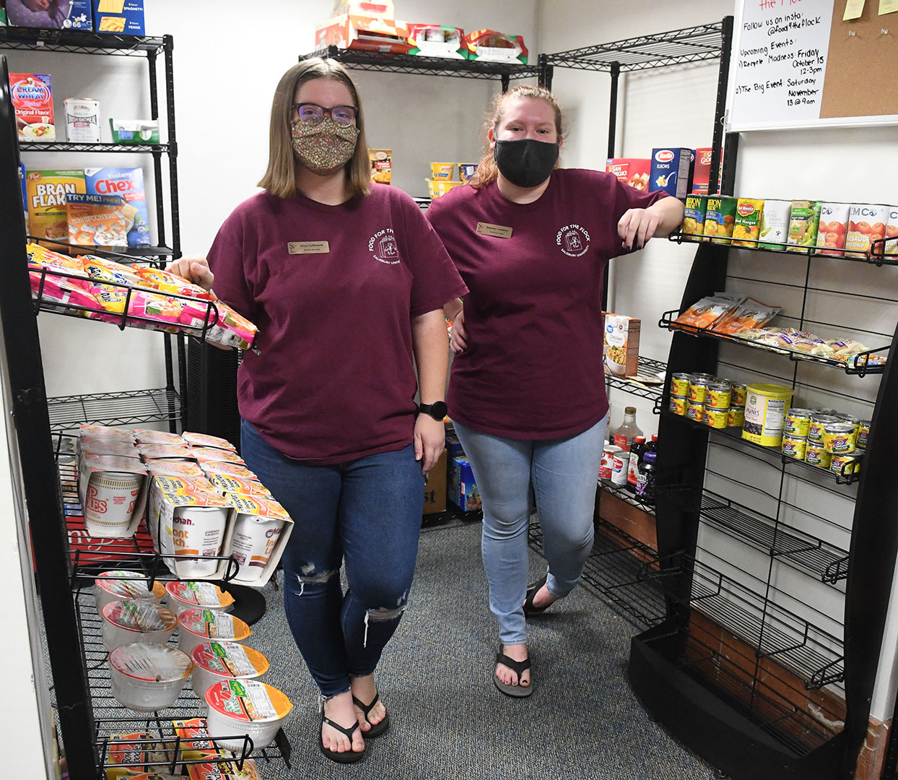

Slide 17
Why Volunteer?
Goes beyond just volunteering
Binds communities
Breaks the mold. Younger generations less likely to volunteer unless required to do so. By being engaged, you can show others what a community looks like.
Establishes SU as a place that gives back

Slide 18

Where to Volunteer?
Animal Shelters
  Can even just be to walk the animals
Libraries
Hospitals
Food Pantry
Homeless Shelters

Slide 19

Example: Food for the Flock
Food for the Flock is run by PACE
www.Salisbury.edu/foodfortheflock
Staff can volunteer/ lend a hand numerous ways
  Time
  Donations
  In-Kind Service

Slide 20
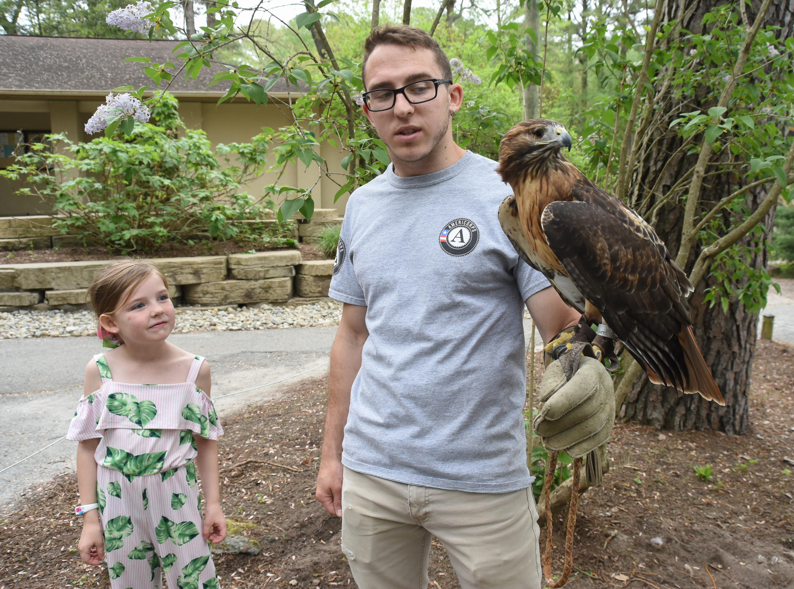
How to Volunteer?
Volunteer Center is also for Staff!
www.Salisbury.edu/pace → “Volunteer and Get Connected”

Slide 21
Thank you!
Michael Webber
mawebber@Salisbury.edu
x75054

