Slide 1
Identity Theft & cybersecurity
How to protect your personal data and family from Identity theft and other trending cybersecurity threats.

Slide 2
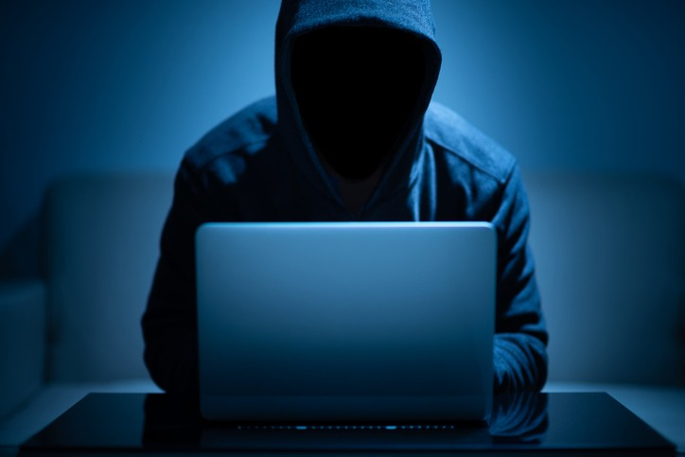
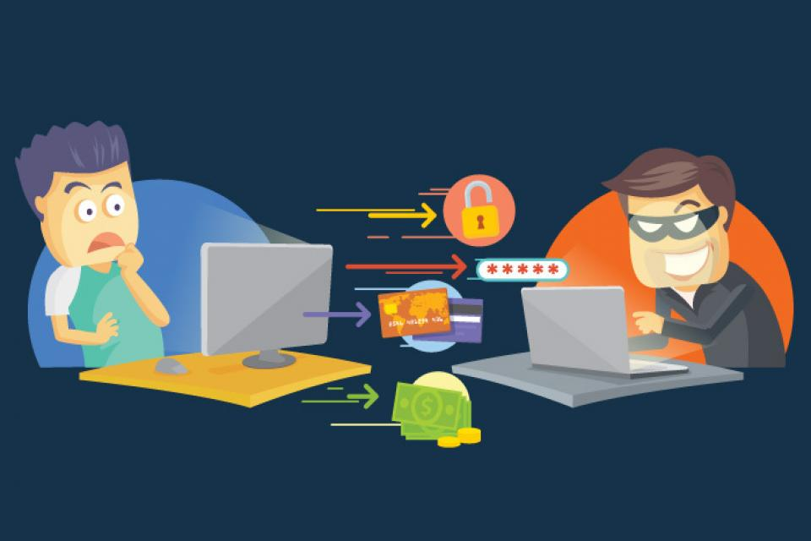
What is Identity Theft?
Oxford Definition: The fraudulent acquisition of a person’s private identifying information, usually for financial gain.
Usually takes the form of a criminal using your personally identifiable information to either access existing financial accounts or open entirely new lines of credit.
Can go unnoticed initially and utterly wreck your finances and credit score as you fight with your bank and other lenders to prove you didn’t drain your own accounts or open new ones.

Slide 3

Most effective Prevention Techniques
Guard your personally identifiable information (PII) like the crown jewels they are.
Too many pieces of data about you are already freely available on the internet thanks to social media like your full name, home address, relations, employer/job.
Your Social Security # is the last and most vital lynchpin in impersonating you as almost everything else is accessible. Treat this like the valuable commodity it is and evaluate where you provide it and how you store documents containing it.
Freeze your credit for the whole family, kids included!

Slide 4
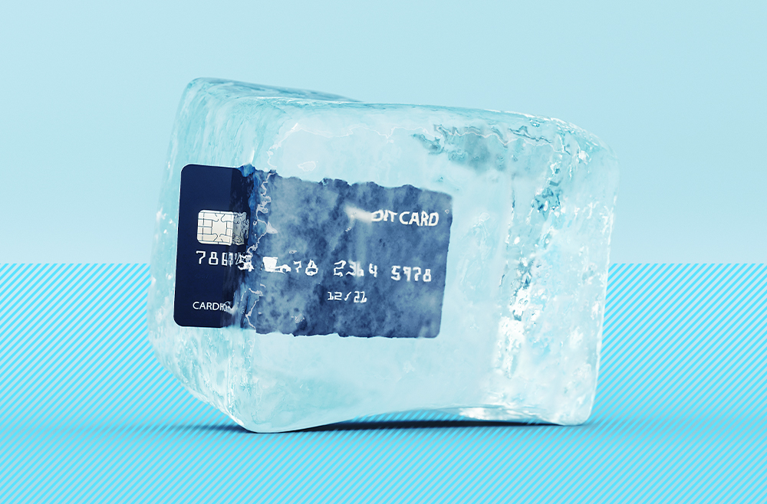
Freezing Credit
Freezing your credit with the three credit agencies prevents any new lines of credit (loans, credit cards) from being opened in your name without someone first unfreezing it temporarily with additional pieces of information beyond just your social/address/name.
The federal government requires all three credit agencies to provide this for FREE but each one doesn’t make it obvious how to go about doing this and often try to sell less effective services to “monitor” your credit rather than freeze it outright. Not only are these objectively worse as they’ll only notify you after the fact that you’ve been violated, they also do this to charge you money since they can’t charge you for the actual effective freezing!
Walkthrough for each agency:
  Equifax – https://www.equifax.com/personal/credit-report-services/credit-freeze/
  Experian – https://www.experian.com/freeze/center.html
  Transunion - https://www.transunion.com/credit-freeze

Slide 5
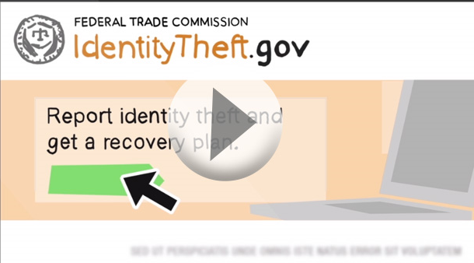
What if it happens to me?
It happens to the best of us, and when it does… it’s a long bumpy ride to get your life back together.
  Notify affected creditors & banks
  Put a fraud alert on all three credit agencies & check credit reports
  Freeze your credit
  Report identity theft to the FTC – https://identitytheft.gov
  Report identity theft to your local police department – Memo
  Work with all three credit agencies to remove fraudulent info – Sample Letter
  Change ALL your passwords
  Request replacement identification records – SSN Card – Drivers licenses - Passport

Slide 6
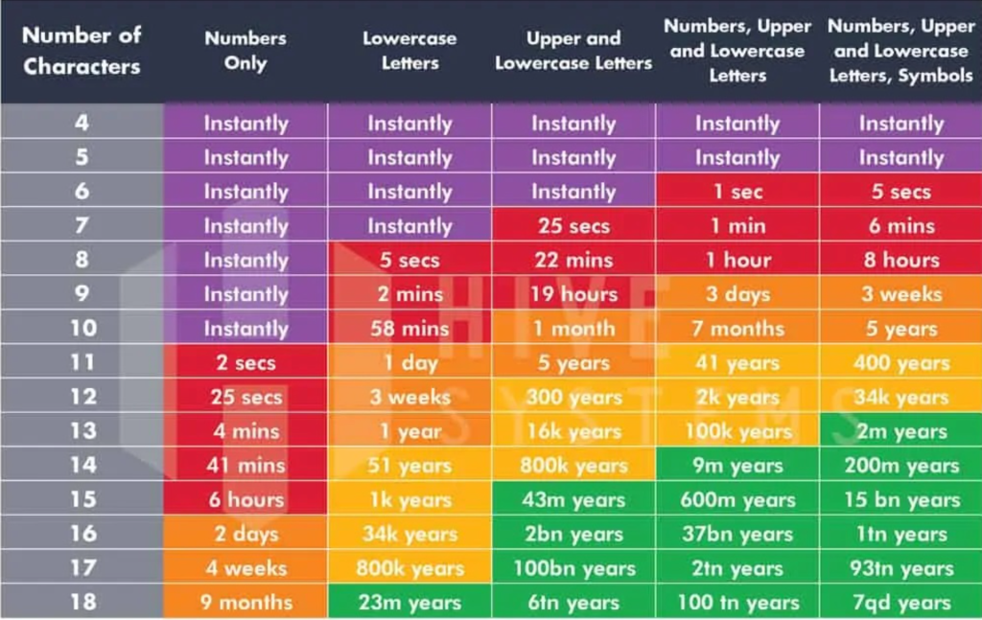

Family Security
Accounts & Passwords Best Practices
  Password length is the most important factor in determining the actual difficulty in brute forcing a password: “ILoveSalisburyUniversity21!” is a more effective and easier to type/remember password than “1Ed84$z9-!”
  Passphrases are ideal, 18+ character phrases are actually faster to type, remember, and harder for any computer/program to hack even when using common words.
  You should only have to realistically remember 2-3 passwords: personal email account, work email account, and password manager login. All other passwords should be unique to each service and will be in your password manager!

Slide 7
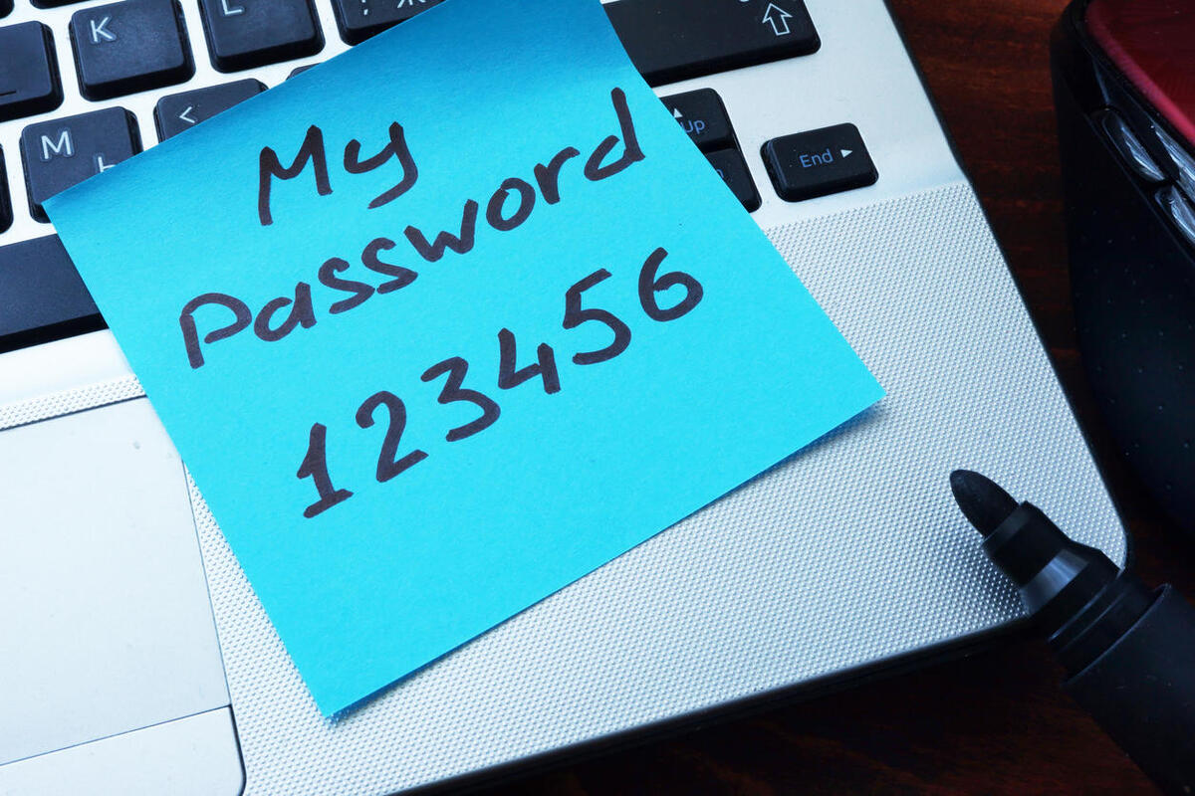
Password Managers
Why not use a browser?
Things to look for in a password manager
  Local / Cloud
  Dark Web
  Travel Modes
  Copy/Paste
  Fix Compromised Accounts
  Life Events
1Password – Paid, feature rich, good for the whole family
Myki.com – Free password manager app for your phones, stores all passwords locally NOT in the cloud and encrypted on your own device.
Lastpass.com – Free cloud-based password manager, extremely convenient has web and app functionality with multifactor authentication. Paid version ~36/year
http://Bitwarden.com – Free open-source password manager with multifactor authentication but minimal features in the free version. Paid version ~12/year
Notes:
Don’t PANIC!

Slide 8
Multifactor Authentication
Multifactor Authentication requires an additional step beyond just your password to be able to login.
Most important for your financial systems and email accounts. Email accounts if compromised can then be used to “forgot my password” most other systems even if you use unique and complex/long passwords for all other sites. Your email account is one of your crown jewels that should be as protected as your financial accounts.
Best forms of multifactor are those that leverage an application on your phone such as Duo, Google Authenticator, Microsoft Authenticator, RSA, etc. MFA that relies only on texting you a code is a weaker alternative and phones/texting is vulnerable to many exploits as the system was never designed to be secure. Always use MFA apps whenever possible, insist on them for your banks.
Notes:
Remember – Pass Managers can act as this!

Slide 9
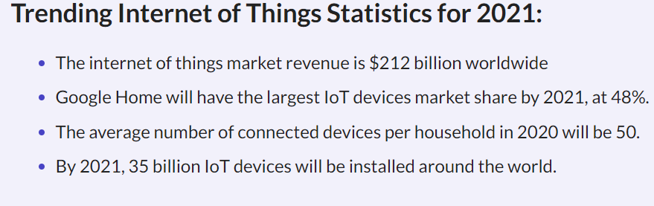
Home Network Security
Strong Password for WiFi
Guest / Separate Networks
IOT
  Check for Updates
  Privacy Features
    Arlo Privacy Shutter
    DON’T THROW AWAY

Slide 10
Application Security
Your phone is now a critical piece of your identity and is a gold mine of personal information/data.
Permission review. Not designed with security in mind.
Social Login pitfalls.
Keep it patched/updated just like you would any other modern software/device.
Remove unused applications, they can be an attack vector, keep what you need on your phone and periodically purge old/unused apps.

Slide 11
Questions?

