Slide 1

Advanced FinAid Solutions Fall 2018 Planning Session
Deb Schreiber
Executive Consultant

Slide 2
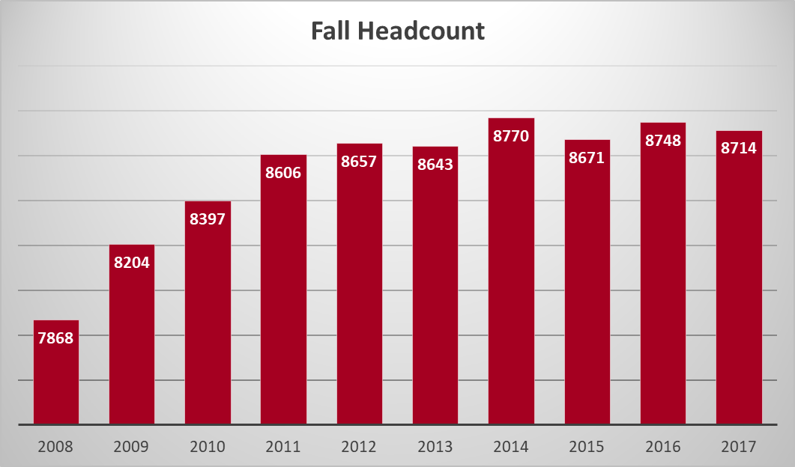
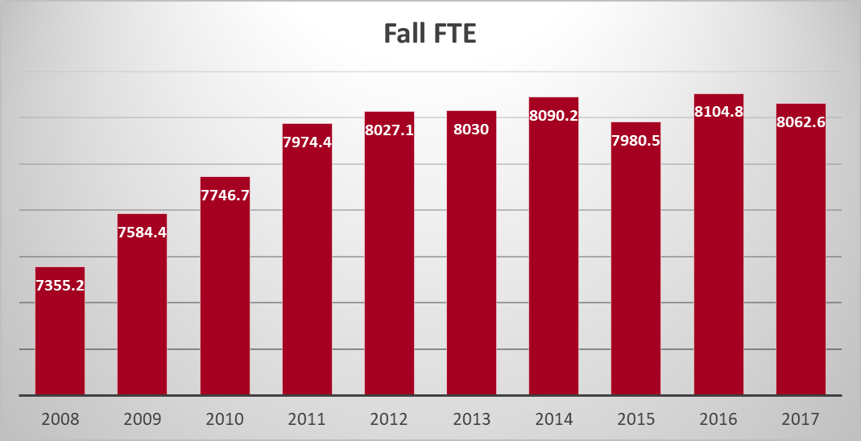

Slide 3
1
Competitor Benchmarking & National Trends

Slide 4
| RNL ADVANCED FINAID SOLUTIONS
Today’s Landscape
8.6% overall discount rate increase 2007–2016 (private)
4.1% overall discount rate increase 2013–2016 (public)
Trends in Financial Aid
High school graduates
2.3% decline in 2017
3.47M in 2012
3.3M in 2031
Minority students
46% of enrollment in 2025
Completion gap remains
Affordability
College cost increasing
Amount of aid decreasing
Discount rate
41.6% private schools
16.6%
public schools
Cost of losing an enrolled student
$15,420
4-yr private
$9,740
4-yr public
$3,530
2-yr public

Slide 5
Maryland
The competition factor
63,485 high school seniors / 2017-18*
59 institutions of higher education**
64.0% college continuation rate (40,630)*** (ranks 19th among states)
37.5% leave the state to go to college (15,218)**** (ranks 7th among states)
† In-state institutions receiving the largest number of in-state freshmen. †† Competition factor equals college continuation rate less number of students migrating and the three in-state institutions receiving the largest number of in-state freshmen.
Three Largest Institutions†***** | Number of In-state Freshmen*****
University of Maryland – College Park | 2,885
The Community College of Baltimore County | 2,387
Montgomery College | 2,091
18,049 students ÷ 56 institutions = 322 students per institution††
Sources:
*Western Interstate Commission for Higher Education, Knocking at the College Door, 2016
**The Chronicle of Higher Education, 2017
***Postsecondary Education Opportunity, Chance for College by Age 19 by State 1986-2010, 2013
****Postsecondary Education Opportunity, Interstate Migration of College Freshmen 1986-2012, 2014
*****National Center for Education Statistics, IPEDS Fall Enrollment Survey (2014)

Slide 6
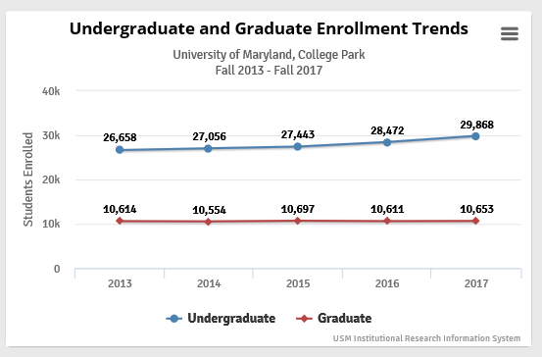
Growth of Flagship
UMCP increased its freshman class size by 32% 2015-2017 and an additional 600 students this fall.

Slide 7
Net price positioning chart

Slide 8
Net price positioning chart

Slide 9
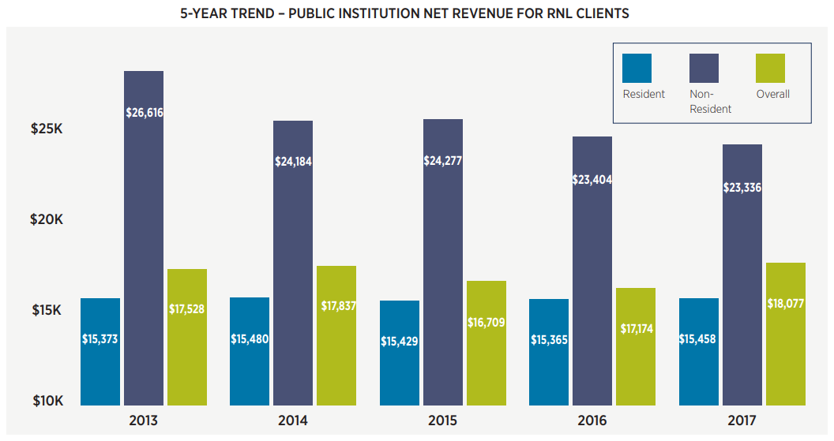
First-year Student Net Revenue Benchmarks
Four-year Public Institutions
© Copyright 2018, Ruffalo Noel Levitz, LLC
2018 Discounting Report for Four-Year Public Institutions

Slide 10
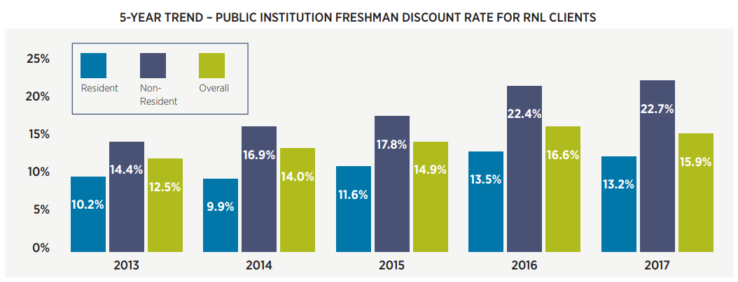
First-year Student Discounting Benchmarks
Four-year Public Institutions
Salisbury (2017): 9.4% 12.1% 10.0%
© Copyright 2018, Ruffalo Noel Levitz, LLC
2018 Discounting Report for Four-Year Public Institutions

Slide 11
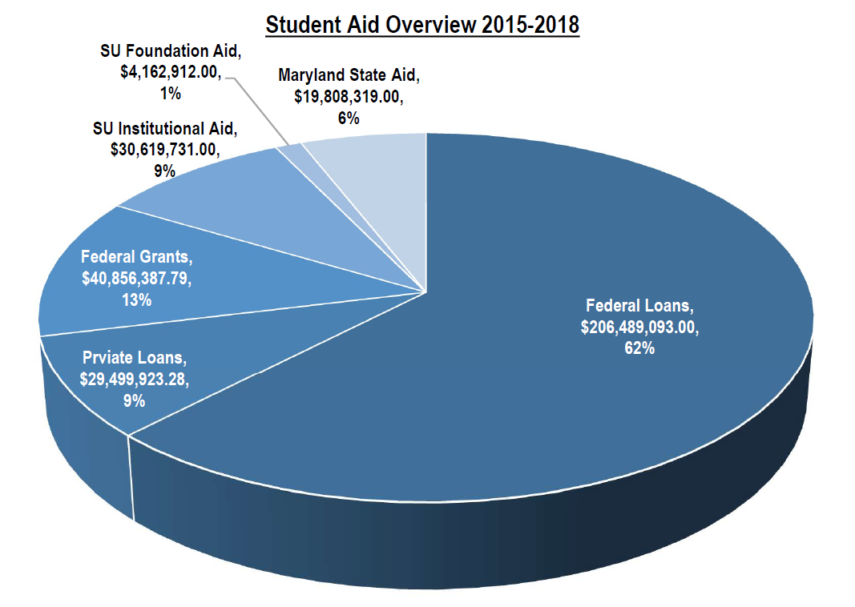
Student Loan Debt
In the last 28 years, SU families have borrowed $977M in federal loans, but 35% of this total was borrowed in the last five years.

Slide 12
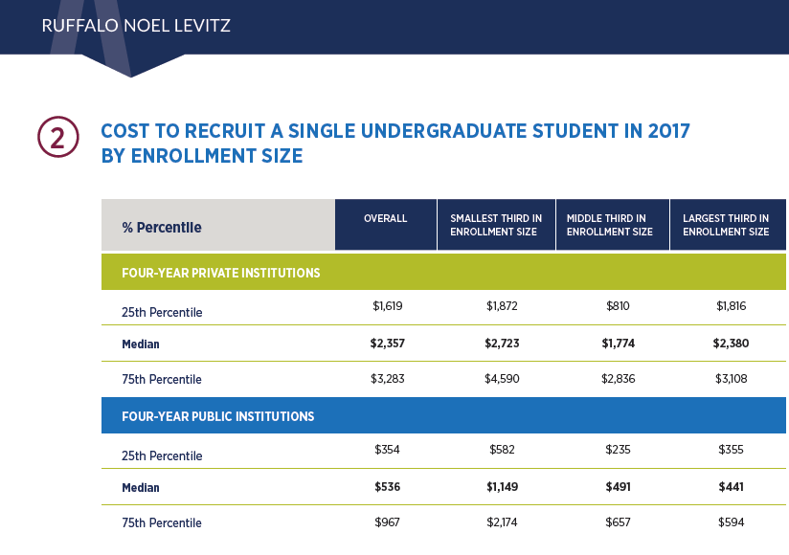
Salisbury: $876

Slide 13
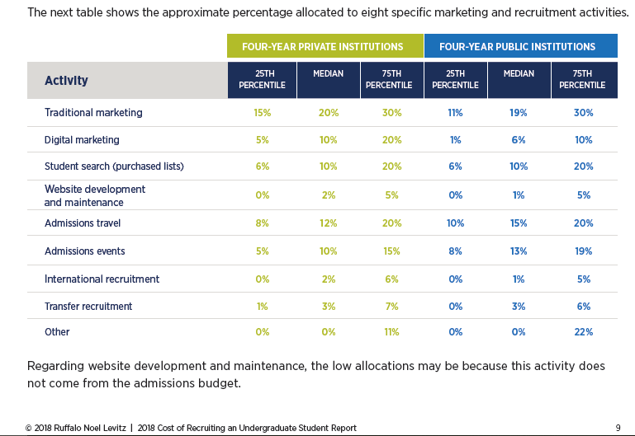
Salisbury
2.5%
.1%

Slide 14
An Overview of Top 10 Student-planned Educational Majors: 2008-17
*2013 is the first year data has been captured for this category.
© Copyright 2017 ACT Profile Report—National. All rights reserved.
Reprinted with permission. This material may not be posted, published, or distributed without further permission from ACT, Inc.

Slide 15
An Overview of Bottom 10 Student-planned Educational Majors: 2008-17
*2013 is the first year data has been captured for this category.
© Copyright 2017 ACT Profile Report—National. All rights reserved.
Reprinted with permission. This material may not be posted, published, or distributed without further permission from ACT, Inc.

Slide 16
2
Historical Results
Note: data as of 7/30/18

Slide 17
Academic tier distribution
Enrolled students

Slide 19
High School GPA Trends at SU

Slide 20
2018 data as of 7/30/18

Slide 21
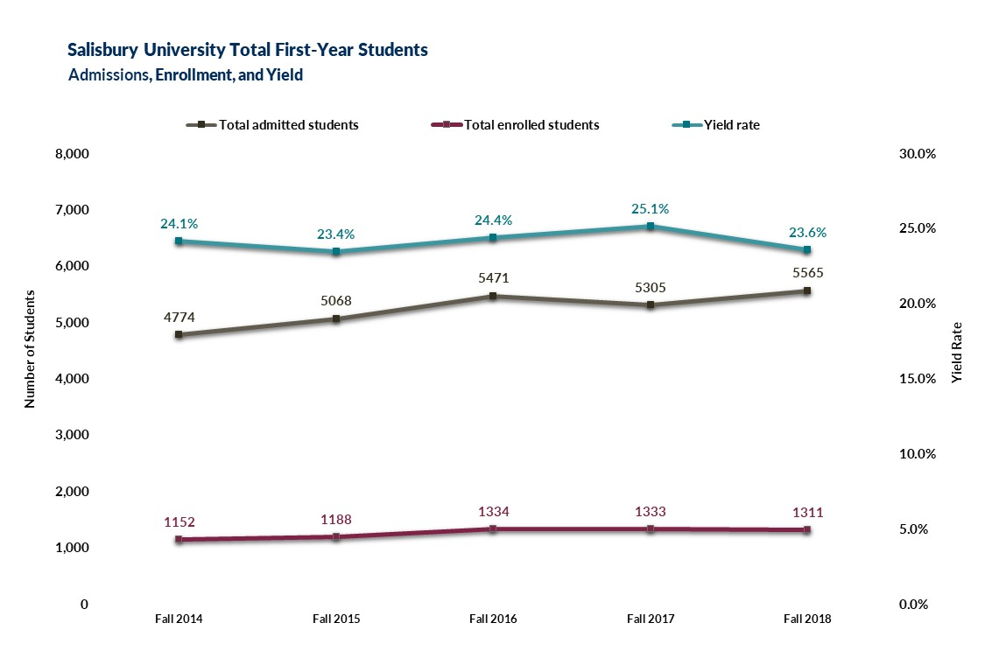
2018 data as of 7/30/18

Slide 22
Campaign Summary 2018-2019
Inquiry Marketing – 2019 Grads
ForecastPlusTM Inquiry to Enrollment Model
Three outreach emails
Phone launch with up to 350 dedicated calling hours
Six fulfillment email versions
5,000 print fulfillment materials
Launched June 28, 2018

Slide 23
Campaign Summary 2018-2019
Demand Builder – Student Search
Campaign launches to an estimated 100,000 search records
Modeling: Search predictive model to 4 distinct markets
Two phone launches with 925 dedicated calling hours
Nine outreach emails
Text message reply mechanism
Direct mail launches to 100% of records with valid addresses
Fulfillment email template with 5 fulfillment email versions
Digital Dialogue Campaign
Senior, 2019 graduates, set to launch August 20, 2018
Junior/Soph set to launch November 2018; February 2019; April 2019

Slide 24
2019, 2020 Search Summary
Search Summary
Entry Term | Vendor | Total Searched | Total Responders | Overall Response Rate
19 Fall
 | College Board | 28,763 | 2,002 | 7.0%
 | NRCCUA | 21,452 | 2,172 | 10.1%
20 Fall | College Board | 9,054 | 270 | 2.9%
Total |  | 59,269 | 4,444 | 7.5%

Slide 25
Inquiry Marketing Conversion Analysis Fall 2018
 | Total from campaign | Salisbury Total | Percentage of Total
Inquiries | 9,306 | 20,258 | 46%
Applications | 2,116 | 6,763 | 31%
Admits | 1,918 | 5,434 | 35%
Enrolled | 553 | 1,346 | 41%

Slide 26
In-State admit model (not econometric model). Given current structure, aid strategy is optimized.
Out-of-State econometric model shows less price sensitivity (4% of the variation in enrollment behavior attributed to net charges). Translation? Given current structure, aid strategy is optimized. (Or it would take a lot of money to move the needle in yield with additional dollars only.)

Slide 27
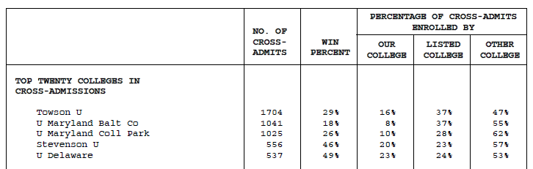
ASQ Results
Weak Win Percentage Suggests Brand Awareness
Vs. Top 5 Overlaps, SU Perceived as:
6/6 Academic Factors
4/6 Social Factors
5/6 for Setting Factors

Slide 28
Fall 2019 Enrollment Objectives
Expansion of admission to achieve enrollment targets with declining transfer numbers. Assumes shifting of students from spring admission to fall admission.
Assumes 2185 new student enrollment goal (2098 first-time and first-degree only)
~1420 first-year students
~678 transfer students

Slide 29
RNL Recommendations
Hire branding consultant / branding exercise most impactful (multiple data points, Middle States recommendation). Consider pricing study (we need to know how inquiries are perceiving Salisbury)
Cost: TBD by RFP Process
Expand incoming freshmen access by admitting students that would have been pushed to spring (because of academic profile). Additional benefit – will weigh heavier on FTE.
Cost: Potential lowering of profile
Add level 4 first-year out of-state merit award of $2,000. Make first step in improving access for needy students by enhancing need with gift percentages for first-year in-state and first-year out-of-state
Cost: Increase financial aid budget by $1,397,00, but projected net revenue of $825,000

Slide 30
RNL Recommendations
Pilot Delmarva expansion by including all of Virginia in 2019-20. Increase Delmarva from $5,000 to $6,000.
Cost: Max $170,000 in discount. Should increase revenue if successful.
Current yield is so high on transfers that increasing recruitment and marketing funding is more efficient than large aid infusions for transfers.
Cost: To get to average benchmark of RNL clients would be $390,000

Slide 31
Thank you! Here’s to a successful year ahead!
Deb Schreiber
Deb.schreiber@RuffaloNL.com
623.242.9337 / 800.876.1117

