Slide 1
Performance Management Process (PMP) Non-Exempt Staff
Human Resources – 2023

Slide 2
Agenda
Important Dates
Review of 2022-23 Cycle
PMP Form / optional Self-Assessment
Annual Review Meeting
SMART Goals for 2023-24 Cycle
Coaching and One-on-Ones
Q&A

Slide 3
Important Dates
Cycle Dates: May 16, 2022 – May 15, 2023
Completed PMP Deadline:
Due to HR by Friday, May 26, 2023
Email to: PMPForms@Salisbury.edu

Slide 4
Remember…
PMP is a process…
…not a form

Slide 5
Process and Cycle
Set objectives and
identify performance End-of-cycle evaluation
factors*
Coaching…Counseling…Feedback…Development
*The PMP process is designed to evaluate performance for the current review period only, not for past performance.
May 2022
May 2023

Slide 6
Self-Assessment
Employee completes optional PMP self-assessment form and submits to their supervisor OR
Employee can email supervisor with feedback on:
Top accomplishments
How they perceive they met their responsibilities
Changes to job duties
Feedback on progress on goals
Any additional training or support they may need
New goals they wish to accomplish
Employees must complete any required training (IT, FERPA, D&I) no later than May 19, 2023 for merit eligibility

Slide 7
Self-Assessment – cont.
If an employee wishes to complete a self-assessment they should:
Request to do so with their supervisor
Submit the self-assessment to their supervisor at least ten (10) days prior to the end-of-year evaluation meeting. Supervisor should provide due date to employees.

Slide 8
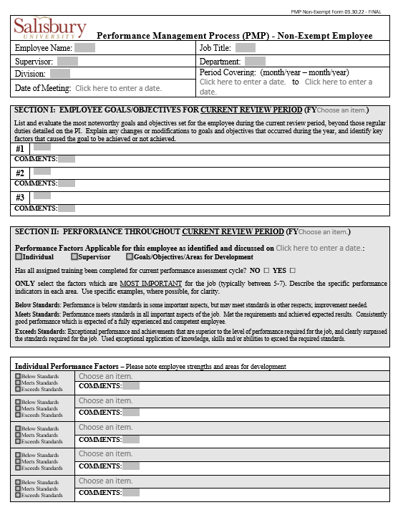
PMP Forms
PMP forms can be found on the HR website under Find it Fast / Manager & Admin Toolkit / Performance Management Process Nonexempt PMP Form
PMP’s are required for all PIN and Contingent II employees who have completed their original probation period.

Slide 9
Probationary Period Employees
Non-exempt probationary period is 6 months
PMP’s are not required for employees during their original probationary period
Opportunity to review PMP process with your supervisor and set goals
Previous supervisors will need to assist with completing PMP for internal transfers

Slide 10
Non-Exempt PMP Form
Comments and rating on achievement of employee goals/objectives for current review period
Evaluate most important factors for the job (typically between 5-7)
Evaluate most important supervisor factors if applicable
Overall rating
Set new goals/identify areas for development for upcoming review cycle
Comments

Slide 11
Non-Exempt Rating Scale
Exceeds Expectations:
exceptional performance in multiple factors
superior to performance required for the job
Meets Standards:
performance meets standards in all important aspects
Below Standards:
performance below in some important aspects, but may meet in others
Performance Improvement Plan

Slide 12
The PMP Meeting
Plan and prepare to be “OPEN”
Observe
Probe
Express how you feel
Next steps discussion
Gather information and documentation, including employee self-assessment or feedback
Review PMP form, discuss feedback/comments with your supervisor
Sign document and keep a copy for your records

Slide 13
Opening Performance Year 2023-24
Supervisors set performance measures:
Non-Exempt: select performance factors; set goals/objectives
Solicit employee feedback
Set training or development plans as needed

Slide 14
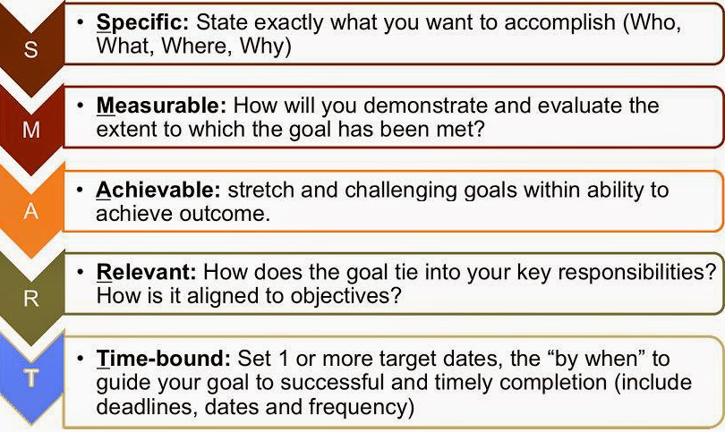
SMART Goals

Slide 15
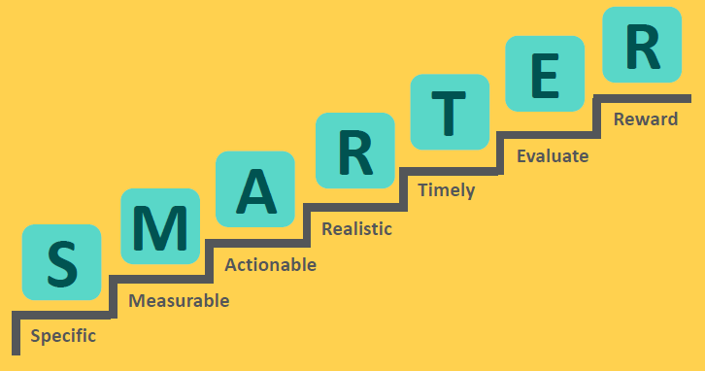
SMARTER Goals

Slide 16
Write SMART Goals
Action Verb | Results in Measureable Terms | By When
Start with an action verb such as: Increase Complete Conduct Attain Achieve | Include measurement such as: How much How many How much better How much faster How much slower | Include due date or time frame, such as: Daily Weekly By next month By the end of the school year

Slide 17
SMART Goals Examples
Poorly Written Goal:
Example: I want to attain an Electrician certification this year.
Specific? | No
Measurable? | No
Achievable? | Not clear
Relevant? | Maybe
Time-bound? | No specific due date

Slide 18
SMART Goals Examples
Well Written Goal:
Example: To advance in my career, I will obtain a Master Electrician certification this year. I commit to taking a prep course no later than December 31, 2023, and plan to study 3 days per week, with a goal of passing the exam by March 31, 2024.
Specific? | Yes
Measurable? | Yes – passing the certification exam
Achievable? | Yes – by studying 3 days/week
Relevant? | Yes – relevant to the goal of advancing career skills
Time-bound? | Yes – due by March 31, 2024

Slide 19
Coaching
Ongoing year-round Coaching
Recognition and feedback
Discuss opportunities for improvement
Employee actively participates in process
Set a date for regular 1:1 discussions

Slide 20
Questions
Please contact the Office of Human Resources with any questions at: humanresources@salisbury.edu or 410.543.6035.

Slide 21
Reference: SMART Goals
LinkedIn Learning video (click image)
Notes:
Click for short video (4:54)

