Slide 1

building conceptual understanding of multiplication
By: Daniela DiGena & Angela Whidbee Mentor: Dr. Jennifer A. Bergner

Slide 2
Introduction
Multiplication and division are foundational to students' learning of a wide array of mathematical ideas (National Council of Teachers of Mathematics, 2008).
Children should develop conceptual understanding and procedural fluency with multiplication and division in Grades 3-5 (Common Core State Standards Initiative, 2010).
However, in these grade levels, children are often taught multiplication and division in a strictly procedural manner without emphasis on conceptual understanding (van de Walle, Karp, & Bay-Williams, 2013).
Notes:
We worked with children coming out of 3rd grade entering 4th grade. Multiplication and division are foundational, to many mathematical ideas. They should gain procedural fluency and conceptual understanding in grades 3 through 5. But often children are taught the procedural manner without emphasis on conceptual understanding.

Slide 3
Purpose and research question:
Purpose: The purpose of the study was to design an instructional sequence to help a group of children entering fourth grade develop both conceptual understanding and procedural fluency for multiplication and division.
Research Question: What is the nature of the children's conceptual understanding and procedural fluency for multiplication and division before, during, and after the instructional sequence?
Notes:
Portions of this slide can be read verbatim…Our purpose and research…..We wanted to designed an instructional sequence… and we posed a research question (read question from slide)

Slide 4
Common core state standards addressed
We used the following Common Core State Standards to set student learning goals for each lesson in our instructional sequence.
Focus Standards
3.OA.1- Interpret a x b as the total number of objects in A groups of B objects
3.OA.3- Use multiplication and division within 100 to solve word problems in situations involving equal groups, arrays, and measurement quantities
4.OA.1- Interpret a multiplication equation as a comparison
Incidentally-addressed Standard
3.OA.5- Apply properties of operations as strategies to multiply and/or divide. Example: If 6 × 4 = 24 is known, then 4 × 6 = 24 is also known as commutative property of multiplication
Notes:
When we were creating the student learning goals we used the following standards to focus on our design (3.OA.1) 3rd operations and algebraic thinking. Read the other standards, and actually 3.OA.5 was incidentally addressed throughout our lessons.

Slide 5
Teaching strategies from literature
In the lessons for this study…
We gave the students the freedom to actively create their own multiplication stories that engaged their interests (Sullivan & McDuffie, 2009).
We encouraged the students to talk through their reasoning with peers in order to grasp a deeper understanding of their work (Whitin & Whitin, 2008).
We planned lessons to help students understand different methods of solving multiplication problems such as, equal grouping (skip counting), repeated addition, building rectangular arrays, and using number lines.
Notes:
In the instructional sequence we would look through the literature for ideas that had been classroom tested to help us decide what tasks would move our students further along their individual learning trajectories. We let them create their own stories, talk and share their reasoning, and worked with different methods of solving mult problems like skip counting (think 3,6,9,12…) aided by a hundreds chart, building arrays, using number lines with equal sized jumps.

Slide 6
Methodology
Participating in the study were 4 students, (2 boys and 2 girls) that will be entering the 4th grade in the fall.
We taught seven weekly 1-hour sessions. Before the first lesson each child participated in a 30-minute individual interview. A 30-minute post-interview using the same task script was administered after the final lesson.

Slide 7
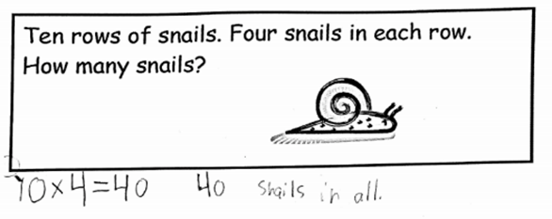
Students’ work pre-interview
Key task #1
In this task, the students were to solve the multiplication problem using whichever method worked for them. Isaac, Ryan, and Chloe all created the equation 10 x 4 = 40. Ryan’s work is shown to the right. Kasey gave the response of 10 + 4 = 14.

Slide 8
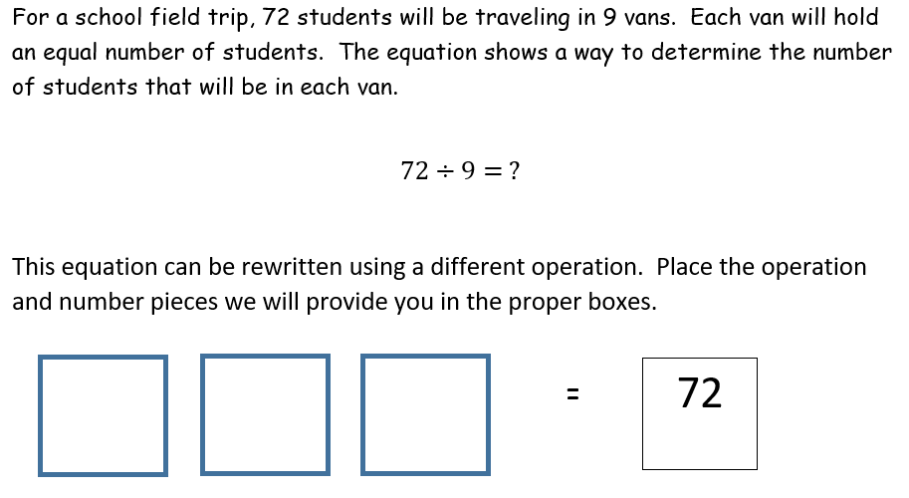
Students’ work pre-interview
Key task #2
In this task, the students chose from a pile of numbers and operations to fill in the blanks. Isaac, Ryan, and Chloe all inserted 9 x 8 while Kasey did not attempt the problem.

Slide 9
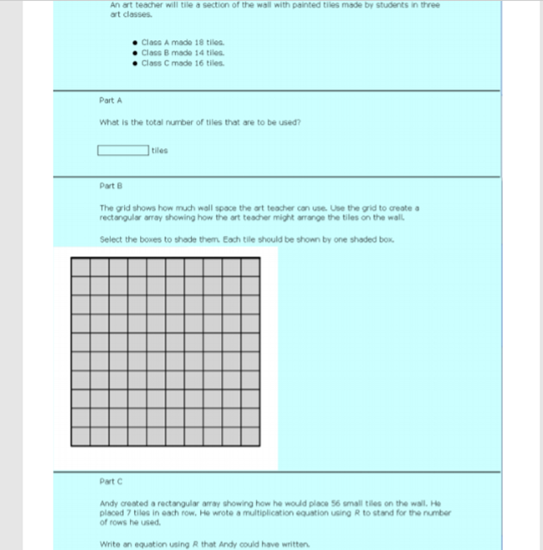
Students’ work pre-interview
Key task #3
Only Ryan and Chloe attempted this task. It took Ryan two attempts to correctly complete the problem. Chloe was not able to solve the task. She attempted the task multiple times but could not find factors of the number of tiles to correctly create a rectangular array.
Notes:
This task had 3 parts…part 1 asked the students to consider three different classes who had created tiles to be placed on a wall, the students were to sum these to get a grand total of 48 tiles that in part b they were to arrange into a rectangular array.

Slide 10
Procedure for instructional sequence
Analyze data through collaborative qualitative coding
Create learning goals for the following week
Formulate a lesson with tasks that reach the learning goals
Carry out lesson and tasks with students
Video record lesson, transcribe it, and retain students’ written work
Notes:
We entered this cycle at the top as during week 1 we had the pre-interview data to analyze…this (along with the learning trajectory identified by our mentor) helped us create learning goals for the children based on where they were at in their understandings. We then created a lesson that would address our students needs and move them further along their individual paths of understanding. This lesson was carried out on Thursday nights when our 4 children came to do math! We video recorded the lesson, transcribed it. This brought us back to the top of the cycle, where we went through a process of analyzing the transcripts and starting the cycle of create-formulate-carry out-video/transcribe-analyze (point to the slide as you capture this cycle).

Slide 11
Lesson 1 & lesson 2: connecting skip counting to multiplication
Lesson One: Our first lesson was designed to continue developing the students’ ability to skip count with different numbers in order to prepare them for multiplication.
Students used 100’s charts to skip count by different numbers, (i.e., 2, 3, 4, 5).
Students did well but struggled with skip counting by 3’s.
We introduced a game to connect multiplication to equal shares of an object.
Lesson Two: Was designed to further develop the students’ abilities to skip count and introduce multiplication number sentences.
We redesigned the game for the students to be able to create multiplication number sentences.
Students created their own multiplication and addition/subtraction number sentences stories.
Each story consisted of a beginning (multiplication sentence), a middle (addition/subtraction sentence) and a ending (multiplication and addition/subtraction sentence combined, e.g. 3 x 4 – 5).
Notes:
You will do this and next slide together…Flip to the next slide to show a hundreds chart when discussing lesson 1
Quickly capture how you redesigned game and show game board on next slide
Share anecdote about Anthony and his cheerios or pancakes problem

Slide 12
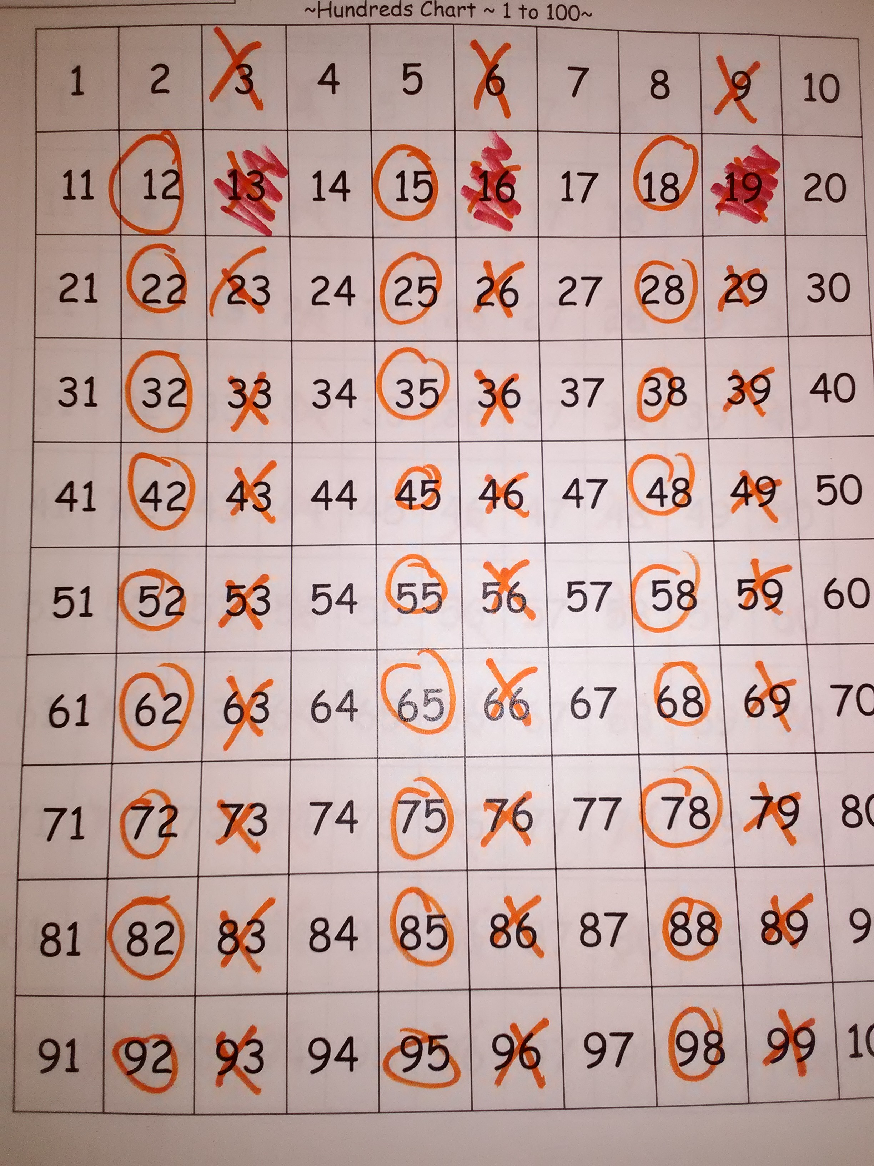
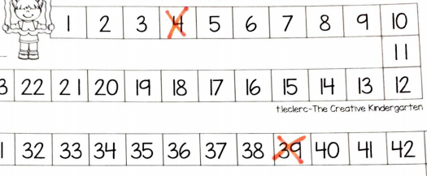
Lesson 1 & 2: student work

Slide 13
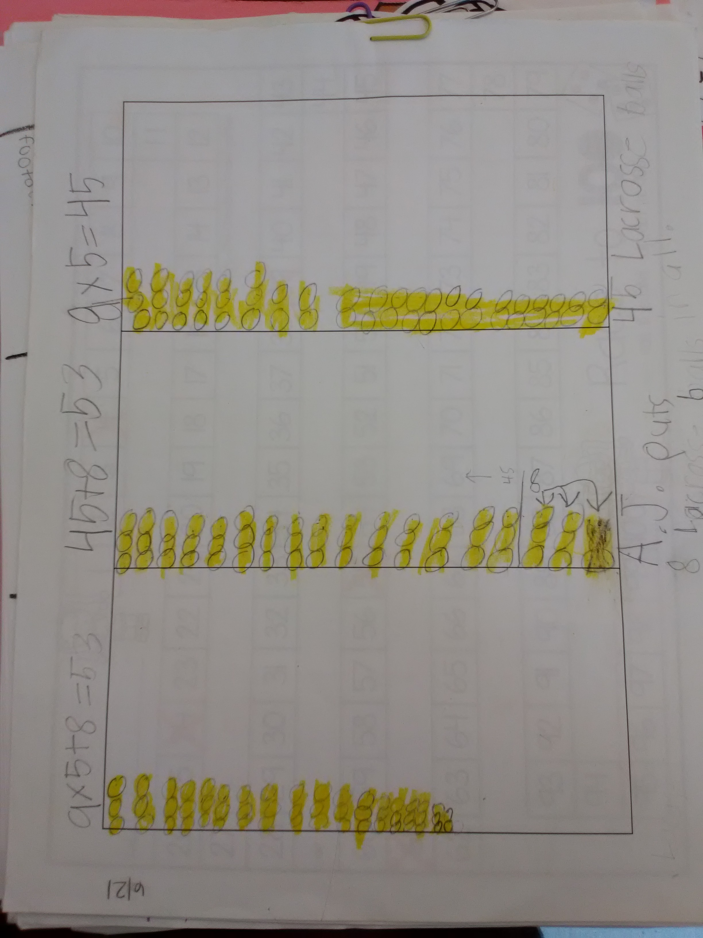
Lesson 3: transitional lesson
Lesson 3: A transitional lesson
Students finished number sentence stories from the previous lesson
Students were given fact fluency worksheets to gauge their strengths and weakness with number facts; students were at different levels.
Students were given multiplication word problem worksheets where they created a multiplication number sentence from the information given. They also created their own multiplication word problems once they finished the worksheet.
Notes:
Give a quick overview of them and how you had them highlight the facts …Anthony said hard but could pop out facts, Lucas knew all, etc…
Give verbal example of problem and associaatd number sentence
Quickly describe the student work shown here

Slide 14
Lesson 4 & lesson 5: grouping and arrays with area
Lesson Four: The students were introduced to the interactive smart board and were asked to create rectangular arrays from multiplication sentences.
Students explained their grouping methods to one another and the commutative property was briefly discussed.
The students used this knowledge to build rectangular arrays and determine their areas.
Lesson Five: The students constructed pools from rectangular arrays and calculated area of the figures together on an interactive smart board.
Students were given grid paper to construct their own towns made of specified rectangular arrays (e.g., arrays with 24 blocks or an array that is 3 by 5).
This allowed them to learn the different ways that arrays can be built with the same area and gave them the opportunity to be creative and share their work.
Notes:
As with the lesson 1,2 slides flip back and forth to the student work and discuss what they are seeing…when Chloe was working with the 4 by 9 array we realized that she was not making connections between her isolated multiplication strategy skills. She knew that 9 times 4 was 36, and in previous work could use repeated addition to sovle a mult problem (eg 5 x 3 is 5 + 5 +5 =15) but when asked to represent the area as a repeated addition sentence she faltered and just added the dimensions of the array multiple times. When questioned she started to break up the array into tetris like pieces. /this led us to focus on connecting their isolated skills in subsequent lessons.
The town activity was a success although Iaasc struggled with seeing the lines…fixed that next lesson

Slide 15
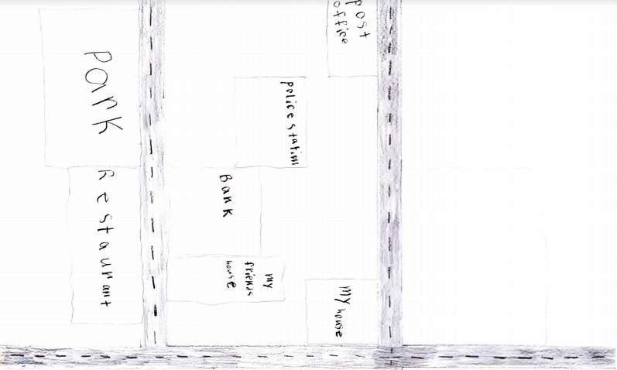
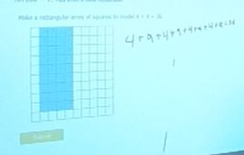
Lesson 4 & 5: student work

Slide 16
Lesson 6 & lesson 7:
100 hungry ants and division with and without remainders
Lesson 6: During this lesson the students were given back their town maps to finish.
Students hung their work up for a gallery walk to explain to their peers their favorite building and the building’s area and dimensions.
Also during this lesson, each student was given 24 ants and red checkered picnic boards. The students explored all rectangular arrays that they could make with the number 24.
The students were given an extra ant (now making 25 ants) to explore the topic of division and remainders, and attempted to create arrays for equal rows of 2, 3, 4, and 6.
Lesson 7: This was our last lesson with the students as a class, and we wanted to continue with more division with and without remainders
Students were read the book 100 Hungry Ants by Elinor J. Pinczes; they were given 100 plastic ants to work together to create arrays using the numbers 2, 4, 5, and 10.
With division the students were asked to put the arrays in rows of 3, 6, and 7, numbers that did not go into 100 evenly that would result in remainders.
We finished this lesson with the skip count game that they learned in lesson 1 and 2; using a 100’s chart students showed great improvement with fact fluency.
Notes:
The children’s lit book, 100 Hungry Ants was the stimulus for this set of lessons. We realized that we wanted to continue with arrays, but connect them to the other ideas in multiplication…equal sized groups, skip counting, repeated addition, factors as dimensions and also connect it to division. We started with 24 because multiples of 12 have numerous factors…it worked out nicely to add 1 more ant to the pile to get 25 ants per child and 100 hungry ants all together.
Flip to the next slide at some point to show the ants in the array and point out the food they are going to

Slide 17
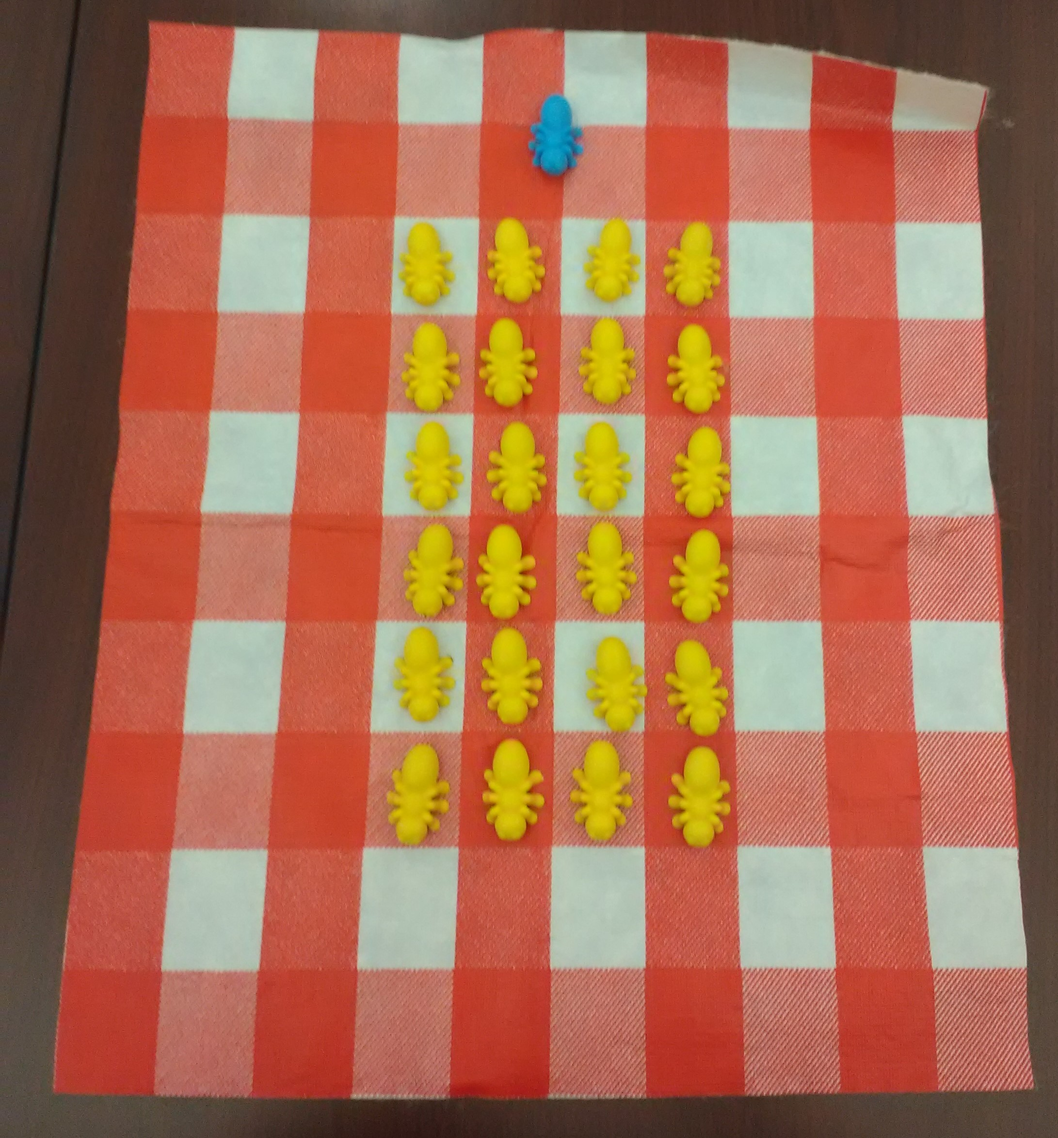
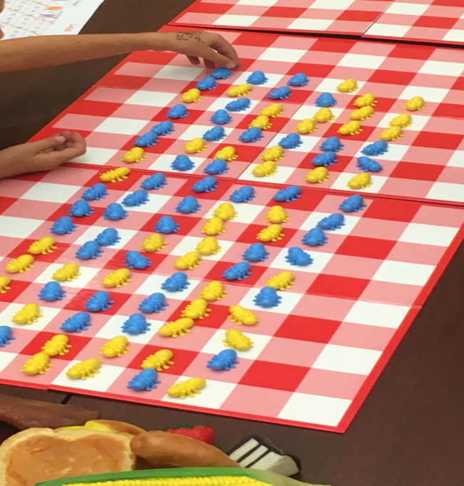
Lesson 6 & 7: student work

Slide 18

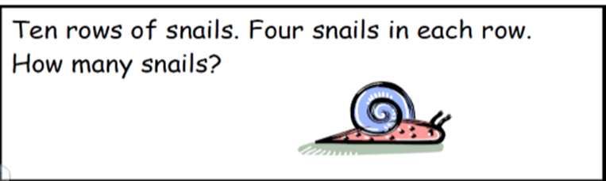
POSt-interview key tasks students’ work
Kasey’s Work
Notes:
Quickly highlight their performance on this in contrast to pre-interview

Slide 19
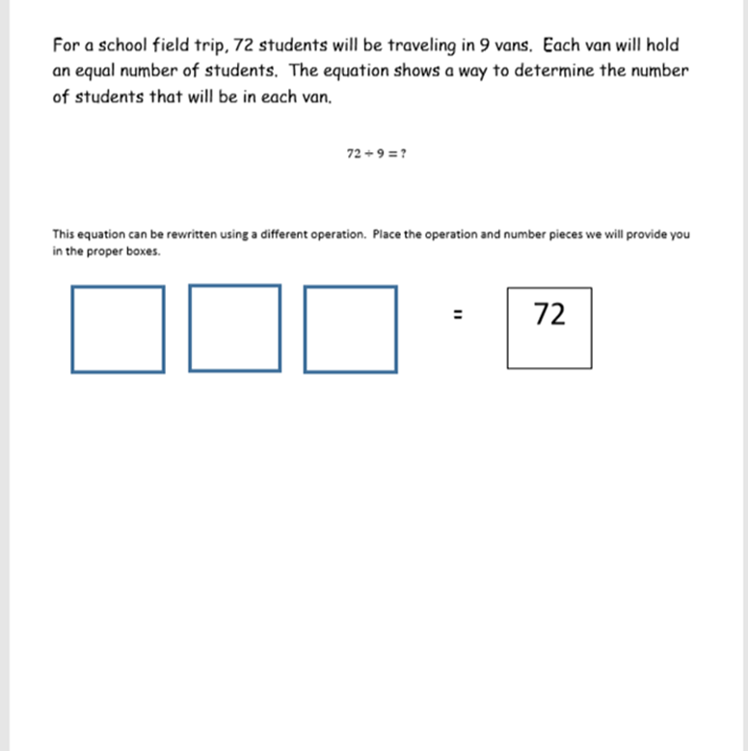
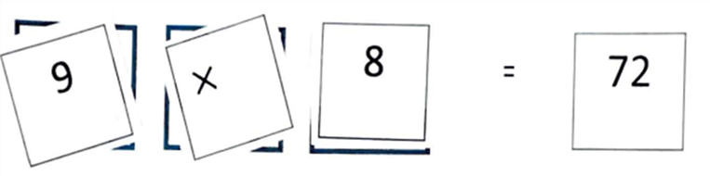
Post interview key tasks students’ work
Isaac’s Work
Notes:
Quickly highlight performance in contrast to pre-interview

Slide 20
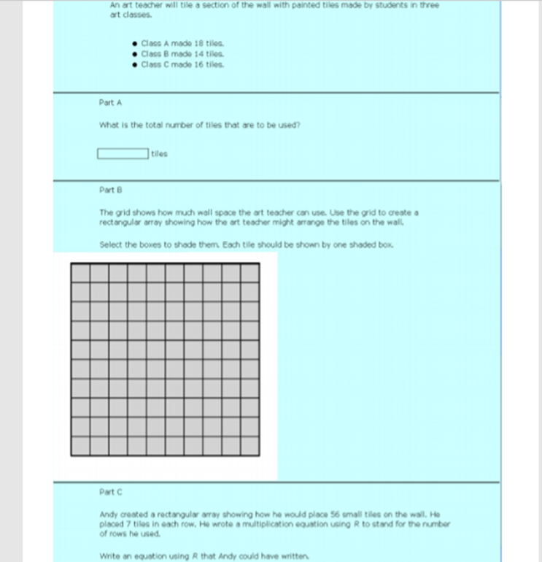
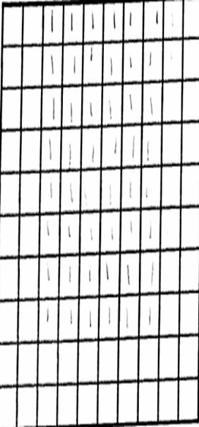
Post interview key tasks students’ work
Chloe’s Work
Notes:
Discuss how getting the sum correct hindered the two of them,….but that they could do part b with their incorrect numbers (?) Discuss the cool leap that Chloe made…her performance on this is amazing and shows how she learned to make connections between her isolated skills

Slide 21
Reflection:
During our study students demonstrated the abilities to skip count, construct rectangular arrays, and solve multiplication sentences.
Developing students’ conceptual understanding was a high priority because procedural understanding alone is fragile and insufficient for making sense of complex problems students will encounter in the future; we did so by prompting them to think about how skip counting, repeated addition, and areas of rectangular arrays are connected to multiplication.
We recommend that other teachers work to help students make these connections as well, incorporating communication with peers and allowing students to have creative flexibility with tasks, as modeled in our research results.
Notes:
Try to paraphrase these results….

Slide 22
references
Anghileri, J. (1989). An investigation of young children's understanding of multiplication. Educational Studies in Mathematics, 20(4), 367-385.
Common Core State Standards Initiative. (2010). Common core state standards for mathematics. Retrieved from http://www.corestandards.org/math
Confrey, J., Nguyen, K. H., Lee, K., Panorkou, N., Corley, A. K., & Maloney, A. P. (2012). TurnOnCCMath.net: Learning trajectories for the K-8 Common Core Math Standards. Retrieved from http://www.turnonccmath.net
National Council of Teachers of Mathematics. (2008). Curriculum focal points for Prekindergarten through Grade 8 mathematics: A quest for coherence. Reston, VA: NCTM
Sullivan, D.A., & McDuffie, A. R., (2009). Connecting multiplication to contexts and language. Teaching Children Mathematics, 15 (8), 502-510, 512
van de Walle, J.A., Karp, K.S., & Bay-Williams, J.M. (2013). Elementary and middle school mathematics: Teaching developmentally (8th ed.). New York: Pearson.
Whitin, P., & Whitin, D. (2008). Learning to solve problems in primary grades. Teaching Children Mathematics, 14(7), 426-432.

