Slide 1
An Exploration of Students’ Base- Ten Concepts
By: Emily Hawthorne & Britni Ilcuk
Mentor: Dr. Claudia Burgess

Slide 2
Introduction
Background: Research suggests that teachers must take multiple measures to promote students’ understanding of place value.
Goal: The goal of this research was to analyze the ways in which students engaged with and thought about place value content. We sought to design lessons that would move each student along his or her own unique individual learning trajectory to understanding place value.
Research Question: Research suggests that teachers must take multiple measures to promote students’ understanding of place value.

Slide 3
Theoretical Framework
Five Strands of Mathematical Proficiency
(Kilpatrick, Swafford, & Findell, 2001, p. 116)
Conceptual Understanding
Procedural Fluency
Skill in carrying out procedures flexibly, accurately, efficiently, and appropriately.
Strategic Competence
Ability to formulate, represent, and solve mathematical problems.
Adaptive Reasoning
Productive Disposition
Comprehension of mathematical concepts, operations, and relations.
Capacity for logical thought, reflection , explanation, and justification.
Habitual inclination to see mathematics as sensible, useful, and worthwhile, coupled with a belief in diligence and one’s own efficiency.

Slide 4
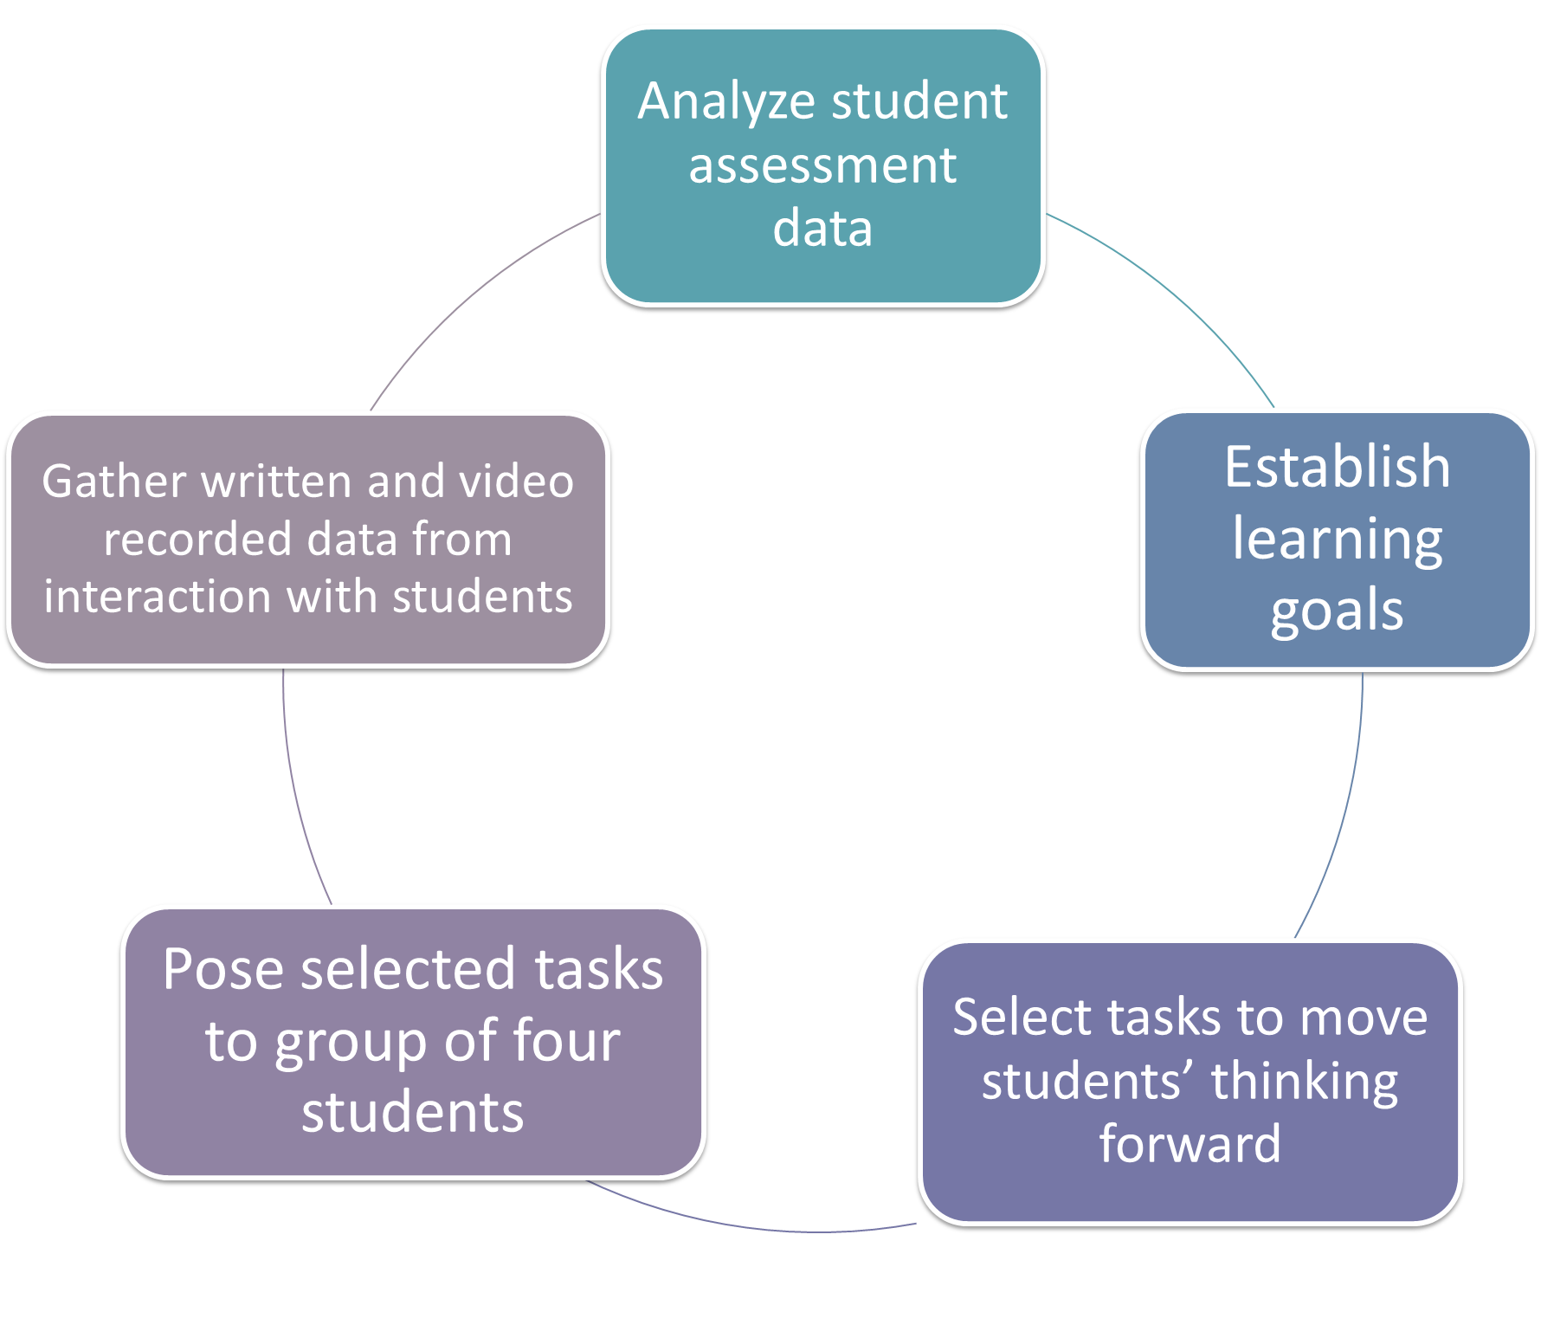

Methodology
Participants:
Four students- three male and one female
Student pseudonyms: Katie, Gavin, Michael, and Eli
Transitioning from Grade 3 to Grade 4
Each participated in a pre- and post- assessment interview (30 minutes each)
Three students participated in all sessions, one student missed one session

Slide 5
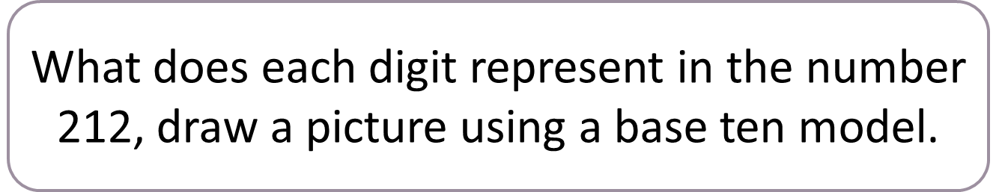
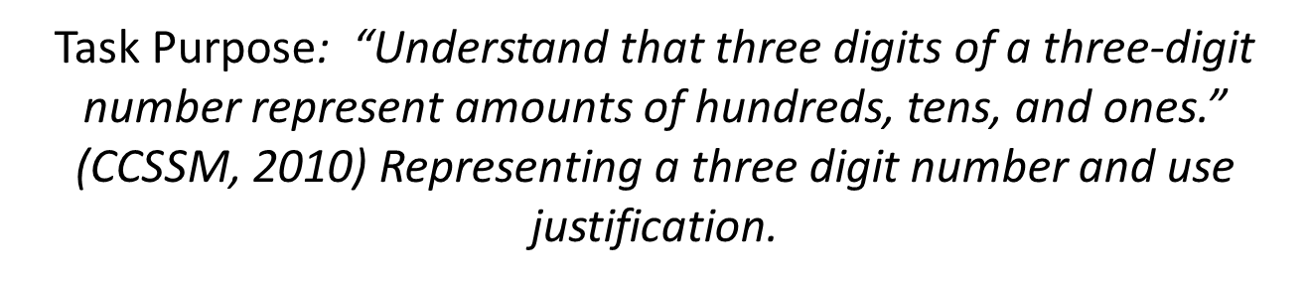
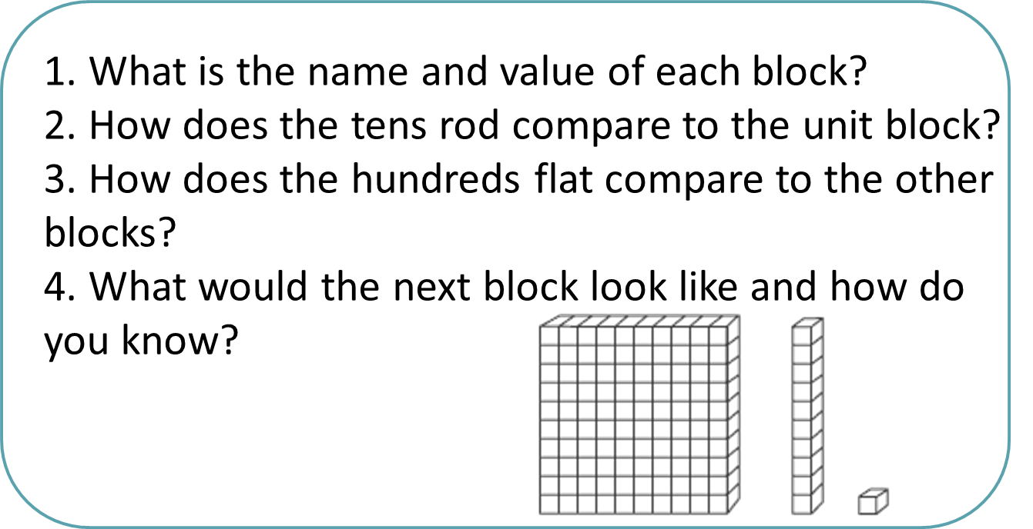
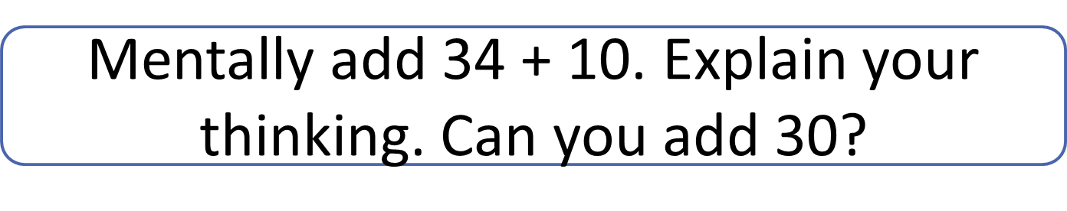
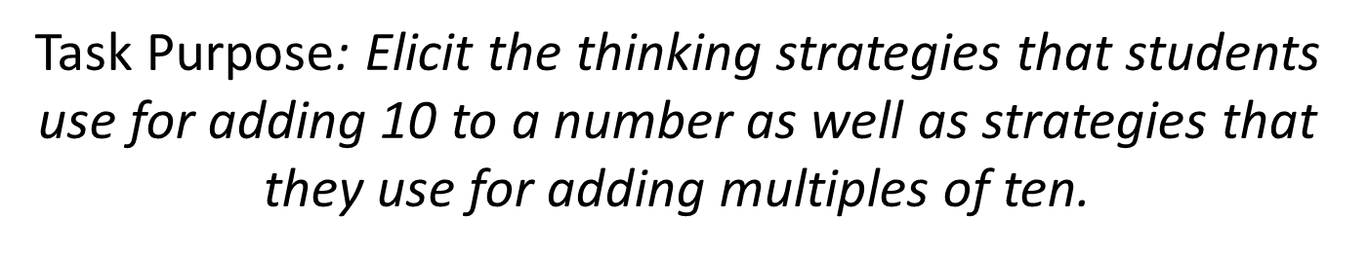
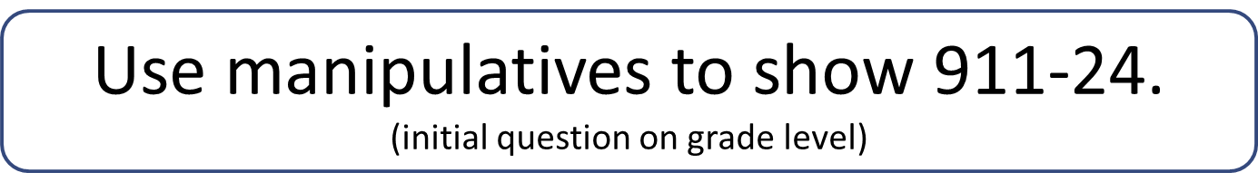
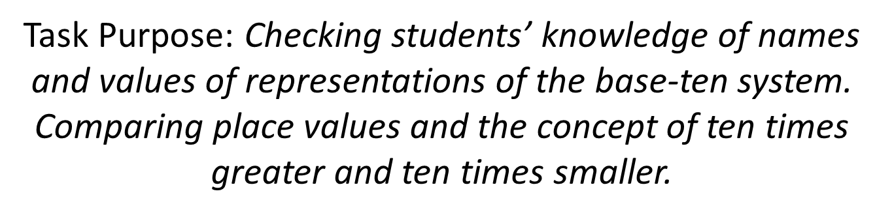
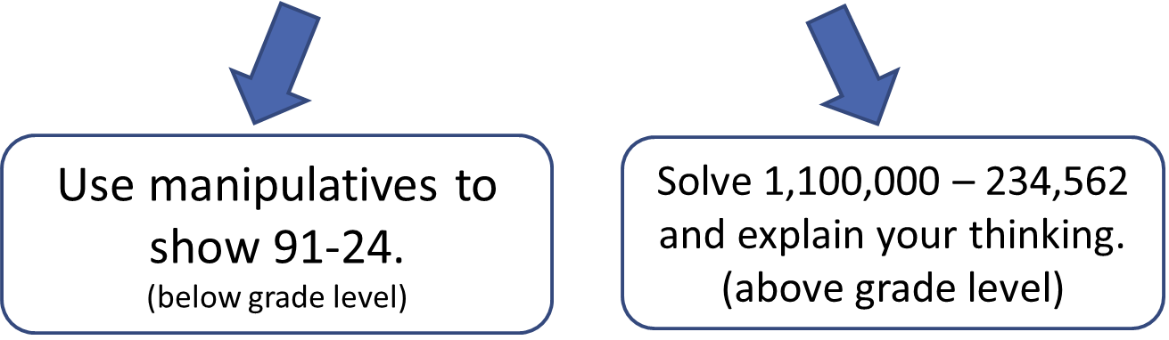
Methodology

Slide 6
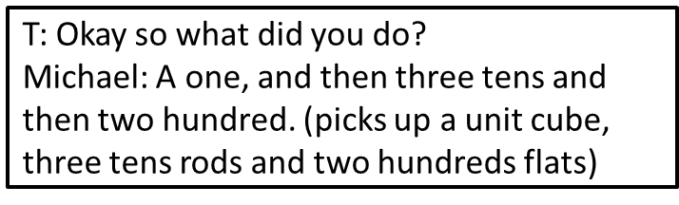
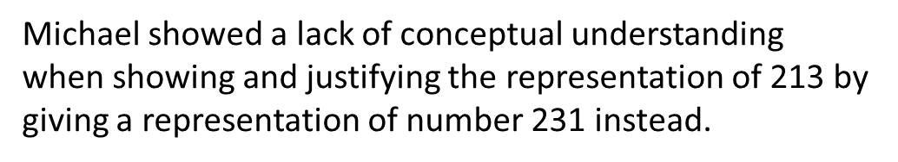
Initial Assessment Results
Students showed varying strengths in procedural fluency, but all lacked conceptual understanding to some degree.
Students performed traditional addition and subtraction algorithms correctly but were unable to explain their thinking with drawings or manipulatives.
For example:
Task: Use manipulative to show 213.

Slide 7
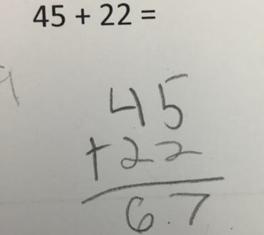
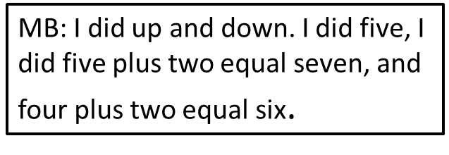
Initial Assessment Results
Task: Solve the following problem with an algorithm and explain your thinking.
Michael demonstrated strength in procedural fluency by correctly solving the standard algorithm.
In his explanation, he did not show a clear understanding of the value in the digit 4 in 40 and he digit 2 in 20.

Slide 8
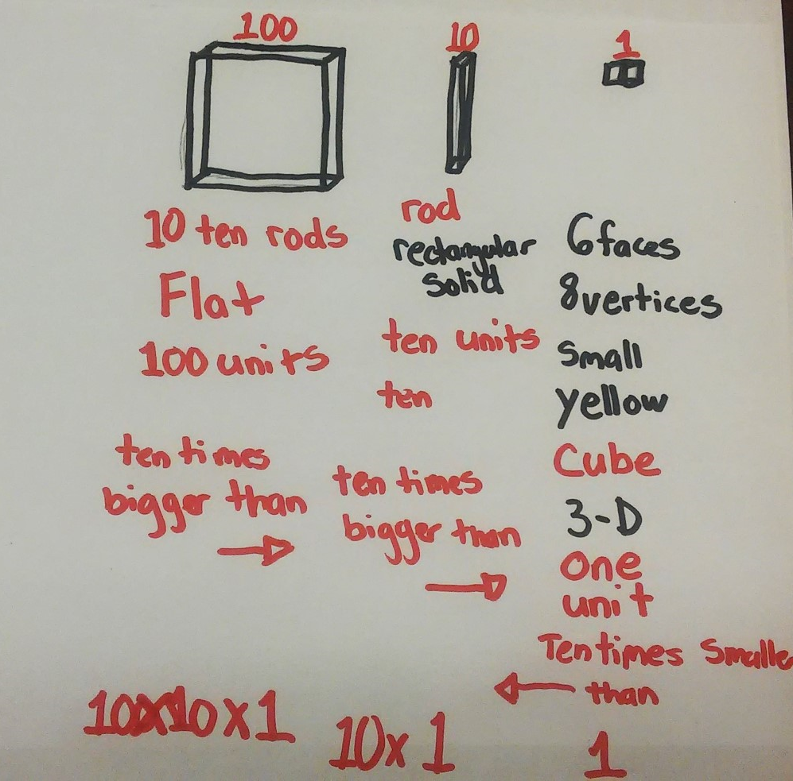
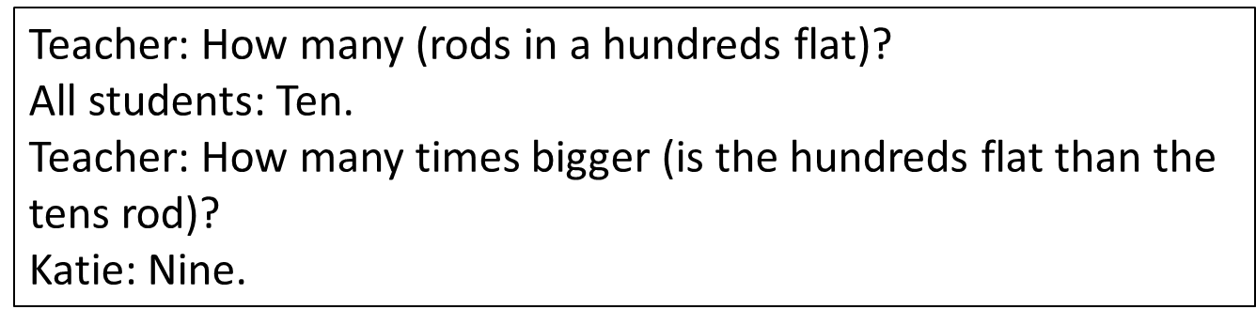
Base-Ten Representations- Cluster 1
Beginning lessons focused on students’ understandings of base-ten blocks. Students were asked to compare blocks, look for patterns, predict the next block and record these results on large chart paper in the correct place value order.
Students had trouble comparing different base 10 blocks to one another. Lack of understanding of “ten times greater” was a barrier, as shown in the dialog excerpt below:
Together students agreed that the hundreds flat was
nine times larger than the tens rod.

Slide 9
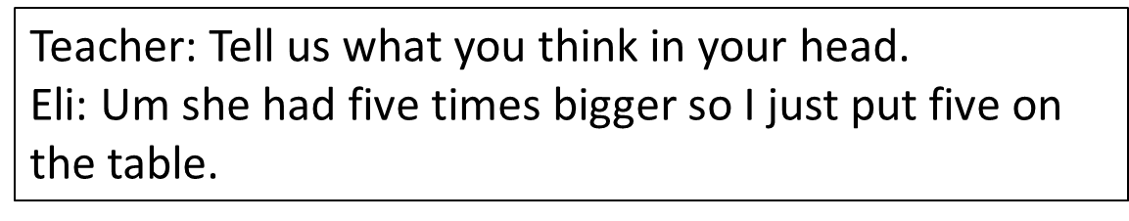
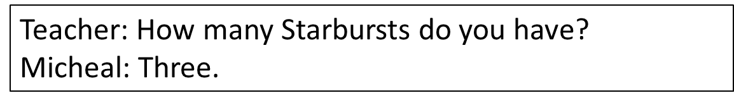
Multiplicative Comparison- Cluster 2
Task: Researchers placed one Starburst on the table and asked students to make it five times greater.
Students mimicked problems that only involved making one object an amount greater.
Task: Researchers put a pile of three Starbursts and asked students to make it four times greater

Slide 10
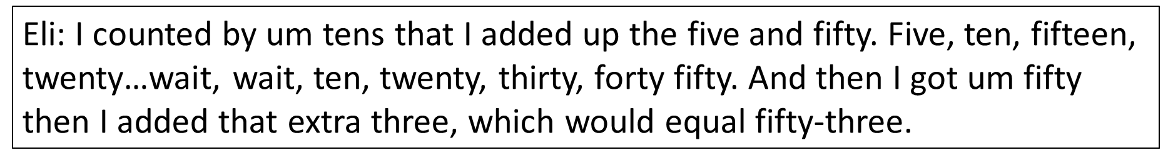
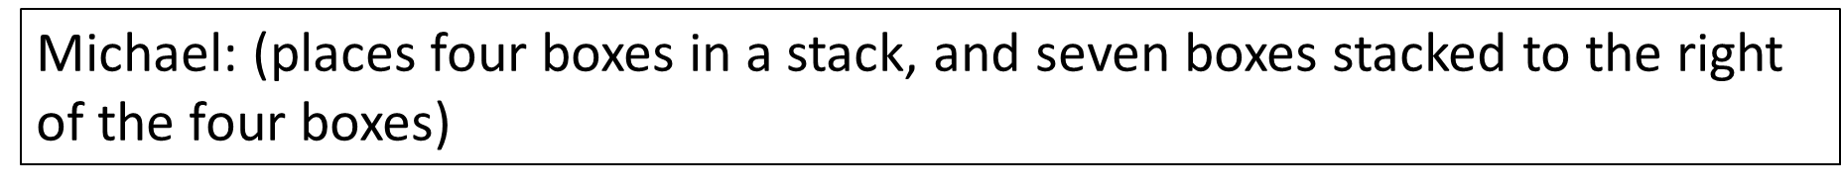
Grouping by Tens- Cluster 3
Students demonstrated memorization of procedures but did not show understanding of the tasks given, therefore these lessons were designed to focus on natural grouping by ten to discover place value.
Task: Donnie boxes his donuts in groups of ten. If Donnie has five full boxes and three leftover donuts, how many donuts does he have altogether?
Task: Represent forty-seven donuts in boxes and left overs.
Due to the varying levels of understanding and representations using groups of tens, researchers designed differentiated lessons involving combining numbers.

Slide 11
Grouping by Tens – Cluster 3
Examples of differentiated tasks:
Whole Group: Donnie has 47 donuts that he needs to package. How many boxes does Donnie need?
Eli: Donnie has 265 donuts and his friend Ellie has 596 donuts. They want to combine their donuts into one order.
Michael: Donnie has 5 blueberry donuts and his friend Ellie has 9 raspberry donuts. They want to combine their donuts into one order.

Slide 12
Post-Assessment Results
Eli: Showed understanding of patterns of ten within place value. During the post-assessment, Eli explained the patterns of ten times larger when moving to the left in place value.
Michael: Did not show improvement in conceptual understanding and place value as he continued to grasp for a memorized procedures such as skip counting and algorithms when solving problems. In last lessons, Michael proceeded to count boxes of donuts by tens, but also counted single donuts by tens.
Gavin: Showed improvement in representation of numbers and operations. Throughout the lessons, Gavin began to represent his thinking as well as operations using foam tens frames.
Katie: showed subtle improvements in procedural fluency as she could now add ten to a number without using an algorithm.

Slide 13
Reflection and Discussion
The most difficult standards to attain were those that involved conceptualizing numerical values and operations in the base-ten system.
Students should use representations to combine numbers in order to naturally group by tens before memorizing algorithms. When students have memorized procedures and have been taught to rely solely on algorithms, they lack the conceptual understanding of numbers and operations that is necessary for mathematical proficiency.
By conceptualizing and contextualizing quantities and grouping by ten, students see place value concepts as less abstract and build their conceptual understanding in the process.

