Slide 1
Developing 5th Graders’ Understanding of Fraction Multiplication
Researchers: David Bright & Kayla Davis
Mentor: Dr. Jathan Austin

Slide 2
Introduction
Wilson et al. (2011) stated “It is well documented that even in middle school students continue to struggle with concepts of rational numbers” (p.231).
In particular, students show difficulty in fraction multiplication.
Tsankova et al. (2010) stated "it has been found that students often have difficulties applying the algorithm with flexibility” (p.281).
Visual models were emphasized in this study to provide students with the opportunity to identify fraction multiplication as a conceptual relationship between rational numbers (Webel et al., 2016).

Slide 3
Purpose and Research Question
We aimed to design methods to build students’ conceptual understanding of fraction multiplication.
What are the characteristics of an instructional sequence that helps students understand fraction multiplication?

Slide 4
Theoretical Framework
Conceptual Understanding
Procedural Fluency
Strategic Competence
Adaptive Reasoning
Productive Disposition
ability to carry out procedures accurately, flexibly, efficiently and appropriately
ability to formulate, represent and solve mathematical problems
capacity for logical thought, reflection, explanation and justification
inclination to see mathematics as useful, sensible, and worthwhile, as well as belief in one’s ability
integrated and functional grasp of mathematical concepts which allows students to connect ideas
(Kirkpatrick et al., 2001.)

Slide 5
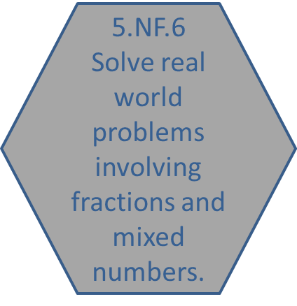

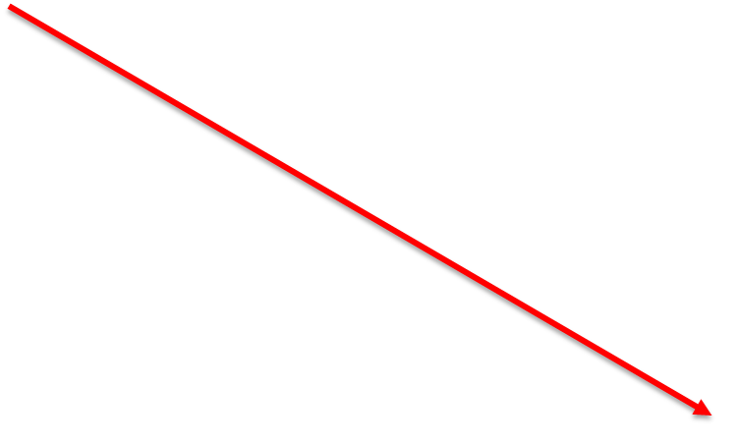
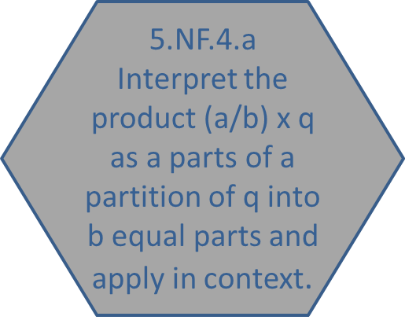
Learning Trajectory
(Confrey et al., 2012)

Slide 6
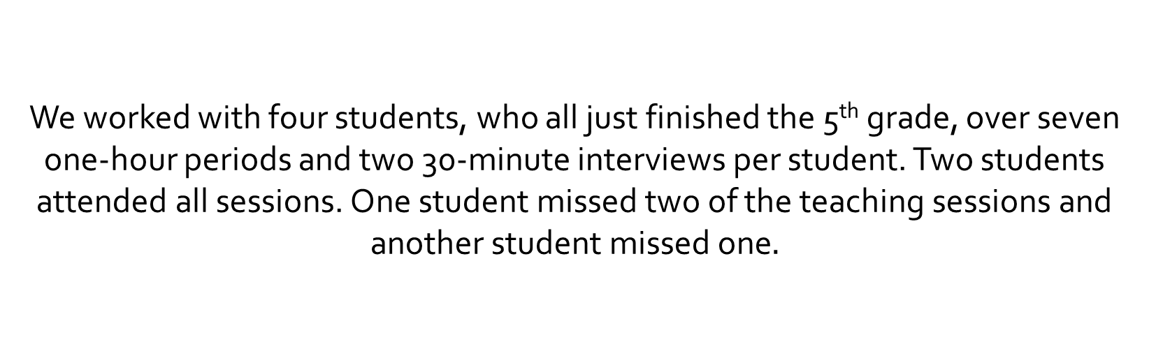
Methodology
We worked with four students, who all just finished the 5th grade, over seven one-hour periods and two 30-minute interviews per student. Two students attended all sessions. One student missed two of the teaching sessions and another student missed one$.$

Slide 7
Methodology
During the pre-interviews there were some problems that revealed the extremes of our students’ thinking.
They are as follows:

Slide 8
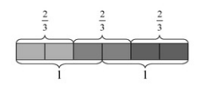
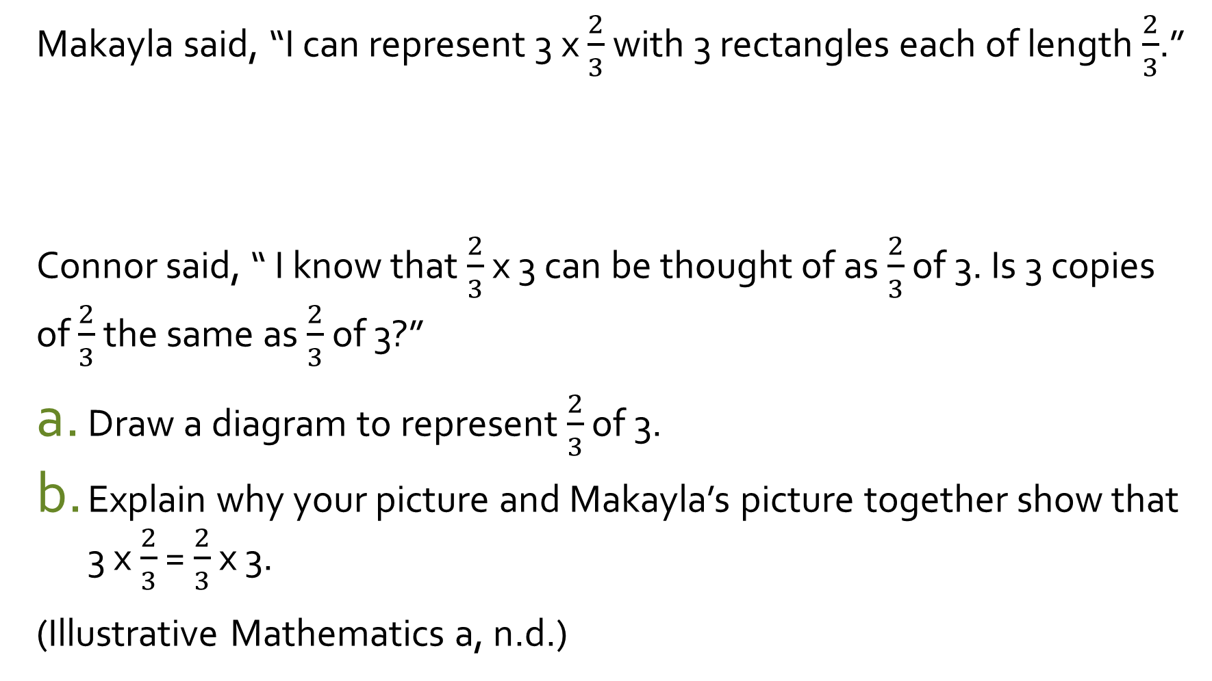
Makayla said, “I can represent 3 x $\frac{2}{3}$ with 3 rectangles each of length $\frac{2}{3}$.”
Connor said, “ I know that $\frac{2}{3}$ x 3 can be thought of as $\frac{2}{3}$ of 3. Is 3 copies of $\frac{2}{3}$ the same as $\frac{2}{3}$ of 3?”
Draw a diagram to represent $\frac{2}{3}$ of 3.
Explain why your picture and Makayla’s picture together show that 3 x $\frac{2}{3}$ = $\frac{2}{3}$ x 3.
(Illustrative Mathematics a, n.d.)

Slide 9
The members of a cross country team like to continue their training on their own during the summer. Nero ran 1 ½ miles one day.
Lily ran 3 times as far as Nero. How far did Lily run?
Jorge ran ¾ times as far a Nero. How far did Jorge run?
Belinda ran 2 1/3 times as far as Nero. How far did Belinda run?
(Illustrative Mathematics b, n.d.)

Slide 10
Procedure
Teach and audio/video record lesson
Transcribe audio and video
Analyze the transcript and make conjectures
Create lesson draft based on conjectures
Create formal lesson plan after critique
Practice lesson with mentors and fellow undergraduate researchers
Teach lesson to students
Repeat seven times

Slide 11
Instructional Cycle
Analyze students' assessments
Establish appropriate learning goals
Select tasks to develop students' thinking
Pose selected tasks to group of students
Gather written and recorded data from interaction with students

Slide 12
Initial Assessment Results
Most students initially struggled to use visual models to solve problems. They had less trouble with execution of procedures.

Slide 13
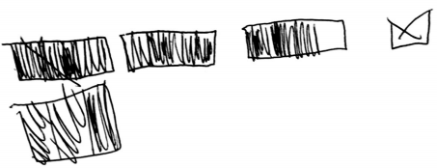
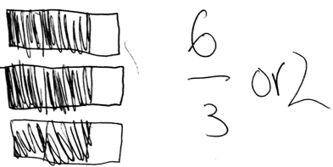
Initial Assessment Results: Student Work

Slide 14
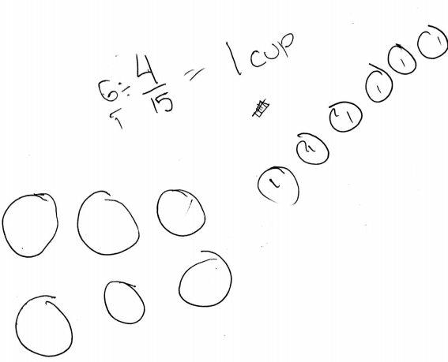
Initial Assessment Results: Student Work
T: So, For a certain brand of orange soda, each can contains 4/15 cup of sugar. Part a is how many cups of sugar are there in six cans of this orange soda.
S1: Hmmm. This is hard.
T: Yeah? What are you thinking about it?
S1: That you have to divide 4/15 into 6 cans.

Slide 15
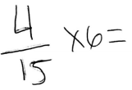


Initial Assessment Results: Student Work

Slide 16
Week 2 Instruction
For this week of instruction we decided to encourage the use of specific language, such as “groups of”, along with the use of drawing and pattern blocks. We introduced whole number times fraction number sentences and word problems that involved modeling repeated addition. Students’ work on the problems revealed their understanding of language and visual models, as exemplified in the classroom artifacts below.

Slide 17
T: Do you know how you can draw a picture of 3 x 5?
S2: Uh, three—uh not really a picture. I was going to say, you can do like fractions with it because 3/15 x 3/15.
T: Okay. What about you -------? Did you have a different answer?
S3: You can do can like circles—three circles with five in each circle.

Slide 18
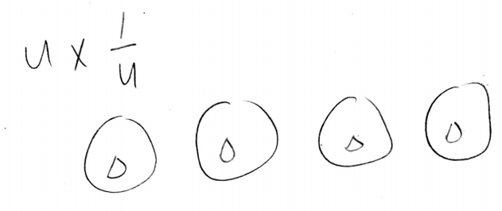


S2 Work
S3 Work

Slide 19
Week 3 – 5 Instruction
Students solved and modeled a series of word problems involving multiplication of fractions by whole numbers. Students were hesitant to use conceptual fraction models so we introduced a new modeling technique that forced the students to solve problems without using algorithms.

Slide 20



Slide 21
S1: *lays out 5 wholes and divides the rest with a pencil then cuts 3 wholes into fifths*
S2: *stares at all pieces*
S3: *divides every piece with pencil and then cuts every piece into fifths*

Slide 22
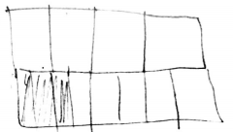

Slide 23
Week 6 – 8 Instruction
Due to students’ difficulty constructing models in the previous weeks, we decided to take a different approach that would introduce the students to different models. The instruction during the final three lessons would also give the students multiple opportunities to explain and describe the models in discussion.

Slide 24
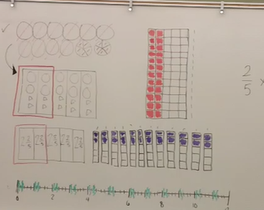
T: So what, after discussing these, what can we notice about our models in the middle there? Any similarities, any differences?
S4: They’re all representing one equation?
T: Are they?
S4: Yeah.
S3: That the number sentence is 2/5 times 12.

Slide 25
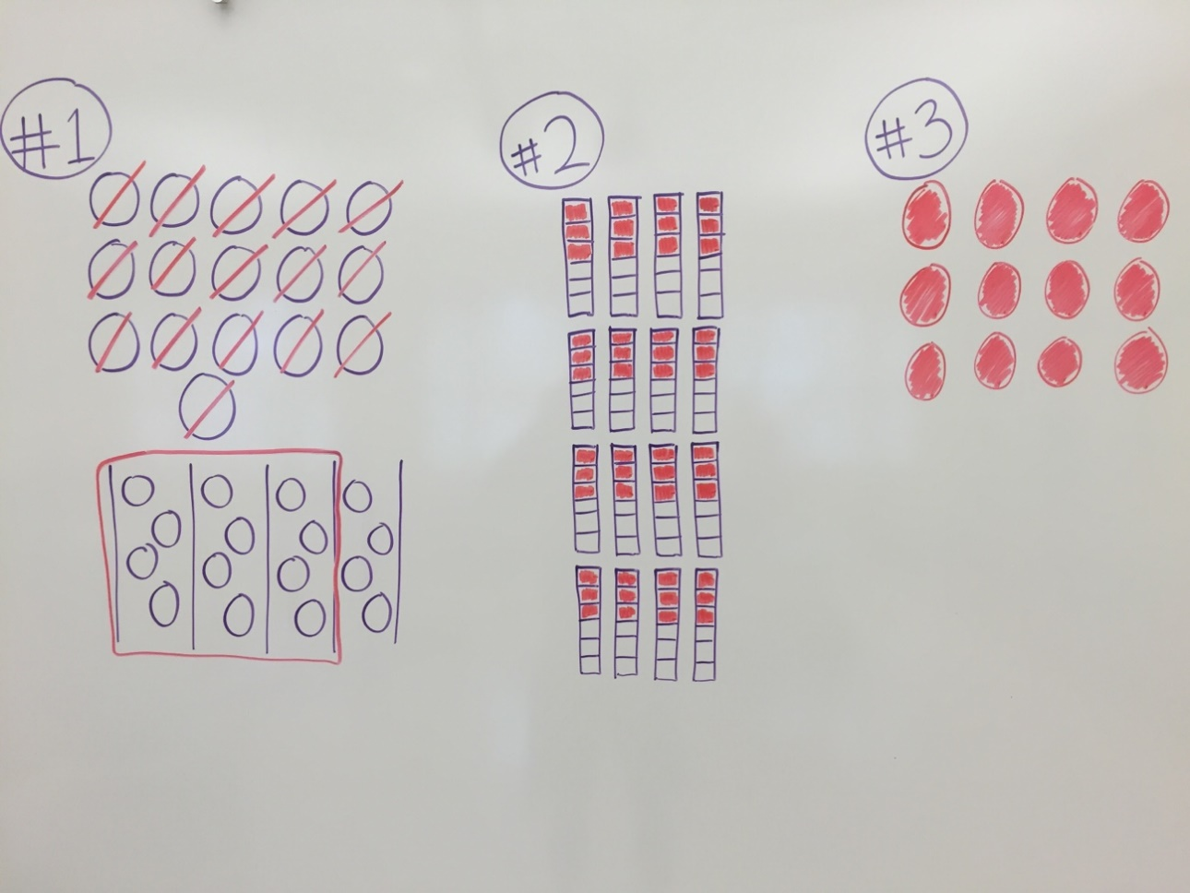
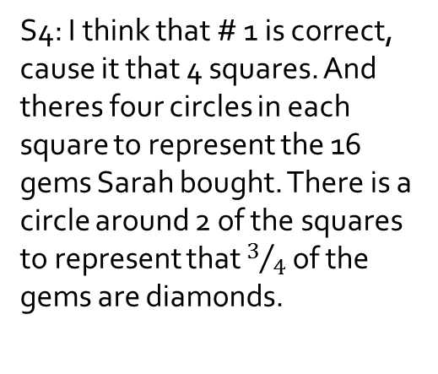
S4: I think that # 1 is correct, cause it that 4 squares. And theres four circles in each square to represent the 16 gems Sarah bought. There is a circle around 2 of the squares to represent that $3/4$ of the gems are diamonds.

Slide 26
Post-Assessment Results
By the end of the seven lessons, students showed improvement with not only creating models to go with number sentences but also creating stories to go with pre-made models.

Slide 27
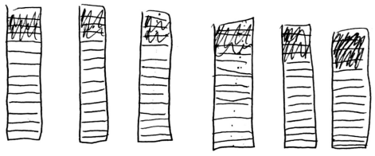

Slide 28
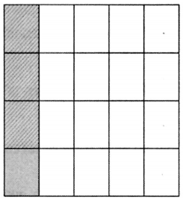
S2: Uh, this person got 4/20 of a car –
T: Of a car?
S2: Mhmm.
T: Okay *chuckles*
S2: Then he multiplied it by 5 and then he got the full car. Because that’s only what the insurance claimed.

Slide 29
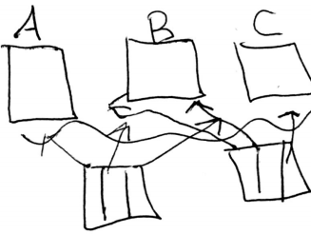

Slide 30
Reflection and Discussion
The standard in our learning progression that was most difficult to obtain was solving real world problems involving fractions and mixed numbers.
Students had difficulty creating appropriate models to coincide with the context of the word problems.
For example, when asked to show 2/3 of 3, their models initially depicted 3 groups of 2/3.
Students seem to benefit from having to explain their thoughts to the class step-by-step. Once they were put in the “teacher’s” position they generally realize any mistakes they may have made.
Data from our study also point to the conceptual difference between a fraction times a whole number versus a whole number times a fraction. This distinction needs explicit attention.
Future research might examine the potential benefits of teaching the case of a fraction times whole number first, in order to examine the impact of such an instructional sequence on students’ learning.

Slide 31
References
Confrey, J., Nguyen, K. H., Lee, K., Panorkou, N., Corley, A. K., & Maloney, A. P. (2012). TurnOnCCMath.net: Learning trajectories for the K-8 Common Core Math Standards. Retrieved from http://www.turnonccmath.net
Illustrative Mathematics a. (n.d.). 5.NF Connor and Makayla discuss multiplication. Retrieved from: https://www.illustrativemathematics.org/content-standards/5/NF/B/4/tasks/321
Illustrative Mathematics b. (n.d.). 5.NF Cross country training. Retrieved from: https://www.illustrativemathematics.org/contentstandards/5/NF/B/4/tasks/2080
Kilpatrick, J., Swafford, J., & Findell, B. (Eds.). (2001). Adding it up: Helping children learn mathematics. Washington, DC: National Academy Press.
Tsankova, J. K. & Pjanic, K. (2010). The area model of multiplication of fractions. Mathematics Teaching in the Middle School, 15(5), 281-285.
Webel, C., Krupa, E. & McManus, J. (2016). Using representations of fraction multiplication. Teaching Children Mathematics, 22(6), 366-373.
Wilson, P. H., Edgington, C. P., Nguyen, K. H., Pescosolido, R. C., Confrey, J. (2011). Fractions: How to share fair. Mathematics Teaching in the Middle School, 17(4), 231-236.

