Slide 1
Navigating CS Advice From a Senior Student

Slide 2
AGENDA
About me
Course advice
Career advice
Opportunities
Things to learn
Words to live by

Slide 3
Introduction
The purpose of this presentation is to reflect on my time here as a computer science student at Salisbury University and share the things I wish I had known when I started.

Slide 4
Freshman Year
Attended Brigham Young University and was studying Applied Mathematics
Courses taken
MATH 202 (Calculus 2)
MATH 306 (Linear Algebra)
MATH 210 (Discrete Mathematics)
MATH 310 (Calculus 3)
COSC 120 (Computer Science 1)
COSC 220 (Computer Science 2)
Interned that summer at a LED lighting called GreenerVolts, working with a low-code database platform called Filemaker Pro

Slide 6
Sophomore YEAR
Transferred to Salisbury University and changed my major to computer science
Worked as a lab assistant for COSC 118 (Scientific Programming)
Courses taken
COSC 386 (Databases)
COSC 320 (Advanced Algorithms)
COSC 362 (Theory of Computation)
COSC 425 (Software Engineering 1)
COSC 250 (Micro Computers)
January of my sophomore year I started working at a software company called Open Professional Group building data pipeline management software using PHP, MYSQL and a web framework called Laravel

Slide 7
Junior Year
Worked as a COSC department tutor
Courses taken
MATH 465 (Mathematical Models)
COSC 426 (Software Engineering 2)
COSC 350 (Systems Software)
COSC 330 (Object Oriented Programming)
Will continue to work at Open Professional Group through the end of May
Attended HenHacks, HoyaHacks, and HackUMBC
Interning at Booz Allen Hamilton this summer
Also received offers from
KBR
WGS Systems
Open Professional Group (return offer)
Tidal Health

Slide 8
Senior Year
Will graduate in December of 2024
Courses I will take
ART 312 (Web Design)
COSC 411 (Artificial Intelligence)
COSC 450 (Operating Systems)
Post Graduation Plans:
Would like to work in the intelligence industry and get my security clearance
Interested in backend software engineering

Slide 9
Advice About Courses

Slide 10
What Kinds of Course TO Take
Cross Discipline
Difficult Classes
Skills in programming combined with an overlapping specialty can have much greater impact than either one in isolation:
Computation Biology
Political Science Modeling
Language, Literature, and LLMs
Although it’s tempting to take the classes the are easy, or classes you are familiar with, you will grow much more if you take classes because they are hard and because you have little prior knowledge.

Slide 11
Tracks
Software Engineering
Cybersecurity
AI and Algorithms

Slide 12
Struggling in Classes?
Are you working hard?
Tips for Learning
The first thing to do is honestly ask yourself if you are working hard. This is not a major where you can show up to class, do the bare minimum and expect to learn.
Realistic course load?
Is this the the major for you?
Here are a few tips I have used over the years when I was struggling in a class
Use YouTube for an alternate explanation
Go to office hours (TA or professor)
Actually, read the textbook
Resist the urge to use ChatGPT or GitHub code

Slide 13
ChatGPT Tips
Ask for explanations nor answers
Don’t copy and past code, retype it
If you don’t understand the code, paste it back into ChatGPT to have it explain
Turn off copilot at least for the first few classes

Slide 14
Advice About Jobs/Internships

Slide 15
If you got a job via networking – you got a job because you knew someone
If you got a job via nepotism – you got a job because you knew someone

Slide 16
Networking VS. Nepotism
The Bush Family
Spanish Habsburgs
While George W. Bush, was certainly a qualified president, he likely would not have been able to secure the presidency without his father’s help
Fundraising from large donors
Connections with the leaders of the Republican Party
Campaign advice
Key endorsements
A dominant Catholic Empire in the 16th and 17th centuries
Ruled, Spain, Italy, and expansive American colonies
Great wealth from new world mines
As the empire matured, nepotism ran rampant, with unqualified family members appointed to key roles
This weakness of leadership led to the empire’s fall by the end of the 17th century

Slide 17
If you are competent, it’s called Networking. if you aren’t It’s called Nepotism

Slide 18
Networking 101
How to start
Types of things to ask them about
Ask parents, siblings, professors, family friends etc. if they know anyone who works in “IT”
Get their email and send a brief introduction
Ask if they would be willing to meet for coffee, lunch or over zoom
Don’t go hoping they’ll give you a job/internship, go because you genuinely want to learn more about the field and get advice
Bring your resume for them to review/give feedback on
Ask their advice about the industry
Listen to them tell the story of their career
Tell them about yourself and the classes you have taken
Do your homework

Slide 19
I networked to get my First Two Internships
GreenerVolts
Open Professional Group
Family friend who had known me since I was five, heard from my mom that I was interested in programming. His company had just fired a contractor who was working on their WMS and asked if I thought I’d be able to make some improvements.
Googled and emailed every software company I could find in Maryland. Most did not respond, but I was able to talk ~ 5 software engineers who gave advice and suggestions. I was offered an unpaid internship at one company and my paid internship at OPG without interviews because of those conversations.

Slide 20
Niche
It will be very hard to be the best applicant for every role, but it is much less hard to be the very best applicant for a specific type of role.
Python developer at a finance company
C developer at an aerospace company
Java Developer at a pharmaceutical company

Slide 21
What Makes a great side Project?
Non-trivial – should take months not days
Real use cases – show that you can make useable, useful software
Outside of class – show initiative and interest
Self motivated – build something that interests you, that is the only way to stay motivated to do numbers 1-3

Slide 22
Opportunities

Slide 23
There are More Opportunities than you Realize
REU Summer Research Program
CEO business competition
Research with a CS professor
Research with a non-CS professor
Open-source software
Get a job at an IT help desk (Geek Squad)
Build a non-trivial project that people will use
Attend a hackathon
Be a lab assistant or TA
Attend a Computer Science Symposium or Research Conference
Write technical blog articles or film programming tutorial videos
Robotics team (VEXU)

Slide 24
A word about Hackathons
What is a hackathon?
Why should I go?
When can I go?

Slide 25
Things to be Learning

Slide 26
Version Control
Git
Github
Branches

Slide 27
Typing
Touch typing
Keyboard shortcuts
Learn the shortcuts in your editor of choice (Vim, VsCode, etc.)

Slide 28
Communication
Public speaking
Emails/slack messages
Technical communication
Expand technical vocabulary

Slide 29
Terminal Skills
File navigation and manipulation
Installing packages/software
Simple bash
Searching/processing (grep, sed, awk)

Slide 30
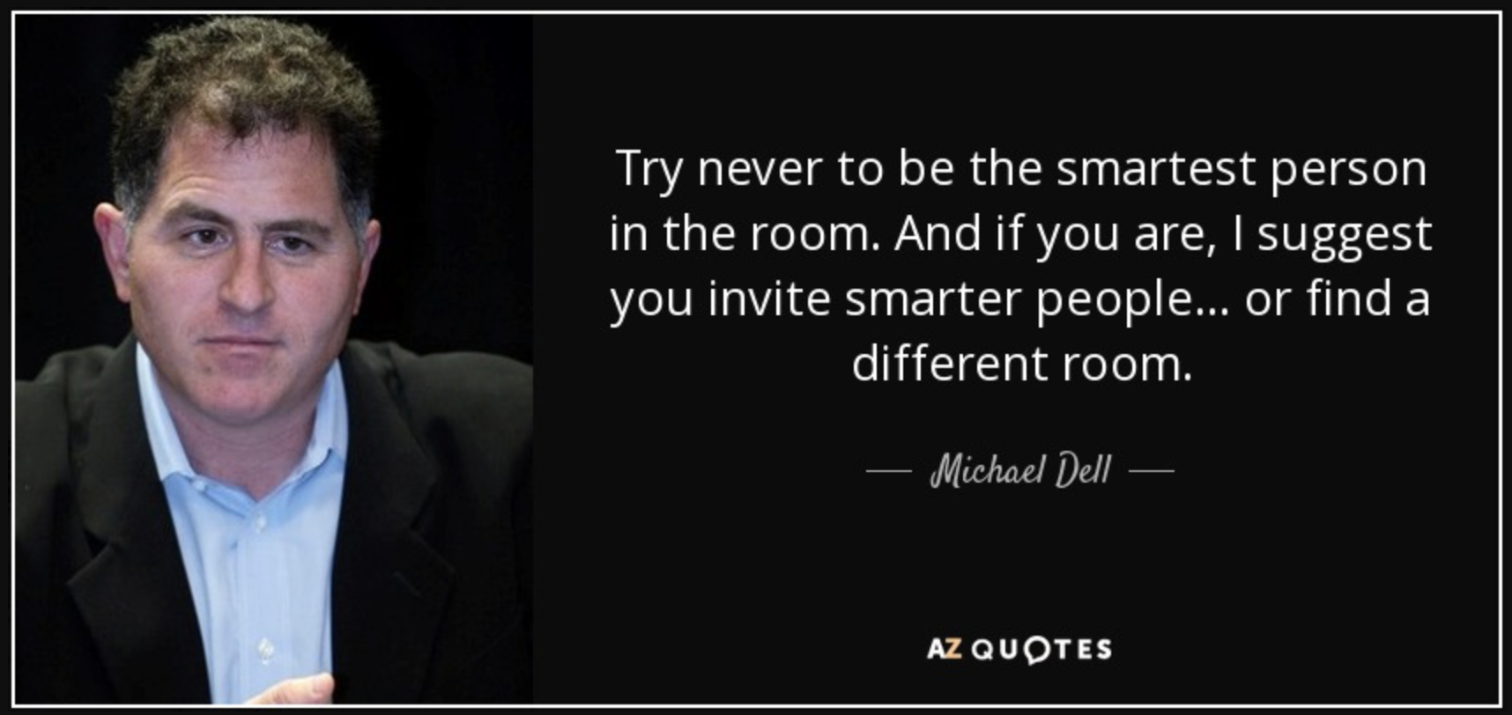
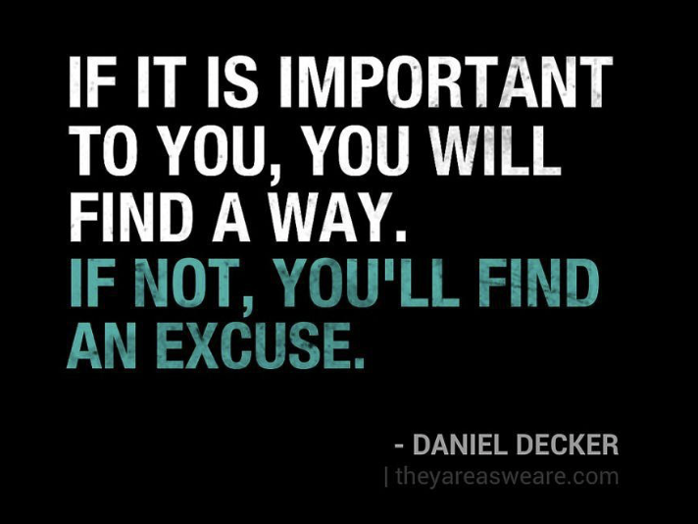
Words to live by

Slide 31
THANK YOU
Isaac Dugan
3-5pm Monday, 9-11 Wednesday
240-608-0905
isaacd4444@gmail.com
isaacdugan.space

