Slide 1
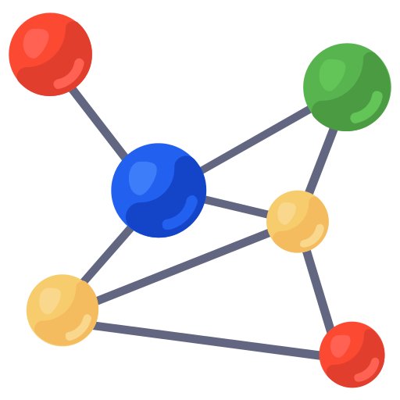
MIT IEEE URTC 2023
PCA-Based Efficient CNN Model Construction for
Salisbury University
ASL Recognition
Joshua Comfort
Dr. Shuangquan Wang
Dr. Xiaohong Wang

Slide 2
Problem Area
Approx. two million people in the U.S. communicate using American Sign Language (ASL).
There exists a gap between those who use the language and those who do not.
There is a need for a non-invasive translation solution to close to this gap.
American Sign Language (ASL)

Slide 3
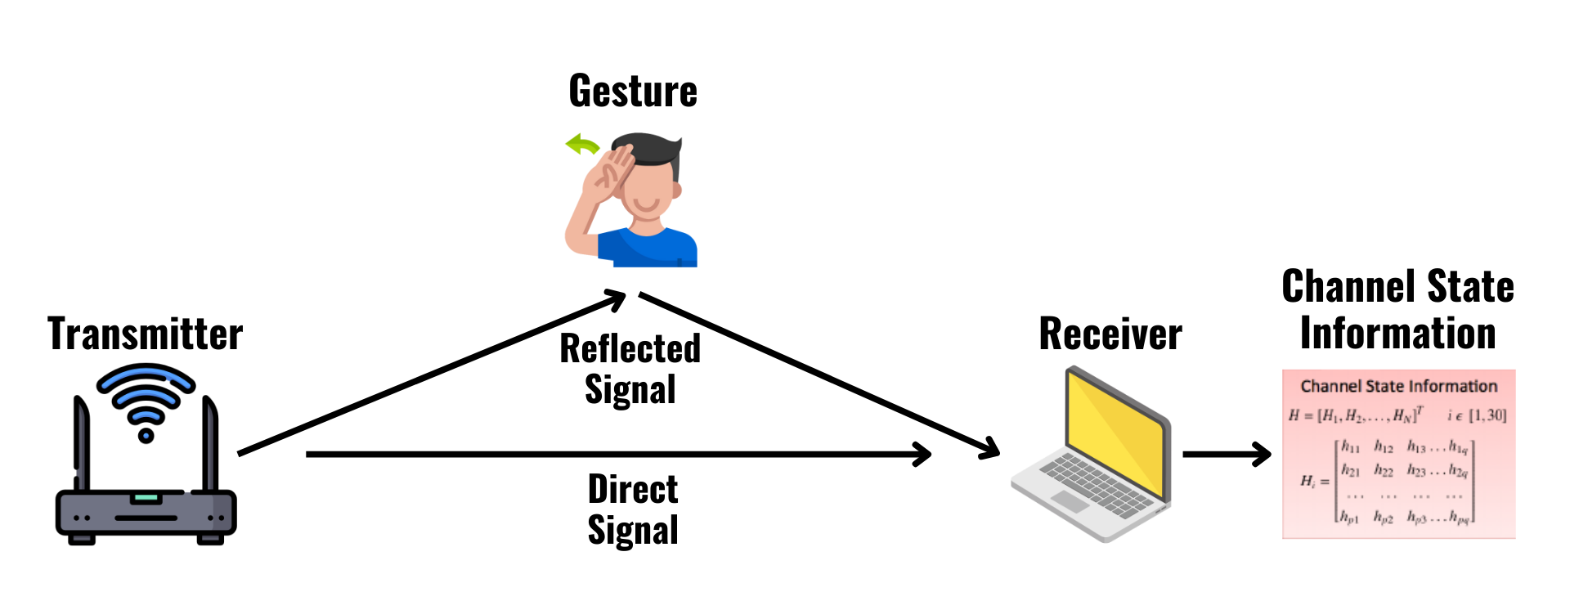
Previous
Research
Research done by Ma et al. in their “SignFi” paper, explores such possibilities [3].
Utilizing signals emitted by wireless devices, they collect Channel State Information (CSI).
This information captures the dynamic environment in which it was taken.
Using a CNN modal they are able to accurately classify 276 unique gestures.
Information describing the gesture is captured in the CSI.
Figure created using icons from [4], [5], [6], [7]

Slide 4
Challenges
In order to adapt to new environments, the CNN must be trained on new data.
Retraining the deep network model on a new environment/user has a high computational cost.
A considerable amount of the CSI data is noise and redundant information.
Can we eliminate this noise and redundant information to reduce the time cost of model retraining?
Noise and redundant information in CSI data increases training times.
Figure created using icons from [9], [10], [11]

Slide 5
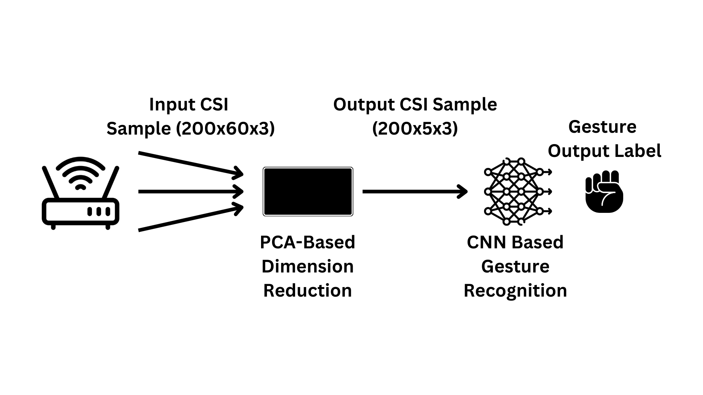
Design Philosophy & Solution
Instead of designing a general recognition model for all users, we focus on a personalized model with high performance.
Utilizing Principal Component Analysis (PCA) we reduce the dimensionality of the CSI to eliminate noise and redundant information.
This greatly decreases the training cost and maintains high accuracy for a single user.
In addition, we designed a new CNN model that specializes in classifying reduced dimension CSI.

Slide 6
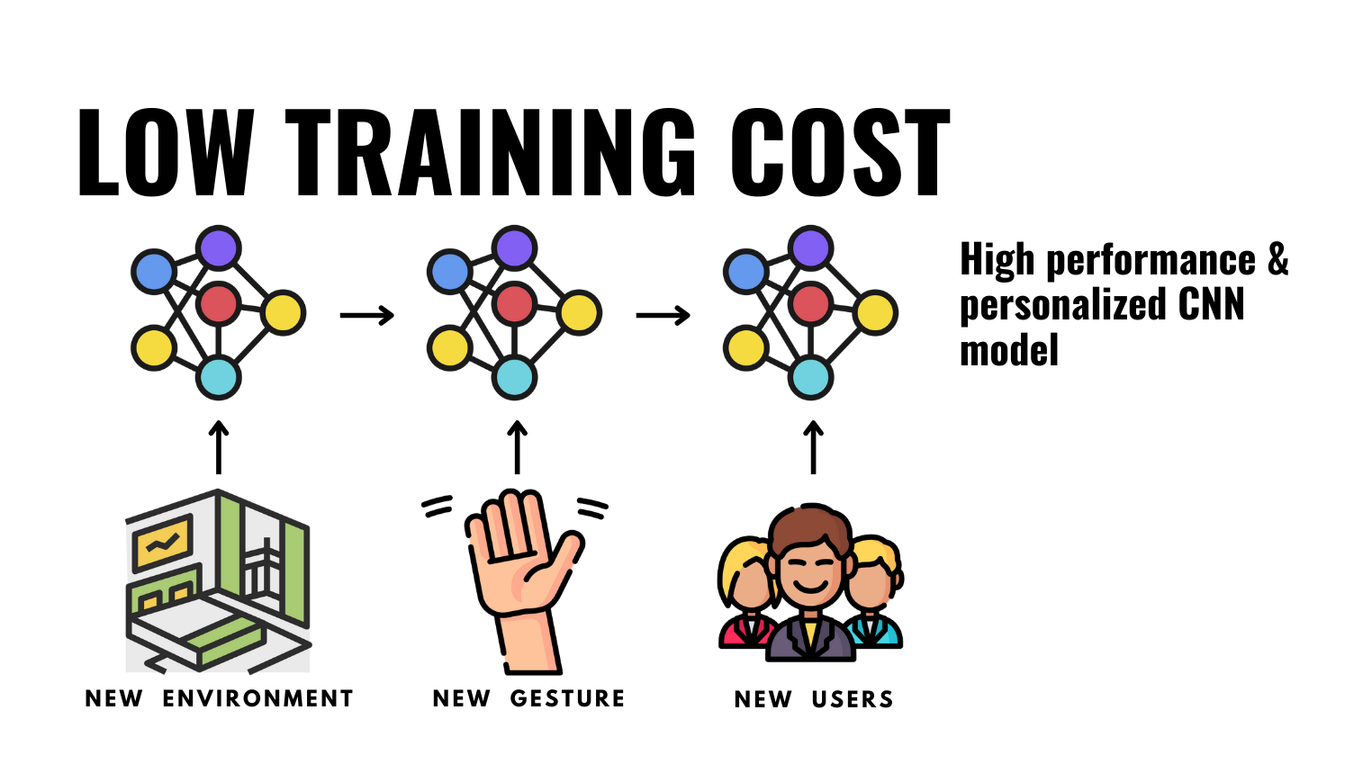
Our Results
The average model training time went from 40.6 seconds to just 17.6 seconds with our new solution.
We maintained a high classification accuracy, 98.10% when compared to the original’s 99.42% [3].
The proposed solution allows for adaptable and personalized ASL recognition.
Figure created using icons from [12], [13], [14]

Slide 7
References
Thank You!
Questions?
[1] “Help free icons designed by Surang,” Flaticon, https://www.flaticon.com/free-icon/help_5849217?related_id=5849230&amp;origin=search (accessed Sep. 22, 2023).
[2] “Mesh free icons designed by smashingstocks,” Flaticon, https://www.flaticon.com/free-icon/mesh_6994454?term=neural%2Bnetwork&amp;page=1&amp;position=85&amp;origin=search&amp;related_id=6994454 (accessed Sep. 22, 2023).
[3] Y. Ma, G. Zhou, S. Wang, H. Zhao, and W. Jung, “Signfi,” Proceedings of the ACM on Interactive, Mobile, Wearable and Ubiquitous Technologies, vol. 2, no. 1, pp. 1–21, 2018. doi:10.1145/3191755
[4] “WIFI Free Icons designed by Freepik,” Flaticon, https://www.flaticon.com/free-icon/wifi_1183606?term=wifi%2Brouter&amp;page=1&amp;position=7&amp;origin=search&amp;related_id=1183606 (accessed Sep. 23, 2023).
[5] “Laptop Screen Free Icons designed by vectorsmarket15,” Flaticon, https://www.flaticon.com/free-icon/laptop-screen_2888701?term=laptop&amp;page=1&amp;position=17&amp;origin=search&amp;related_id=2888701 (accessed Sep. 23, 2023).
[6] Https://www.researchgate.net/figure/fig3_258088835, https://www.researchgate.net/figure/https-wwwresearchgatenet-figure-fig3-258088835_fig3_258088835 (accessed Sep. 25, 2023).
[7] “Hello free icons designed by Surang,” Flaticon, https://www.flaticon.com/free-icon/hello_5849201?term=sign%2Blanguage&amp;page=1&amp;position=19&amp;origin=search&amp;related_id=5849201 (accessed Sep. 23, 2023).
[8] “Schedule free icons designed by Freepik,” Flaticon, https://www.flaticon.com/free-icon/schedule_3652191?term=time&amp;page=1&amp;position=25&amp;origin=search&amp;related_id=3652191 (accessed Sep. 24, 2023).
[9] “Matrix free icons designed by mayor icons,” Flaticon, https://www.flaticon.com/free-icon/matrix_8801256?term=matrix&amp;page=1&amp;position=35&amp;origin=search&amp;related_id=8801256 (accessed Sep. 24, 2023).
[10] “Neural free icons designed by Becris,” Flaticon, https://www.flaticon.com/free-icon/neural_2103658?term=neural%2Bnetwork&amp;page=1&amp;position=10&amp;origin=search&amp;related_id=2103658 (accessed Sep. 24, 2023).
[11]“Man free icons designed by Freepik,” Flaticon. https://www.flaticon.com/free-icon/man_1165725?term=user&page=1&position=85&origin=tag&related_id=1165725 (accessed Sep. 24, 2023).
[12] “Room free icons designed by Becris,” Flaticon, https://www.flaticon.com/free-icon/room_489405?term=room&amp;page=1&amp;position=19&amp;origin=search&amp;related_id=489405 (accessed Sep. 24, 2023).
[13] “Hands free icons designed by Freepik,” Flaticon, https://www.flaticon.com/free-icon/hands_3256400?term=gestures&amp;page=1&amp;position=16&amp;origin=search&amp;related_id=3256400 (accessed Sep. 24, 2023).
[14] “Introduction to american sign language,” Geneva Public Library Event, https://gpld.org/event/7439174 (accessed Sep. 24, 2023).
Credits: This presentation template was created by Slidesgo, and includes icons by Flaticon, and infographics & images by Freepik.

