Slide 1
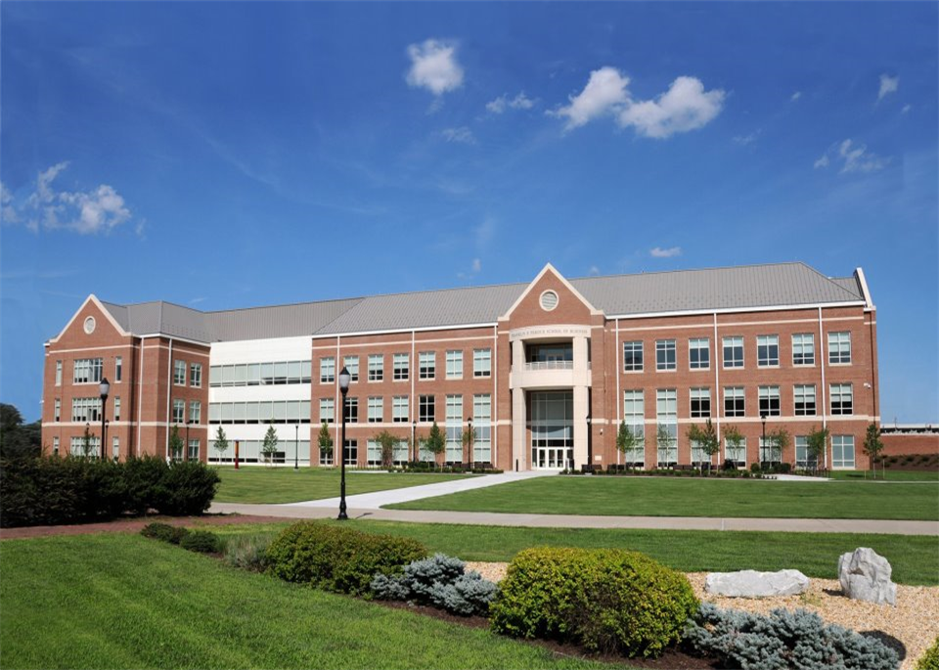
THE Meeting
BUAD 200 Requirement
Three Sessions:
Opening, Breakout, Resource

Slide 2
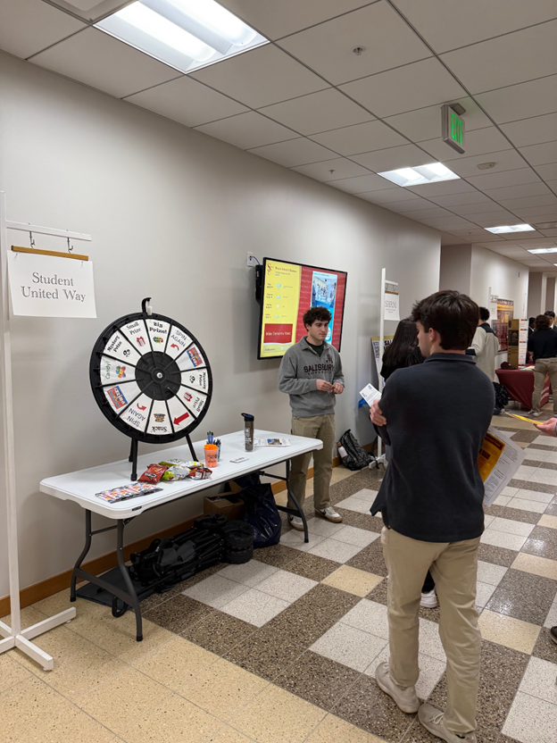
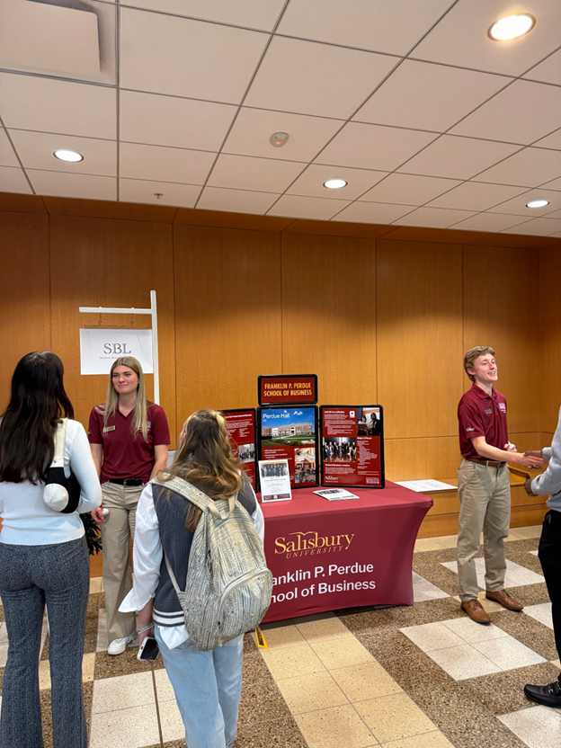
THE Meeting is a modeled after a business conference that allows students the opportunity to learn more about the process to:
Transition from pre-professional to professional
Hear from faculty from their major
Engage with other departments and students
T.H.E.
MEETING

Slide 3
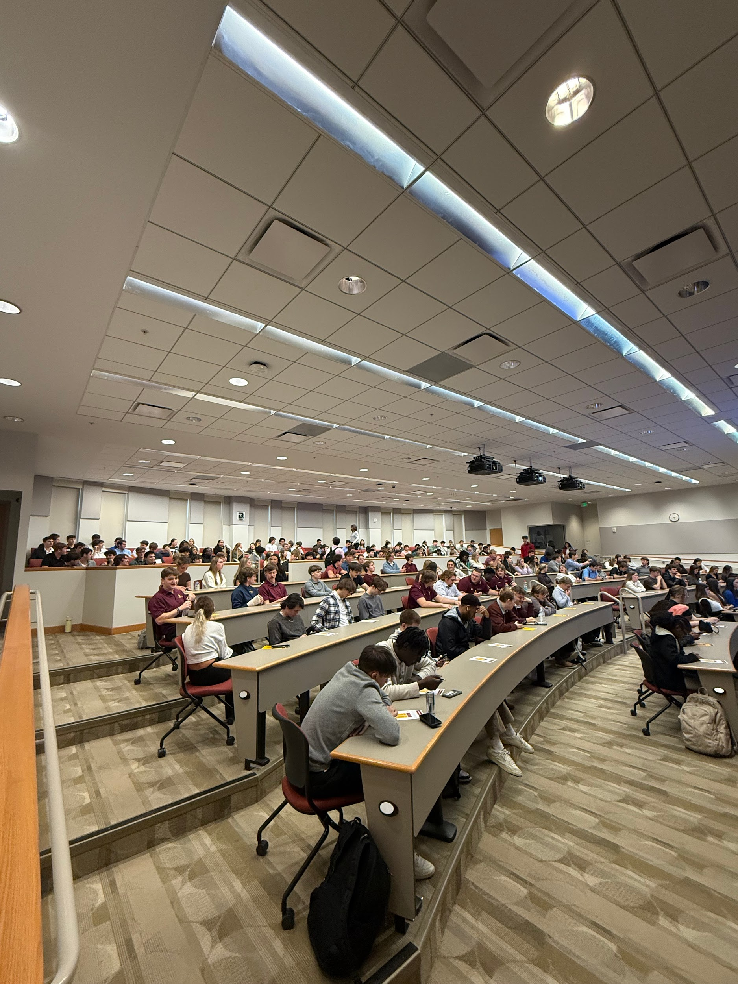
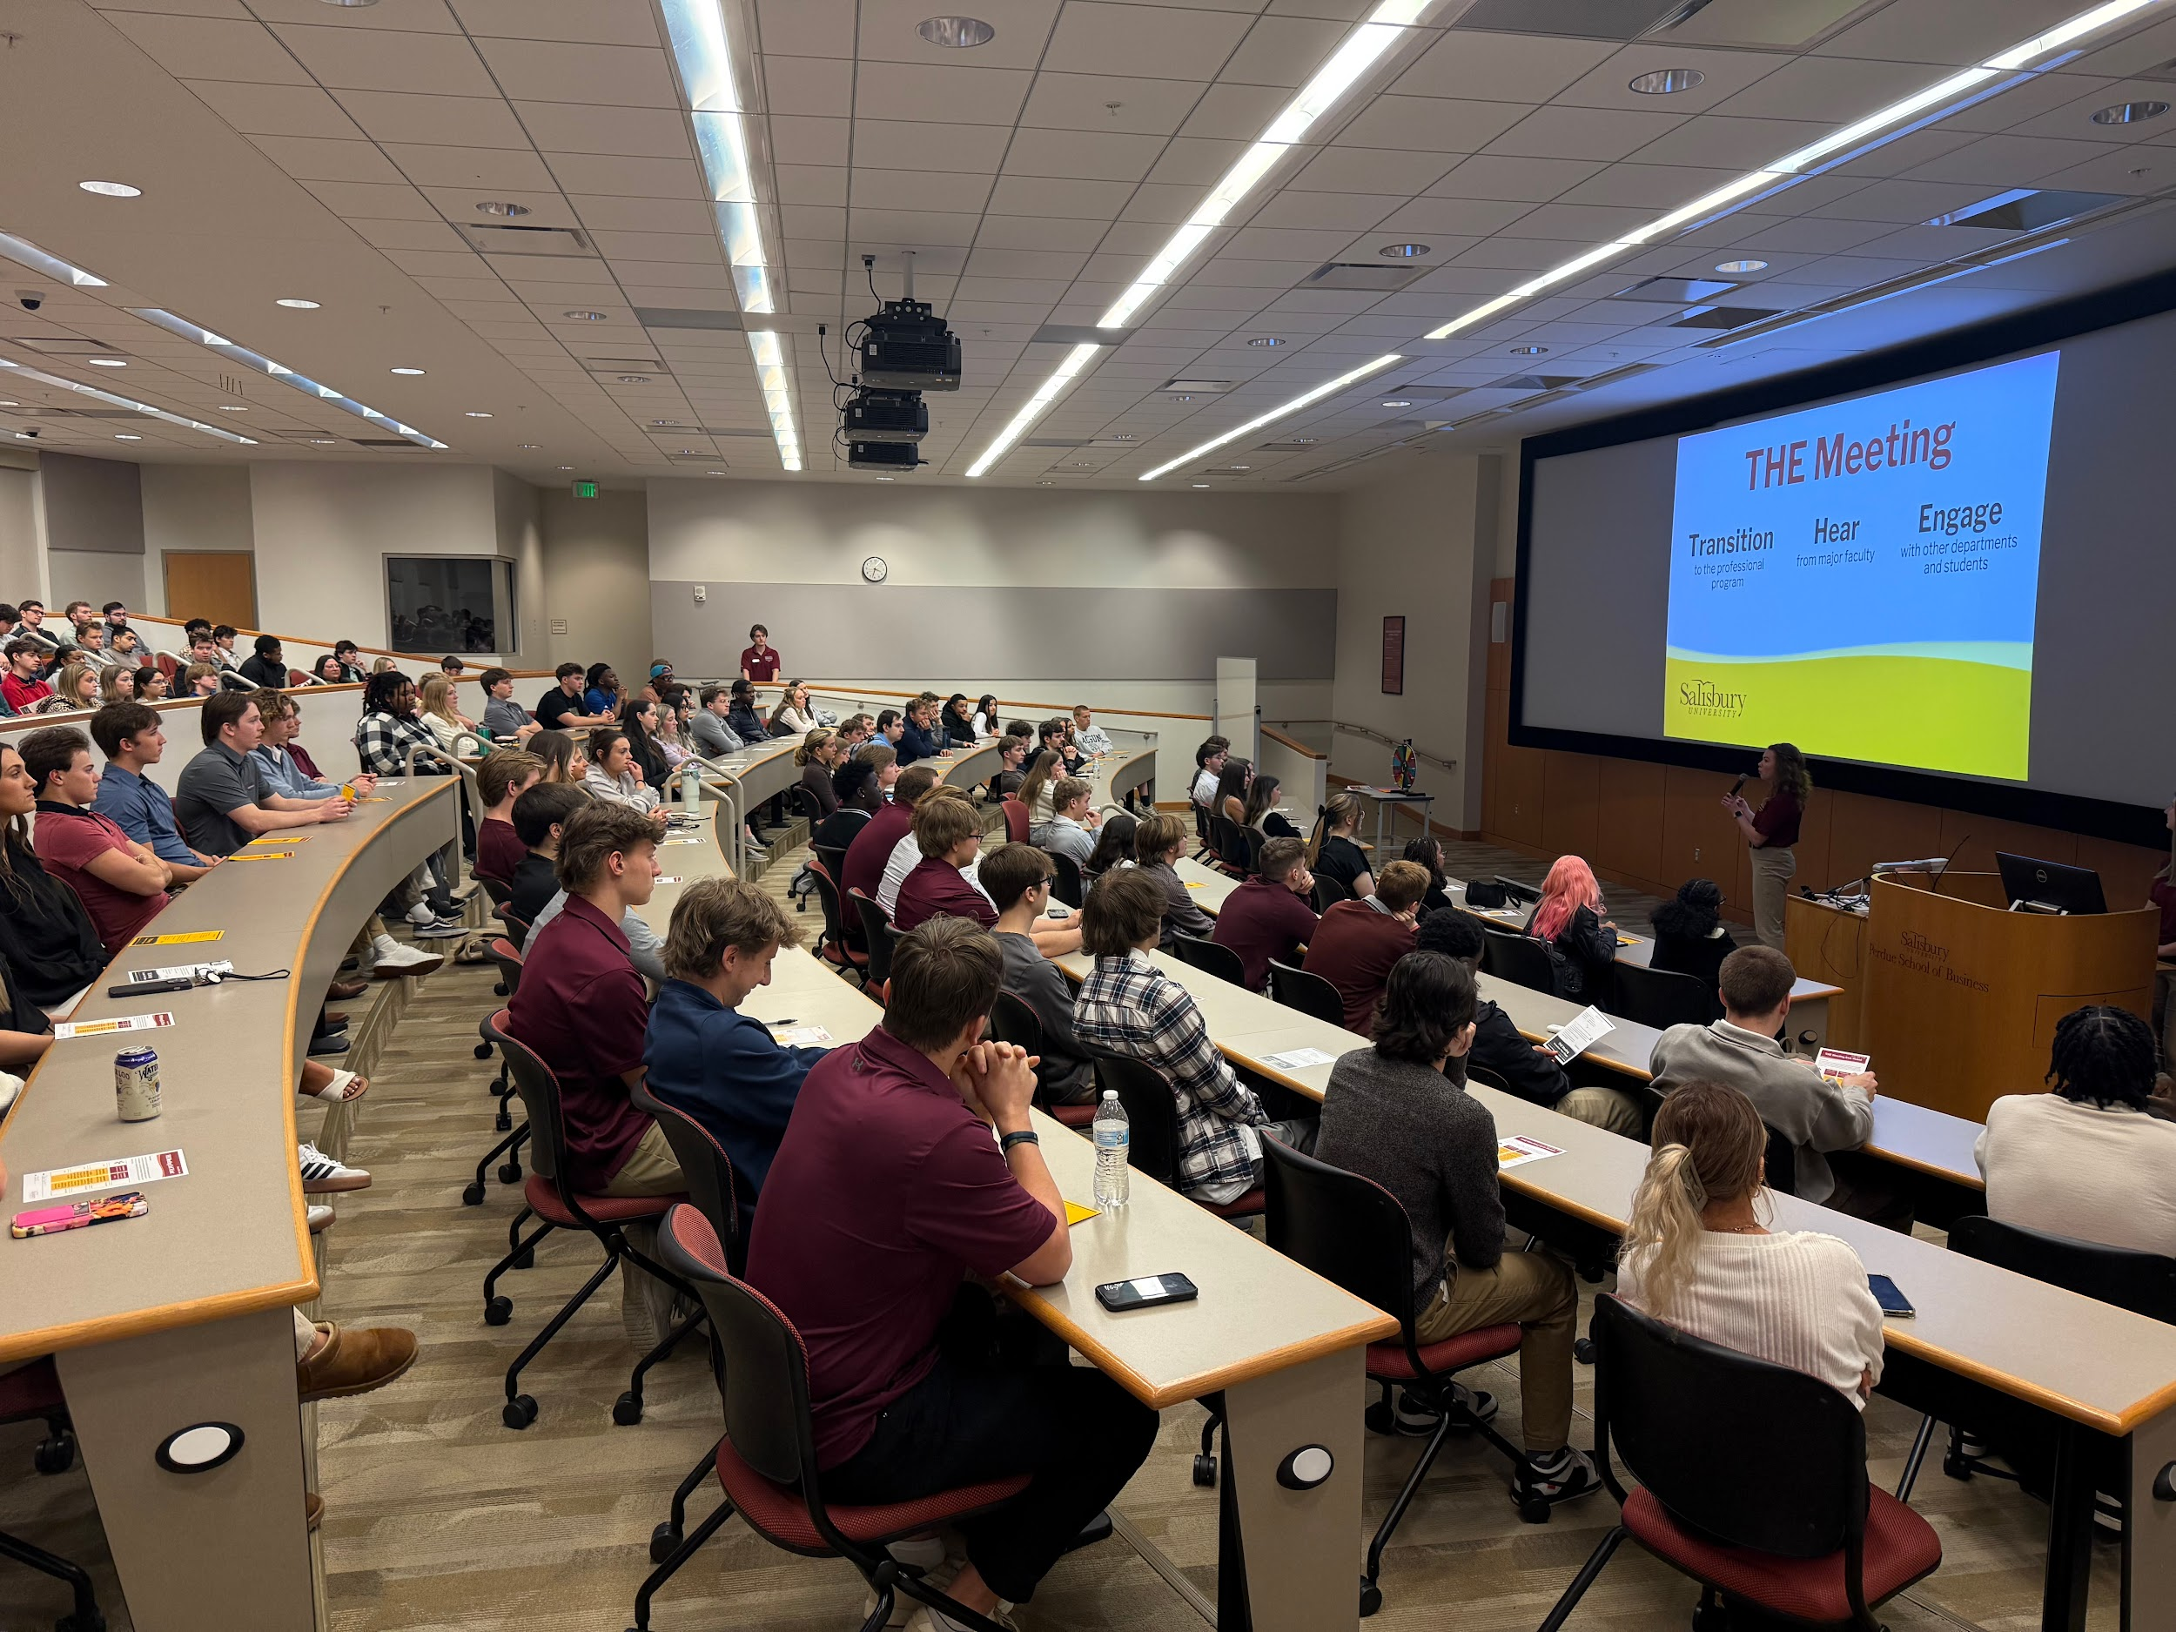
Opening Session
Student Business Leaders explain what THE Meeting is about.
They also share their experience with the programs and campus involvement.

Slide 4
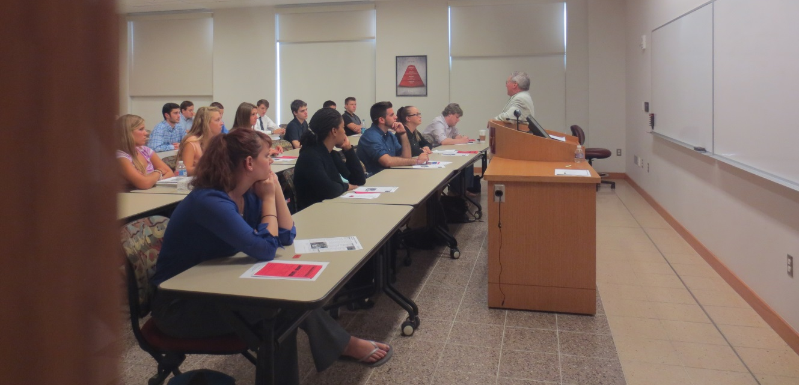
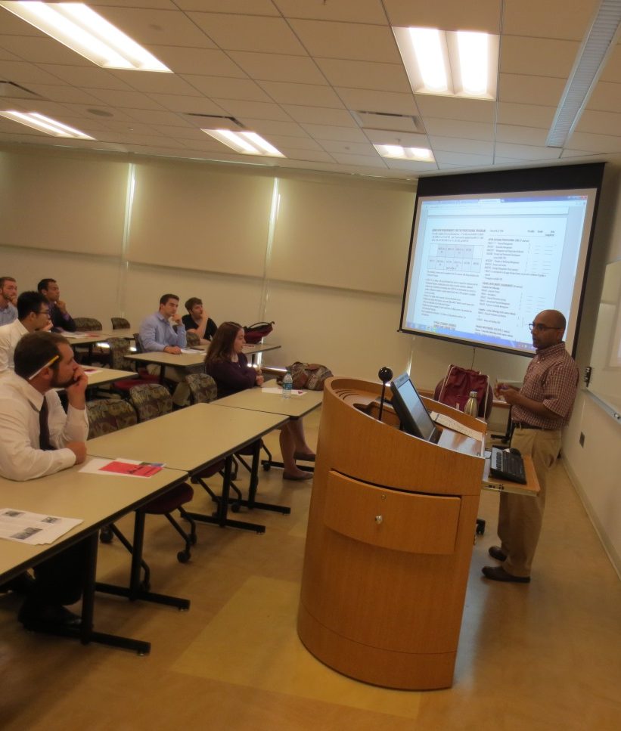
Breakout Session
Breakout sessions allow students to meet professors from their major and learn about the different courses required to graduate.

Slide 5
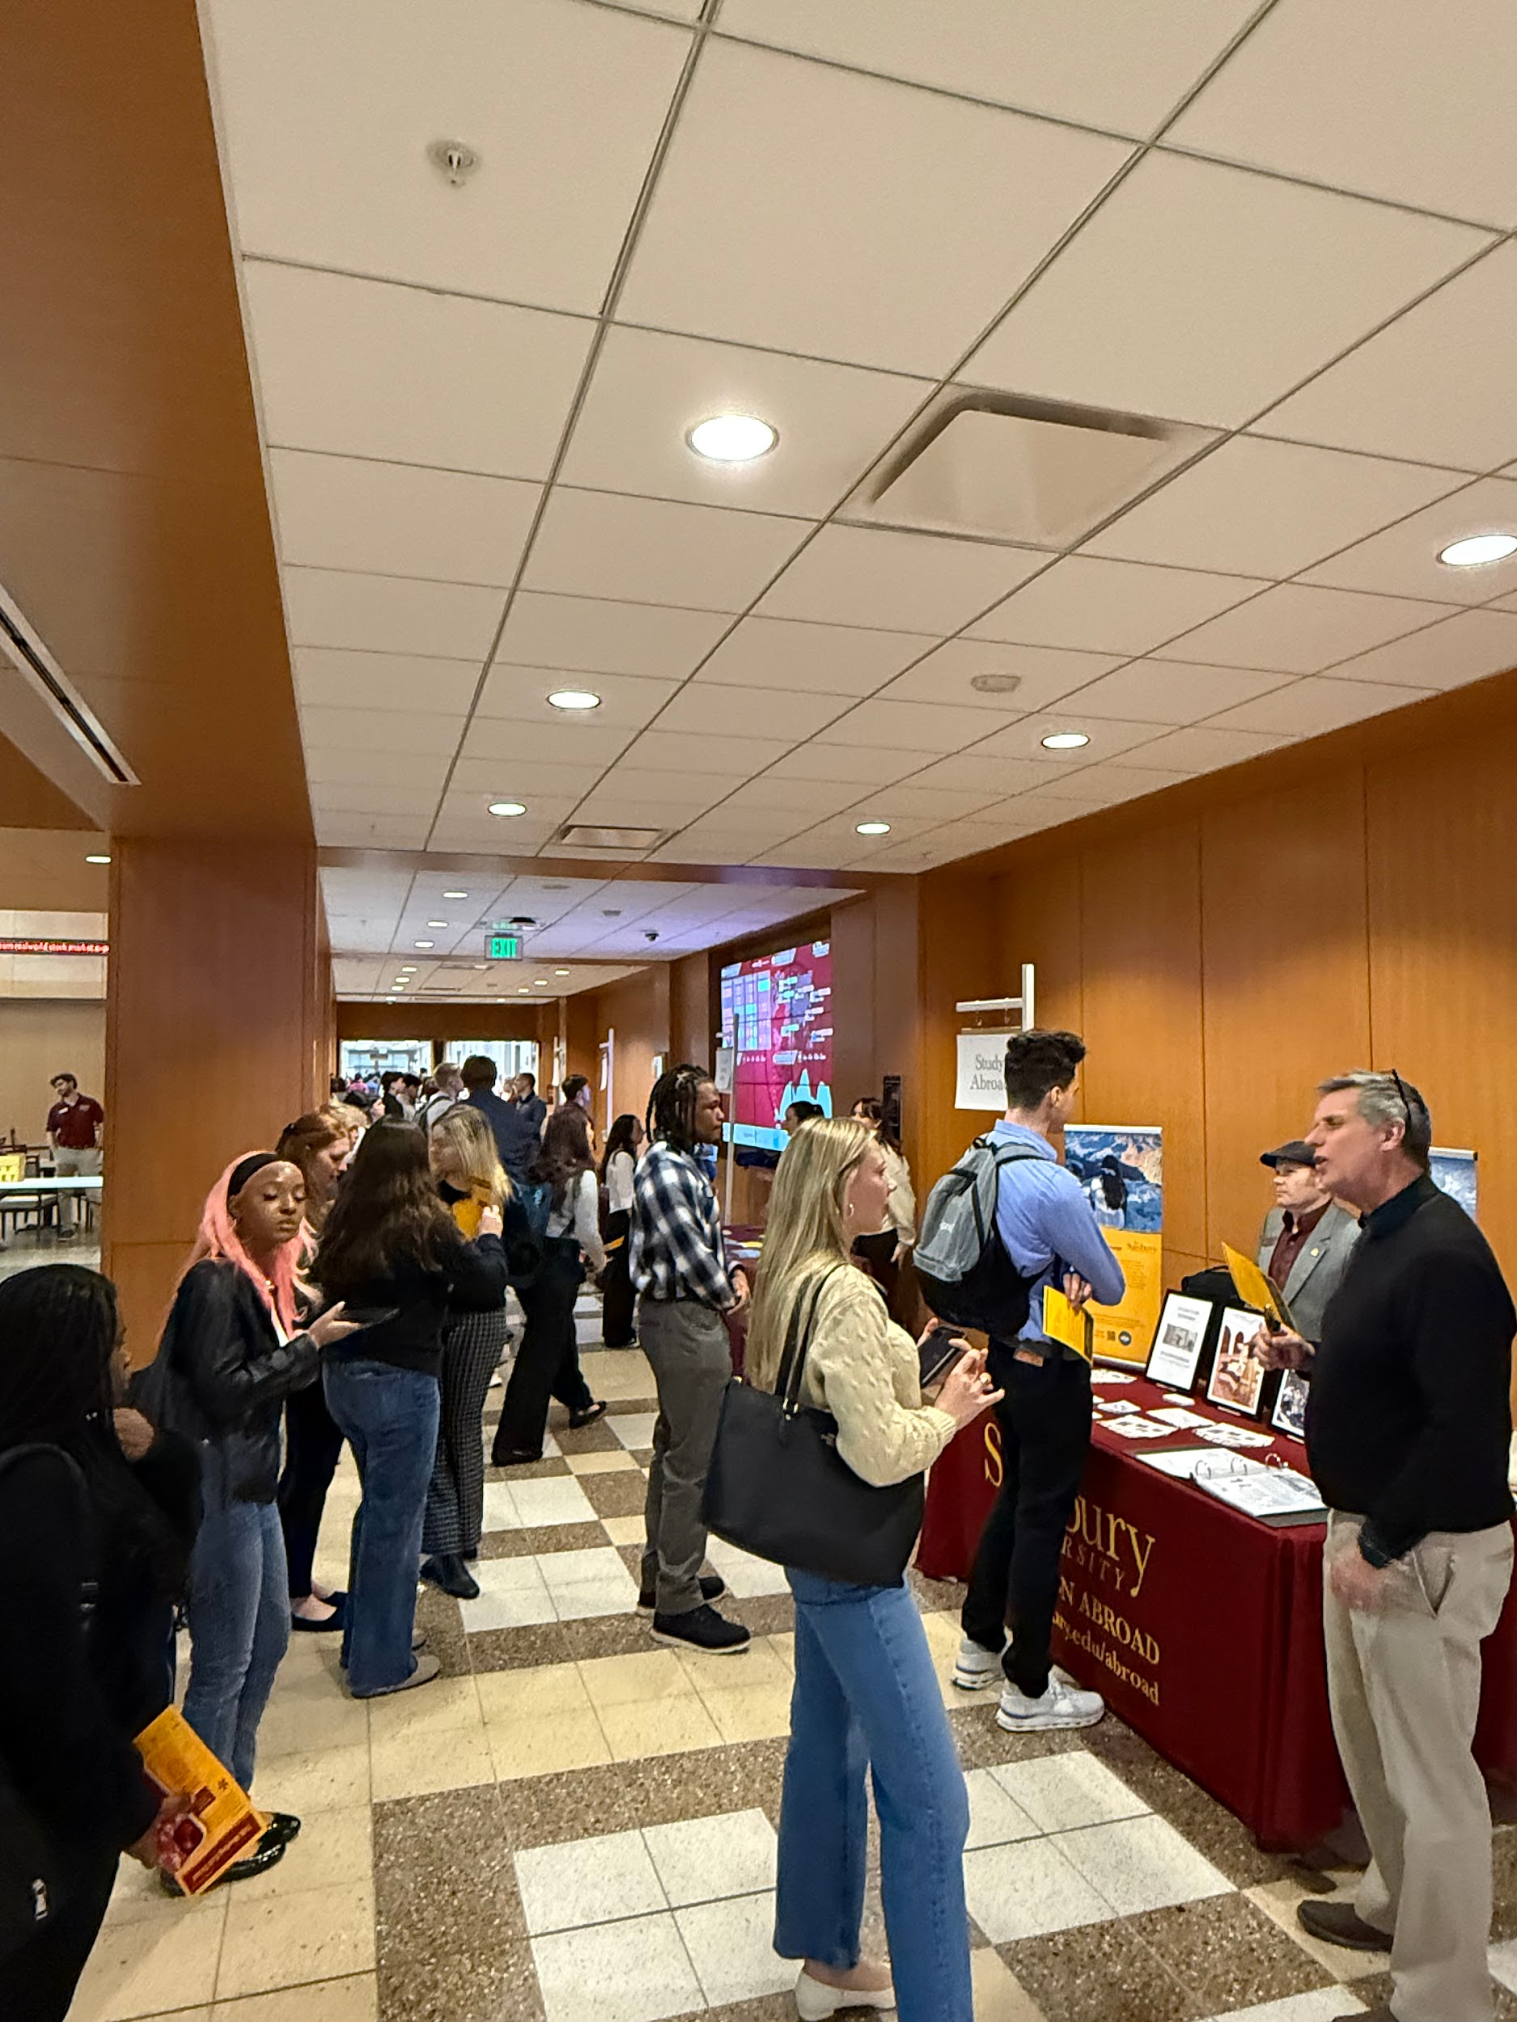
Breakout Session
“The breakout session was very informative!”
Professors come to speak about each individual major.

Slide 6
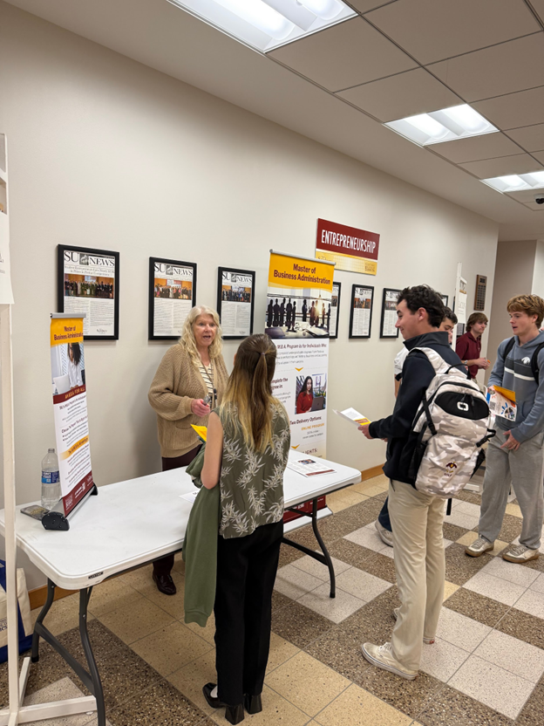
Resource Session
Various SU departments and organizations come to THE Meeting to offer opportunities outside of the classroom.
BUAD 200 students are required to visit three clubs and three non-clubs to receive credit.

Slide 7
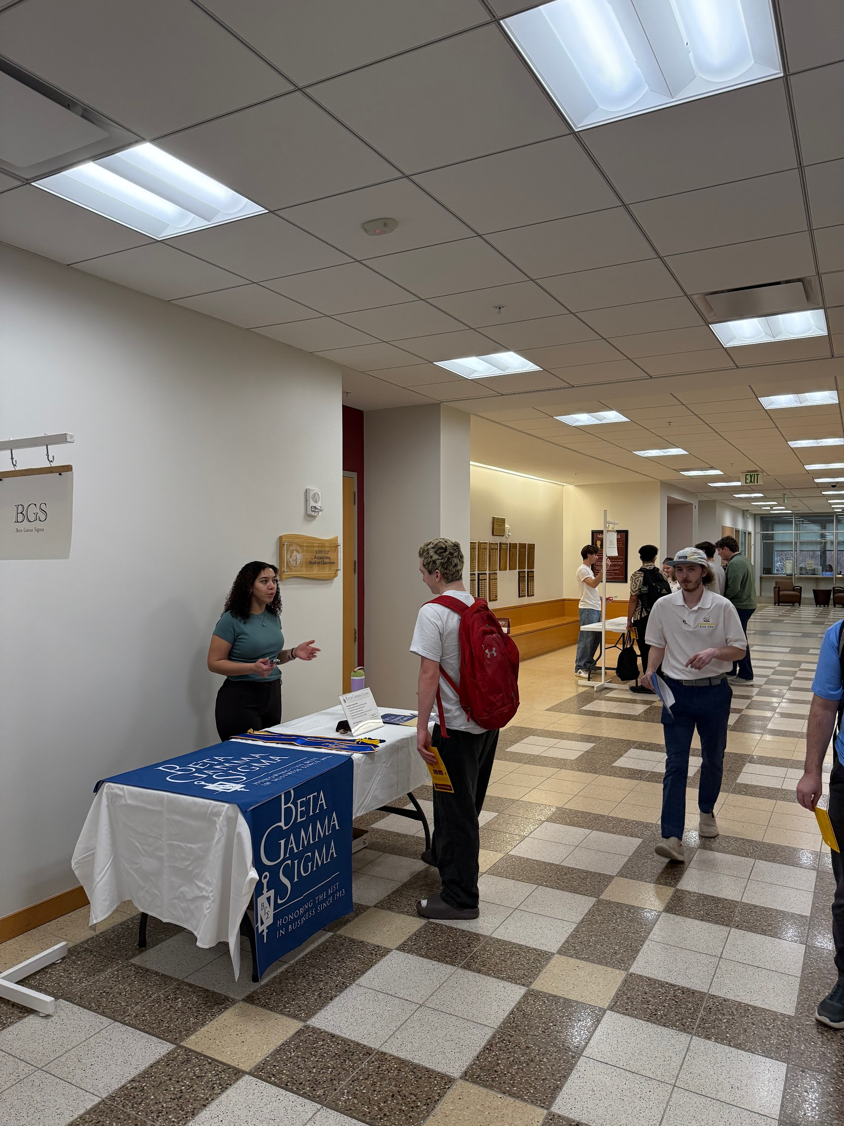

Resource Session
Students are able to talk directly to members of different clubs to learn more about them.
“It was informative and helped me decide what clubs I want to join.”

Slide 8
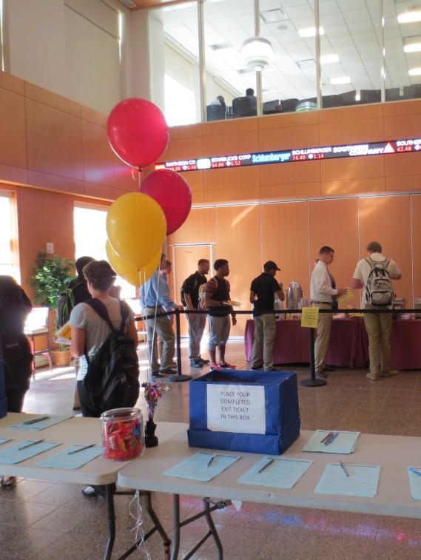
Exit Ticket
Before leaving, students are asked to fill out a survey about their experience at THE Meeting.
“Every part of THE Meeting was perfect and helpful and informative.”

