Slide 1
Students’ Probabilistic Reasoning in the Context of Compound Probability
By: Megan Rickards and Elizabeth Roehm
Faculty Mentor: Dr. Groth

Slide 2
Introduction
Students' everyday notions of fairness can interfere with their development of a mathematical understanding of fairness in compound probability situations (Nelson & Williams, 2009). It can also be challenging for students to coordinate understanding of statistical variation with knowledge of theoretical probabilities (English & Watson, 2016).
Our project sought to answer two questions:
How do children’s pre-existing notions of probability influence their probabilistic problem-solving?
What sequence of teaching methods can develop children’s thinking about empirical and theoretical aspects of compound probability situations?
Notes:
Lizzy

Slide 3
Literature Review
Previous literature suggests several steps that can be taken to help students understand fairness and compound probability. Games, in conjunction with visual organization tools like tables and tree diagrams, can assist students in calculating different probabilities. These games include:
Drawing cubes from bags (Aspinwall & Shaw, 2000),
Flipping coins ( Degner, 2015),
Rock, Paper, Scissors (Nelson & Williams, 2009), and
Computer-based applications such as TinkerPlots (English & Watson, 2016).
Notes:
Lizzy

Slide 4
Common Core State Standards (2010) for 7th Grade
Our instruction primarily targeted the following standards:
“Develop a probability model and use it to find probabilities of events. Compare probabilities from a model to observed frequencies; if the agreement is not good, explain possible sources of discrepancy.”
“Find probabilities of compound events using organized lists, tables, tree diagrams, and simulation” (Council of Chief State School Officers & National Governors Association Center for Best Practices, 2010, p. 51).
Notes:
Lizzy

Slide 5
Methodology
Four students, two male and two female who had just completed 6th grade, participated in the study. Three students attended all sessions, and one student missed one lesson.
The pseudonyms assigned to the students were Tom, Laura, Aidan, and Emilia.
To prepare each week, we utilized a design-based research cycle.
Notes:
Skip because another group will do it

Slide 6
Instructional Cycle
Pilot lesson for students with undergraduate peers to gain feedback and refine lesson structure
Gather data on students’ mathematical understanding and reasoning patterns
Research Process
Transcribe interactions with students, code student reasoning patterns in collaboration with faculty mentor, and analyze student work
Develop a lesson responsive to the student reasoning patterns observed
Notes:
Skip because another group will do it

Slide 7
Methodology
Our 9-week study included individual 30-minute pre-interviews, 7 one-hour lessons, and individual 30-minute post-interviews.
Our pre-interviews allowed us to take baseline measurements of the students’ knowledge prior to the program. Our post-interviews allowed us to examine the progress of our students over the 7-week instructional cycle.
Notes:
Skip because another group will do it

Slide 8
Key Item 1
Imagine you are playing a coin-tossing game against a friend. You take turns tossing a coin. If it is heads, you win a point. If it is tails, your friend wins a point. The person with the most points at the end of the game wins. Each person gets the same number of turns.
Is this a fair game? Why or why not?
If you flipped the coin 500 times, how many times would you expect it to land on heads?*
Could the coin land on heads only 10 times in 500 flips? Why or why not?*
*=used only in the post-interview
Notes:
Megan

Slide 9
Key Item 2
The two fair spinners shown above are part of a carnival game. A player wins a prize only when both arrows land on black after each spinner has been spun once. James thinks he has a 50-50 chance of winning. Do you agree?
NAEP Question ID: 1996-12M12 #9 M070501
URL https://nces.ed.gov/nationsreportcard/nqt
Notes:
Megan

Slide 10
Pre-Interview Results
Key Task 1
All students perceived fairness strictly in terms of the equal amount of turns rather than by the theoretical probability of winning for each player.
Tom’s work is below:
All four students struggled to explain how sample size and variability were related to one another when asked to do so.
Key Task 2
All students struggled with compound probability. All incorrectly thought there was a 50-50 chance of winning the carnival game. Emilia and Tom were fixated on the physical aspect of spinning the spinner, as shown in the following interview excerpts:
Emilia: “...they’ll probably land on the white side dep—or it really depends on how hard you spin it, right?”
Tom: “...if he spins it at like the perfect—if he can spin that with the perfect time—with the perfect—wait, wait—hit with the spinner…”
Notes:
Megan

Slide 11
Lesson 1: What does it mean to be “fair?”
Students were presented with an unfamiliar bag with 2 blue and 8 red cubes and picked red and blue cubes from the bag with replacement.
After recording the frequencies of the two colors after 20 trials, the students examined the contents of the bag and changed the number of red and blue cubes to make the game fair.
Students continued to define fairness by the number of turns, but by the end of the lesson, the students additionally defined fairness by the chance of winning.
Notes:
Lizzy

Slide 12
Lesson 2: Using Technology to Draw Cubes
The fair game activity was given to students again but this time using the statistical software TinkerPlots.
As a class, the percent of blue cubes obtained when drawing two cubes was analyzed.
Students were able to read the graphed data but struggled to understand why particular outcomes had varied frequencies.
Notes:
Lizzy

Slide 13
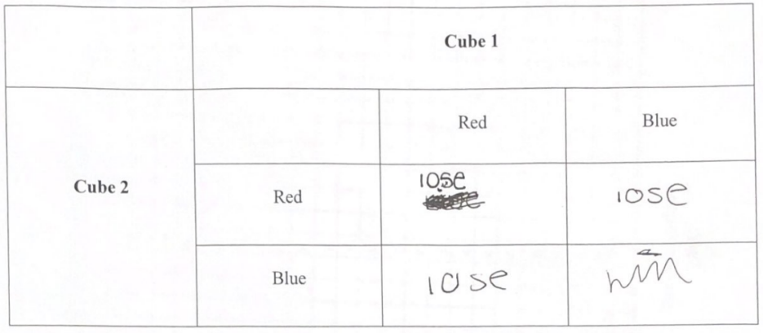
Lesson 3: Individual TinkerPlots Simulations
Students simulated the cubes game on their own in TinkerPlots and graphed the results. They individually graphed the percent of blue cubes obtained when drawing two cubes and compared their graphs.
Students continued to read behind the data, by using a table, to understand why 50% blue cubes has a higher frequency than 0% or 100% blue cubes when drawing two cubes.
Notes:
Lizzy

Slide 14
Lesson 4: Compound Probability with Coins
Students were presented with a new probability scenario, flipping a quarter and penny. Player A won a point if both coins landed on tails or both coins landed on heads. Player B won otherwise.
The students determined if the rules of the game were fair and drew pictures of the possible outcomes when flipping the quarter and penny.
Then, students conducted two 20-trial experiments to test their hypotheses about the fairness of the game. The lesson finished with a discussion about all of the possible outcomes of the game using an organized list.
At times, students struggled to outline the complete sample space.
Notes:
Megan

Slide 15
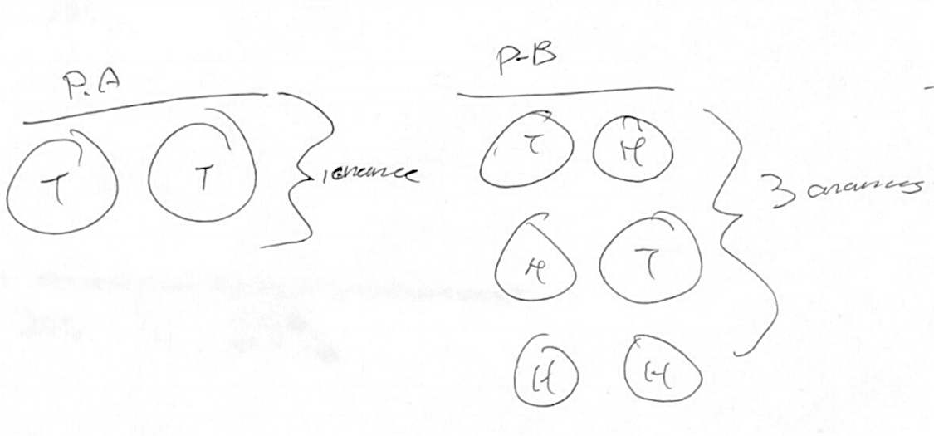
Lesson 5: Theoretical Probability of Coin Flipping
Students were presented with new rules to the coin flipping game. Player A won a point if both coins landed on tails. Player B won a point if the coins landed on anything else. Students again described how the rules of the game were unfair using the potential outcomes instead of the number of turns.
Students visually mapped out the potential outcomes for Player A and Player B. Then, the students calculated the theoretical probabilities of the four outcomes.
Students began to examine the expected value of points Player A would win in 100 turns, but some students struggled to use language involving percentages correctly. Aiden wrote that the expected value was “25%” when other students indicated that the expected values was “25 chances.”
Notes:
Megan

Slide 16
Lesson 6: Flipping Two Quarters
Students were presented with the same rules to the coin flipping game, except the game utilized two quarters instead of a quarter and penny.
Students outlined the complete sample space of outcomes but at times struggled to recognize that the outcome “heads-tails” was different from “tails-heads.”
Then, the students translated the probability of distinct outcomes into percentages and calculated the expected value of getting tails on both quarters in 200 coin flips.
The students identified acceptable levels of variability of experimental data. When asked if it would be possible to obtain tails-tails 47 times in 200 trials, Laura wrote “50/200 would be exact and 47 is very close to 50 so they recorded it right.”
Notes:
Megan

Slide 17
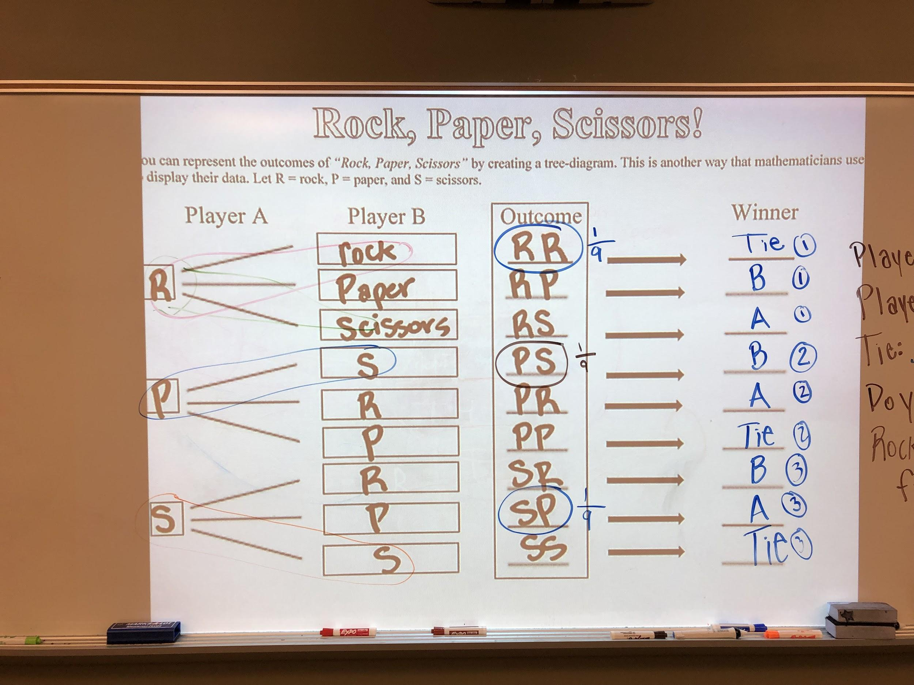
Lesson 7: Rock, Paper, Scissors
We introduced students to tree diagrams by creating one for the coin flipping game from lesson 6. After drawing the tree diagram, students were able to identify distinct outcomes.
Then, the students played Rock, Paper, Scissors.
After playing, the students listed all of the outcomes in an organized list and then translated the organized list into a tree diagram.
The students identified specific outcomes and determined who won each round of Rock, Paper, Scissors.
Students were very successful in interpreting the tree diagram.
Notes:
Lizzy

Slide 18
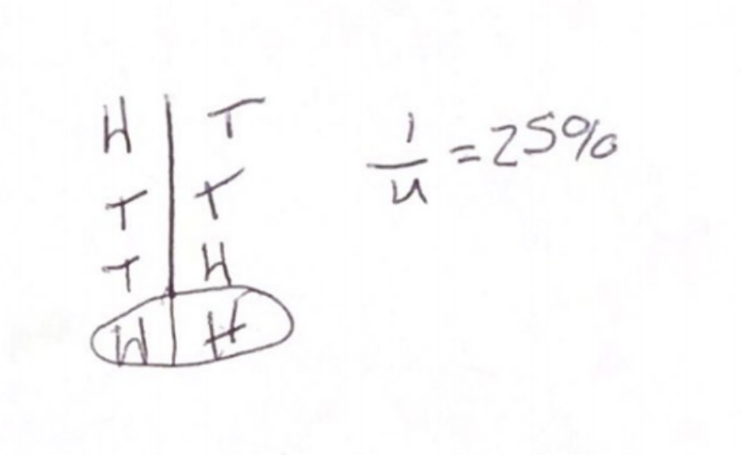
Post-Assessment Results: Key Task 1
In Part A, three students expanded their notion of fairness to include the probability of winning rather than fixating only on the number of turns in the activity.
Laura: “It is a fair game because each get the same number of turns, same number of points and each have the same chance of winning.”
In Part B and C, the students exhibited sound understanding of statistical variation. They were very successful at calculating expected values and reasoning about statistical variation.
Tom expanded beyond a fixation on strict proportional reasoning without variation to using probabilistic language. Tom noted that getting 10 heads in 500 flips was “possible because you have a chance of 490 tails but it is tough to have 10 heads in 500 flips.” He additionally noted that it was “really hard to do, but it’s possible.”
Notes:
Lizzy

Slide 19
Post-Assessment Results: Key Task 2
Only one student was able to outline the complete sample space and recognize that James did not have a 50-50 chance.
However when students were asked about flipping two coins, an activity isomorphic to spinning two spinners, all of them were able to outline the complete sample space. This included verbally outlining the complete sample space and writing an organized list.
Notes:
Megan

Slide 20
Reflection and Discussion
It was challenging to help students develop a mathematical idea of fairness. Throughout the summer, students gradually expanded their notion of fairness beyond just looking at the number of turns each player has in a game.
By playing games each week, students learned to compute theoretical probabilities and expected values and reconcile these with experimental data. They learned to balance proportional reasoning with reasoning about variation when analyzing probability situations.
For teachers helping students with these Common Core State Standards, we suggest using games to help students conceptualize probabilities and use organized lists and tree diagrams. Games facilitate learning and engage the students.
In future lessons with this group of students, it would be interesting to have them compare the chance of winning the two-spinner game (Key Task 2) to the chance of winning the two-coin game from lesson 6. Doing so may help students recognize similar structures across probability situations and further enhance probabilistic reasoning.
Notes:
Megan

Slide 21
References
Aspinwall, L., & Shaw, K. L. (2000). Enriching students' mathematical intuitions with probability games and tree diagrams. Mathematics Teaching in the Middle School, 6(4), 214-220.
Council of Chief State School Officers and National Governors Association Center for Best Practices. (2010). Common core state standards for mathematics. Washington D.C.: National Governors Association Center for Best Practices. Retrieved from http://www.corestandards.org/wp-content/uploads/Math_Standards1.pdf
Degner, K. (2015). Flipping out: Calculating probability with a coin game. Mathematics Teaching in the Middle School, 21(4), 244-245.
English, L. D. & Watson, J. M. (2016). Development of probabilistic understanding in fourth grade. Journal for Research in Mathematics Education, 47(1), 28-62.
Jardine, D. (2000). Looking at probability through a historical lens. Mathematics Teaching in the Middle School, 6(1), 50-52.
Nelson, C. & Williams, N. (2009). A fair game? The case of rock, paper, scissors. Mathematics Teaching in the Middle School, 14(5), 311-14.

