Slide 1
A Path Toward Multiplicative Reasoning with Understanding
Researchers: Caitlin Cody and Julia Pendola
Mentor: Jennifer Bergner

Slide 2
The Problem: Only Surface Level Learning
Students often have a surface level of understanding of multiplication and division.
Lack of understanding
Memorized procedures
Tendency to make many mistakes
Which impairs the ability to transition from solely additive reasoning to multiplicative reasoning.

Slide 3
Our Purpose and Research Question
Create a lesson sequence to build students’ conceptual understanding of multiplication and division
Enhance their abilities to make multiplicative comparisons.
Enable conceptual understanding of multiplication and division
Students can reason and make such comparisons more effectively (Switzer, 2010).
Research Question:
What are the components of a lesson sequence that foster children’s ability to make multiplicative comparisons?

Slide 4
Five Strands of Mathematical Proficiency
Conceptual Understanding
Integrated and functional grasp of mathematical ideas
Procedural Fluency
Skill in carrying out procedures flexibly and accurately
Strategic Competence
Ability to formulate, represent, and solve mathematical problems
Productive disposition
Habitual inclination to see mathematics as sensible and useful
Adaptive Reasoning
Capacity for logical thought, reflection, explanation, and justification

Slide 5
Theoretical Framework: Article Review
Bridging the math gap (Switzer, 2010)
The trouble with long division (Sellers, 2010)
Alternative algorithms aid in building understanding
We set out to accomplish our instructional goals by incorporating conceptual tools such as:
Partial products
Partial quotients
Area model
Students often are taught to memorize a set of procedures without reason
Our goal was to encourage mathematical reasoning and not just procedural thinking

Slide 6
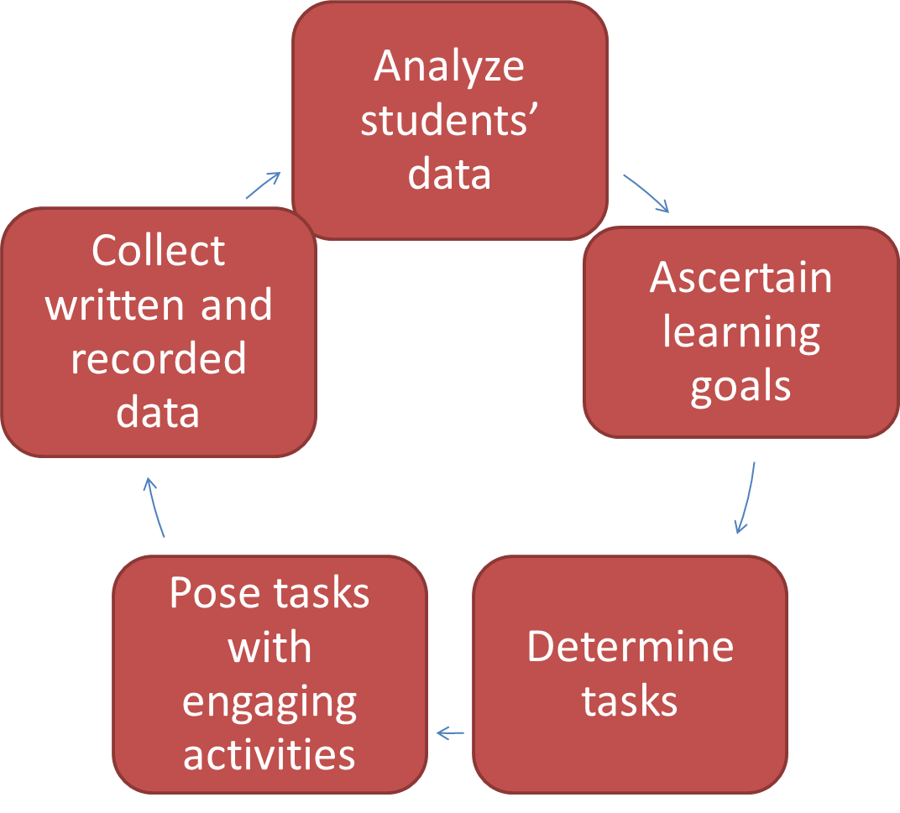
Methodology
Research Cycle:
Each week, we retained students' written work, video recorded our lessons, and transcribed them. We analyzed transcripts using the five strands of mathematical proficiency. We selected tasks for subsequent lessons that would help address students' mathematical proficiency weaknesses and build upon their strengths.
Grade Level: Just completed 4th Grade going into 5th Grade
# Students: 4 students: 2 girls, 2 boys
Student Participation Rate: 100% for 3 of the students, one student missed one session
Duration: pre-assessment interview ( 30 minutes), seven one-hour sessions and one post-assessment interview (30 minutes)
Pseudonyms of participants: Billy, Jackie, Jordan, Marshall

Slide 7
Key Tasks
1. A photographer has 191 photos of animals and 234 photos of plants. He wants to put all of the photos into photo books. Each page of the photo books hold 8 photos. What is the fewest number of pages he could use in the photo book?
2. Could you write an equation that represents the statement:
161 is 7 times as many as 23
161 is 7 more than 154
3. During a class trip to an apple farm, a group of students picked 2,436 apples. They packed them into 6 boxes to take to the local food bank. If each box held the same number of apple, how many apples were in each box?

Slide 8
Common Core State Standards
(National Governor’s Association for Best Practices & Council of Chief State School Officers, 2010)
CCSS.MATH.CONTENT.4.OA.3- Solve word problems including interpreting remainders.
CCSS.MATH.CONTENT.4.MDA.3- Apply the area and perimeter formulas for rectangles in real world and mathematical problems.
CCSS.MATH.CONTENT.4.OA.1- Interpret a=b x c as a multiplicative comparison using times as many as times as much.
CCSS.MATH.CONTENT.4.OA.2- Solve word problems involving multiplicative comparisons.

Slide 9
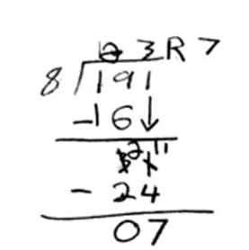
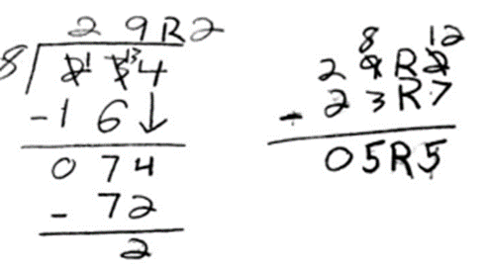
Initial Assessment Results
Initial use of algorithms and procedures:
Strong procedural fluency with computational errors
Weak contextual understanding
Figure 1: Jordan’s Work
A photographer has 191 photos of animals and 234 photos of plants. He wants to put all of the photos into photo books. Each page of the photo books holds 8 photos. What is the fewest number of pages he could use in the photo books.

Slide 10
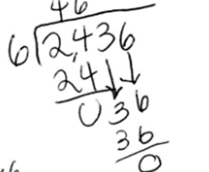
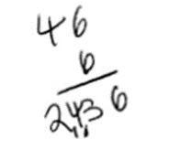
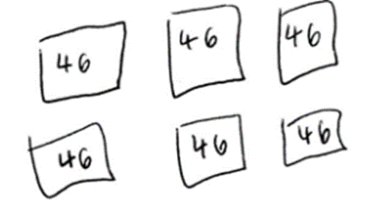
Initial Assessment Results cont.
Initial use of visual diagrams:
Minimal use
Mainly relied on algorithm
Lack of logical visual diagrams
Figure 2: Billy’s work
During a class trip to an apple farm, a group of students picked 2,436. They packed them into 6 boxes to take to the local food bank. If each box held the same number of apples, how many apples were in each box?

Slide 11
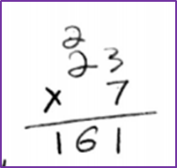
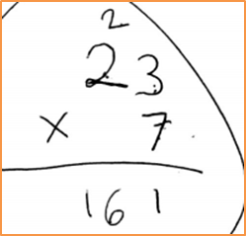
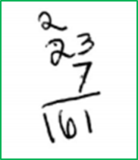
Initial Assessment Results cont.
Initial attempts at multiplicative comparisons:
3/4 students lacked strategic competence
Students tried to compute the given statement
161 is 7 times as many as 23
Figure 3: Jordan’s work
Figure 4: Jackie’s Work
Figure 5: Billy’s work

Slide 12
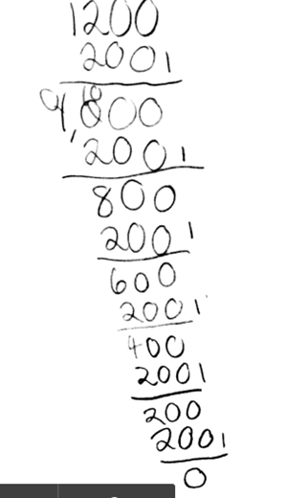
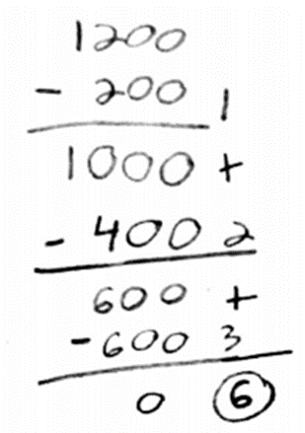
Partial quotients algorithm: Physical context connected to numbers
Manipulatives such as unifix cubes were available to students to lead students to a partial quotients algorithm. We connected the physical chunking of manipulatives into groups with the idea of chunking numbers to create a concrete representation of a partial quotient algorithm.
A paperclip company produced 1200 paperclips and wants to package them into bundles of 200. How many bundles can they sell?
Figure 6: Jordan’s Work
Figure 7: Billy’s Work

Slide 13
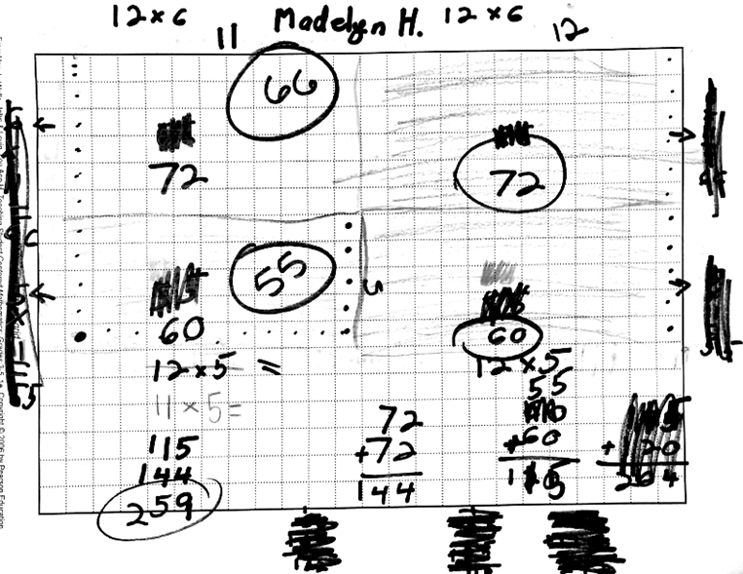
Models: Area model multiplication/division
In an effort to foster students' conceptual understanding, we introduced area models. We prompted students to construct arrays using concrete materials. One such problem dealt with planting different crops in different sections of a garden.
Figure 8: Jordan’s Work
Harold, the gardener, has a 23 by 11 garden and he wants to plant carrots, beets, onions and corn in it. What are some ways in which Harold can design his garden? Use the starbursts to help Harold organize his garden.
Red starburst: Beets
Orange starburst: Carrots
Yellow starburst: Corn
Pink starburst: Onions

Slide 14
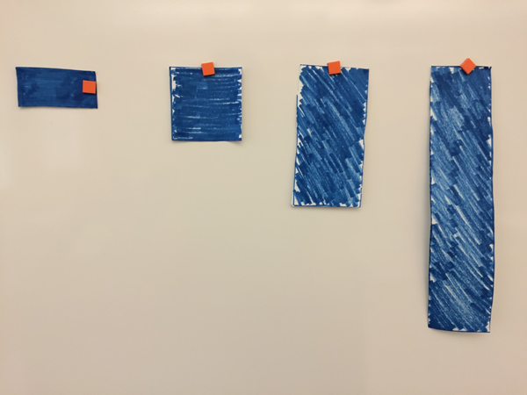
Multiplicative comparisons
We presented the students four rectangles with the dimensions 5 by 10, 10 by 10, 20 by 10, and 40 by 10 (see Figure 9). We intentionally left key words out of our task statement to discourage the automatic use of procedures without connections. Therefore, the students had to understand the problem before they could generate their comparisons.
Jackie further stated that they were “half of one another.” Marshall noticed that the 10 by 10 rectangle was one-fourth, in area, of the 40 by 10 rectangle.
Figure 9:
These are the rectangles
presented to the class in
ascending order.

Slide 15
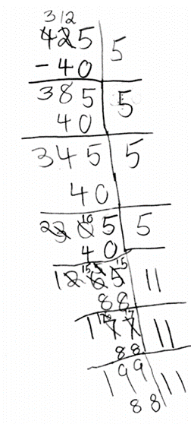
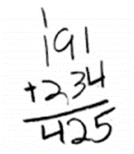
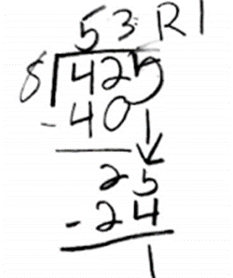
Post-Assessment Results
Jordan was not able to successfully compute the multistep item in our first interview session. After engaging in lessons that approached multiplication and division conceptually, she was able to think of and employ a strategy that allowed for successful completion.
Billy struggled with effectively computing the long division algorithm as he could not recall the “correct steps” during our initial interview. After introducing him to the partial quotients method, he was able to use this strategy efficiently to find the answer to the class trip problem.

Slide 16
Post-Assessment Results cont.
In Jackie’s initial interview her lack of confidence inhibited her from attempting problems. Throughout our time with her we worked on encouraging her to try new problems and to stop her negative self-talk. During the last sessions, she showed great confidence and actually jumped out of her seat to share the growth pattern she saw in the rectangle seen in Figure 9.
Marshall excelled in procedural fluency and had a hard time slowing himself down to really digest problems. Our lessons revolved around real world contexts that forced Marshall to think more deeply about the problem being asked. We encouraged him to make sense of the context and to connect the quantities to the context without immediately jumping into computations. It was evident in his post-interview that Marshall reflected upon answers.

Slide 17
Reflection and discussion
The most difficult standards:
involved solving word problems with multiplicative comparisons (CCSS.MATH.CONTENT.4.OA.2)
multiple operations and were considered “multistep” (CCSS.MATH.CONTENT.4.OA.3).
Their allegiance to the standard division algorithm hindered our exploration of multi-step word problems.
Learning progression recommendation:
the standard algorithm for long division should be delayed until after the connection between computation and the context of the problem and the strategy being used is made.
Our recommendation for teachers:
to approach multiplication and division through problem solving situations that discourage the use of key words but focus on understanding.

Slide 18
References
National Governor's Association for Best Practices & Council of Chief State School Officers. (2010). Common core state standards for mathematics. Retrieved from http://www.corestandards.org/.
National Research Council. (2001). Adding it up: Helping children learn mathematics. Washington, DC: National Academy Press.
Otto, A. D. (2011). Developing essential understanding of multiplication and division for teaching mathematics in grades 3-5. Reston, VA: National Council of Teachers of Mathematics.
Sellers, P. (2010). The trouble with long division. Teaching Children Mathematics, 16(9), 516-520.
Switzer, J. M. (2010). Bridging the math gap. Mathematics Teaching in the Middle School, 15(7), 400-405.

