Slide 1


Invest in My Idea
Poster Pitch

Slide 2


SU Entrepreneurship Competitions
Invest in My Idea “A Poster Competition”
  15 winners move forward
The Gull Cage “A Shark Tank Competition”
  4 winners move forward
The Richard Bernstein Achievement Award for Excellence
  “A Business Plan Competition”
    1 Winner
www.salisbury.edu/perdue/EntrepreneurshipCompetitions
http://www.salisbury.edu/perdue/entrepreneurshipcompetitions/dates-news.html

Slide 3
Poster Logistics
48” x 36” poster board.
Submitted with plan if you want printed at SU.
If you use another poster, it must be self supporting, or bring your own stand.
All will be displayed on the first floor of Perdue Hall, you will stand with your poster to explain the business.
Register at 7:30 AM, at information desk across from Perdue Museum.
Poster session 8:00 – 10:30.
Notes:
Posters are due the same date as Business Plans final date for submission of both 11:59 PM 4/20/2015 it will open to begin accepting March 6th. Other dates referenced correct.
Shore Hatchery
Opens March 6th 8AM closes April 7th 11:59 PM.
Competition May 7th

Slide 4
Invest in My Idea Key Facts
You must win to go to the next round.
Judges will chose to invest in the proposals that show best likelihood of return.
You only have Three minutes to convince them.
They will want about Two minutes to ask questions.
How quickly do you need to tell your story?

Slide 5

One Minute!

Slide 6

One Minute, Is that Realistic?

Slide 7
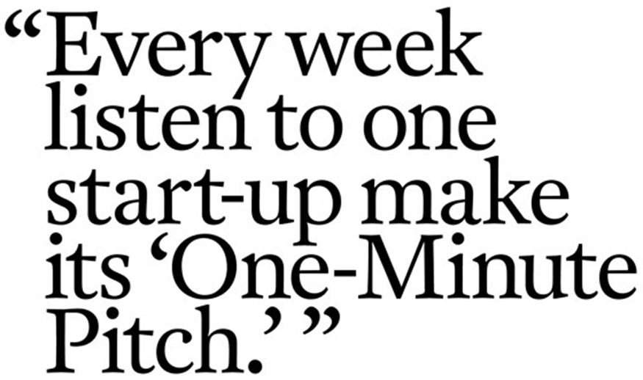


One Minute, Is that Realistic?

Slide 8
What to Tell In One Minute
How you came up with the Idea
What is your Business
How you are better than competing products or services
How you make Money
Where do you get all of this?

Slide 9
Executive Summary
A concise summary of the key points in your plan.

Slide 10

Includes
A synopsis of the company’s strategy for succeeding
A brief description of the market (along with the ingredients for success that make your company unique in that market)
A brief description of the product or service
A brief description of the management team’s qualifications
A capsule summary of the key historical and forecasted financial data
An estimate of the amount of capital or loan funds you need and how you will use it

Slide 11
What is ON the Poster?
What products and services will be offered?
Who is your target customer (and how many are there)?
What is unique?
How do you promote?
What is going on in your location and industry (Why You Now)?
  Competitors
  Trends

Slide 12


Your Logo
My Company’s Name
Your Logo
Market or Industry
Trends Competitors Customers
Product or Service Description and Images
What problem does it solve?
How Do You Make Money?
Break Even Profit Margin Significant Cost Drivers
Target Customer
Their Needs
Marketing & Sales
Promotional Activities Logos Branding
Pricing & Costs
Price Comparison Equipment Costs Start-Up Costs Investment Options
Competitive Advantage
Price, Location and Features
Personnel & Leadership Team
Key Employees or Skills

Slide 13
What is ON the Poster?
How do you make Money and how much?
  Break even
  Pricing
How much capital are you seeking?
What are some key milestones?
Your logo?
Your location?
What do you or your team bring?

Slide 14

Your Logo Here
Company Name
Business Plan (Elevator Pitch)
Company Address Here
`
What is Your Business?
What is your product, service, concept, key technology?
Market Analysis
What is your target market? Size? Competition? Where do you want to be?
Marketing Concept
How are you going to market your product or service?
Strategic Alliances
Who are your strategic partners? Major distribution agreements? Licenses? Large orders?
Burning rate
What is your burning rate? Example: $200, 000 per month
The Team
Key management: names, positions, previous accomplishments
Sales Projections
Five year sales projections
What do you want? What do you offer?
We offer 30% of equity for $2mln investment
Milestones
List your key milestones in R&D, product development, manufacturing, marketing, etc.
Competitive Advantage
What is your competitive advantage in the long run?
Exit Strategy
Acquisition by major market player in 5 years or IPO?
Copyright © 2012 Template.org

Slide 15
Practice Saying it QUICK
My Company (NAME)
is developing / starting (BUSINESS IDEA),
to help / serve (TARGET MARKET),
(SOLVE WHAT PROBLEM)
by (HOW YOU DO WHAT IS NOT BEING DONE NOW).

Slide 16
Try to Say Your Pitch
60 Seconds

Slide 17

I Only Have One Minute!
How do you tell the rest of the story?

Slide 18


sdfIII. Analyzing Your Competition
Charts
Low Prices
Handmade Tortillas
Large Portions
Healthy Menu Items
Cleanliness
Quick Seating
Fast Service
Courteous Service
Open after 10 p.m.
PURCHASE FACTORS
COMPETITORS
Jose’s Cantina
El Paso Rose
Wild Cactus Cafe

Slide 19
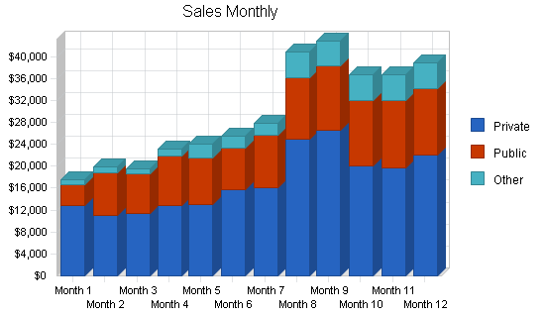
Graphs

Slide 20
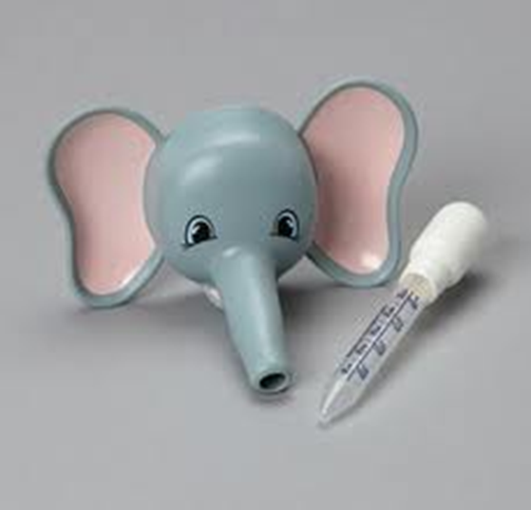

Pictures

Slide 21

Remember
Keep it simple
  Keep your poster simple and uncluttered. Use calm, contrasting, and complementary colors. Use only one or two fonts; do not use all capitals, which are more difficult to read.
Make it visually interesting
  Use color, graphics, photos, and other visuals to illustrate your topic (a picture is worth a thousand words.)
Make it readable
  Make text readable from 5 feet or more away. Use bullets for main points. Details can be included in your conversation or on a handout.
Practice, practice, practice
  There is no substitution for advance preparation. Create your 30-second "elevator pitch" to explain your poster to people as they look at your poster, and practice the pitch with your colleagues.

Slide 22
Important Points
Tell a good, exciting story
Be consistent
Focus on a very few priorities
Be realistic in financial projections
Be prepared to address the downsides
Clear, Concise and Convincing

Slide 23

HAVE FUN WITH IT!
Your Enthusiasm will overcome a lot!

Slide 24
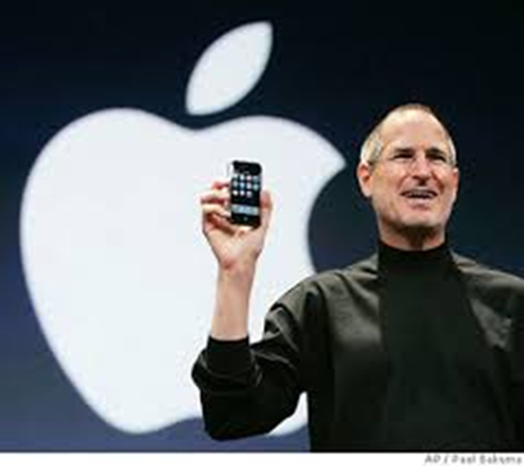
If you don’t LOVE your idea, it will be hard for someone else to.

Slide 25
Financials (1 Page)
  Cash Flow Statement (3-5 years)
    Break down one year monthly
  Income Statement (3-5 years)
  Sources and Uses:
    Need for business loan, possible investors
  Balance Sheet
  Sales/ Income Projections
  Break-Even Analysis
  What are the key cost drivers?

Slide 26

Knowing you are going to make all this money makes it even better!

Slide 27




Slide 28
QUESTIONS???

